Slide 1
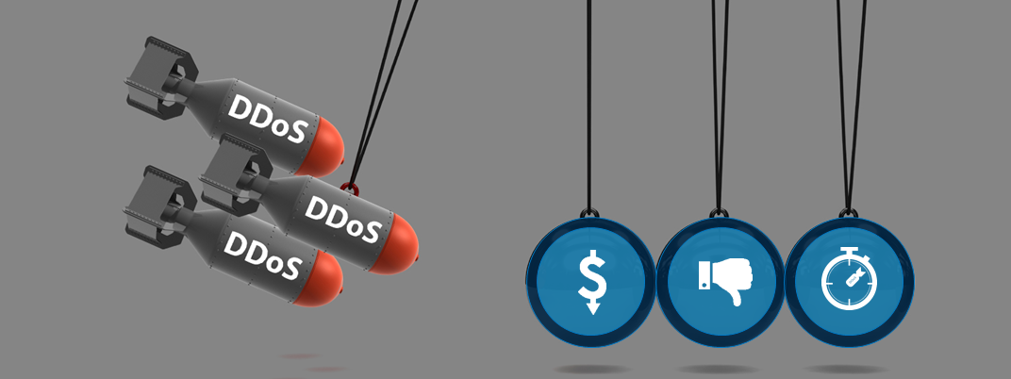
DDoS 攻擊進階防護
A10 台灣區技術經理 陳志緯
Notes:
Attack duration is more than 24 hours on average, sometimes lasting weeks. During this time a lot of collateral damage happens to the business; overloaded customer support, delayed projects etc.
http://www.forbes.com/2010/02/01/brand-reputation-value-leadership-managing-ethisphere.html
£100,000/hr Neustar, 2015
$40,000/hour Incapsula, 2014
$22,000/minute average Ponemon, 2015
Reputation damage
Avg. attack duration: >24hrs Akamai
http://security.radware.com/uploadedFiles/Resources_and_Content/Attack_Tools/CyberSecurityontheOffense.pdf
https://www.stateoftheinternet.com/downloads/pdfs/2015-ponemon-institute-the-cost-of-ddos-attacks.pdf
Ponemon: check 2015
£100,000/hr Neustar, 2015
$40,000/hour Incapsula, 2014
$22,000/minute average

Slide 2
DDoS 攻擊持續演進
單一型攻擊
複合型攻擊
網路層攻擊
Fragmentation
SYN floods
Ping floods
…
應用層攻擊
Slowloris
HTTP GET floods
R.U.D.Y.
…
放大攻擊
DNS amplification
NTP amplification
…
複合型攻擊
網路層攻擊
應用層攻擊
…

Slide 3
電信商遭受 DDoS 攻擊事件
DDoS 攻擊流量
300Mbps / 200K CPS / 2M Concurrent Sessions
多層次 DDoS 攻擊 (複合型 DDoS Attacks)
Network Attack (網路層攻擊)(ICMP)
Amplification Attack (放大攻擊)(DNS-UDP)
Resource Attack (資源耗損攻擊) (TCP)
Application Attack (應用層攻擊) (HTTP Slowloris)
應用層攻擊 特性說明 :
Attacker 透過殭屍網路(Botnet)(90% from TW)發起大量TCP連線及HTTP Request封包 (~1K conns per bot )
對於防火牆而言屬於正常連線存取
防火牆效能下降及 Server 資源耗盡。
!
DDoS
DDoS
DDoS
DDoS
DDoS
Internal LAN
DMZ
ADC
Web Apps
Secure from Outside
Customer Data
Notes:
All data based on list prices

Slide 4
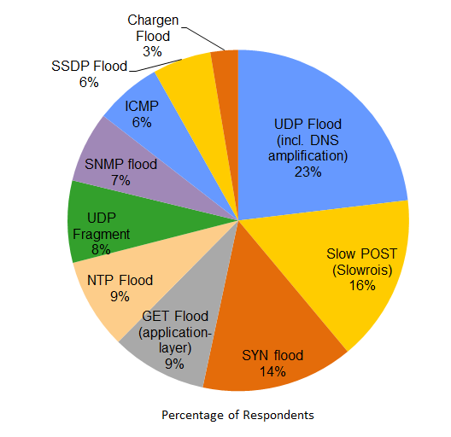
DNS 放大攻擊 (Amplification)
Attacker
Request Packet Size = 32 bytes
Request With spoofed Src IP
Open DNS Resolver
Response Packet Size = 3200 bytes
Response
DDoS
DDoS
DDoS
DDoS
DDoS
Source: IDG, 2016

Slide 5
DNS NXDomain 攻擊
Attacker
Remote Control
Zombies
NXDomain Requests with spoofed Src IP
DDoS
DDoS
DDoS
DDoS
DDoS
DNS Cache
NXDomain Recursive
Source: IDG, 2016
root(.) / TLD / Auth DNS

Slide 6
HTTP GET Flood / TCP Flood 攻擊
Attacker
Remote Control
Zombies
1000 conns per zombie
2M conns
(2K zombies)
DDoS
DDoS
DDoS
DDoS
DDoS
Source: IDG, 2016

Slide 7
HTTP Slowloris 攻擊
Attacker
Remote Control
Zombies
Uncompleted HTTP Requests
DDoS
DDoS
DDoS
DDoS
DDoS
Source: IDG, 2016

Slide 8
SSL Renegotiation / SSL Conn Flood 攻擊
Attacker
Remote Control
Zombies
SSL Renegotiation &
SSL Authentication
DDoS
DDoS
DDoS
DDoS
DDoS
Source: IDG, 2016

Slide 9
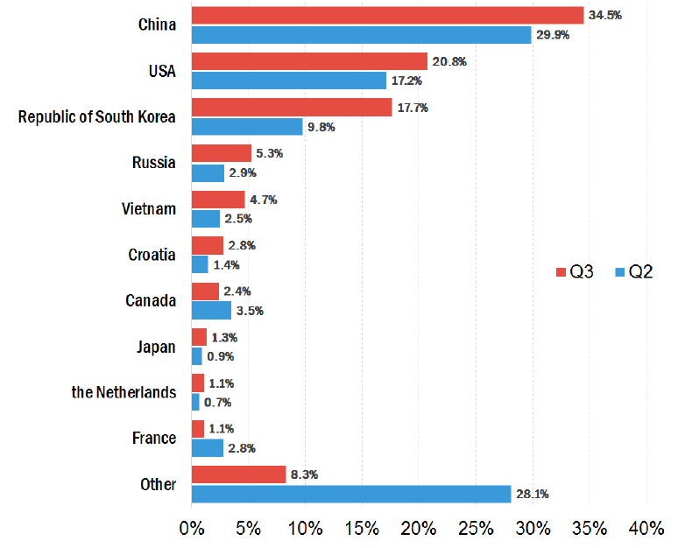
DDoS 攻擊來源
DDoS
DDoS
DDoS
DDoS
DDoS
Source: Kaspersky , Q3 2015
Notes:
All data based on list prices

Slide 10
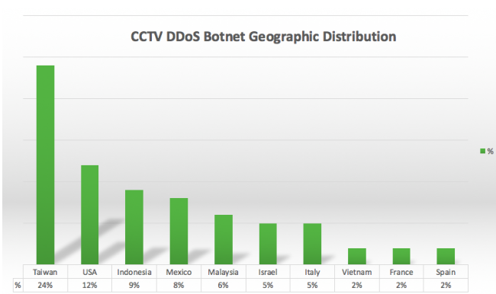
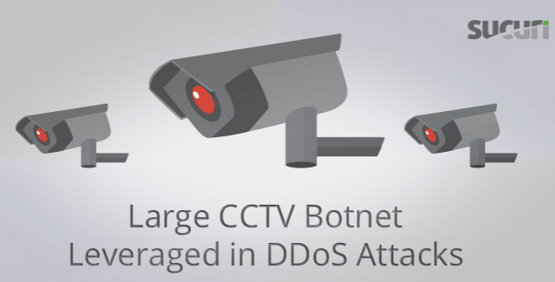
DDoS 攻擊來源 – CCTV 影像監視系統
Source: SUCURI BLOG , Q2 2016
Notes:
All data based on list prices

Slide 11
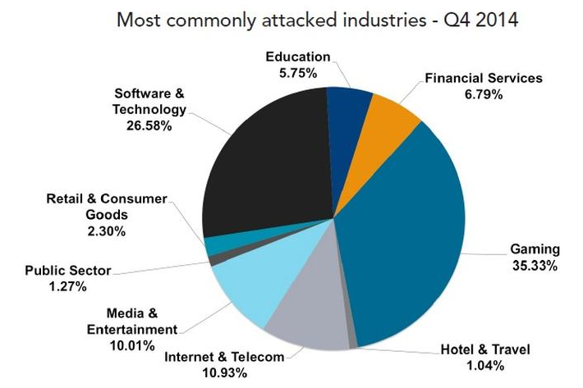
DDoS 攻擊目標
Source: Akamai Q4 2014
Notes:
All data based on list prices

Slide 12
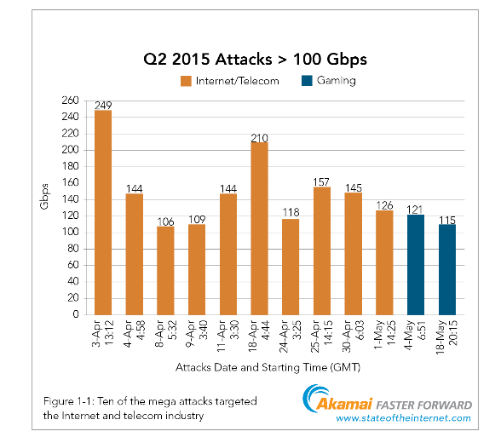
頻寬型 DDoS 攻擊
1 Gbps DDoS Traffic :
SYN Flood (0.5Kb) : 2M PPS
ICMP Flood(2Kb) : 500K PPS
DNS Flood (10Kb) : 100K QPS
UDP Flood (2Kb) : 500K PPS
Source: Akamai
Notes:
All data based on list prices

Slide 13
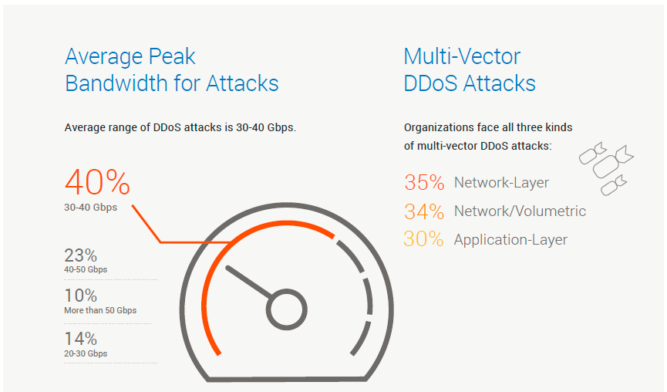
DDoS 攻擊類型比例
DDoS
DDoS
DDoS
DDoS
DDoS
Source: IDG, 2016
Notes:
All data based on list prices

Slide 14
多層次(Multi-Layer) DDoS 防禦網路
Huge Bandwidth Attack
High Latency ?
Poor Customization ?
Verisign
OpenHybrid
Scripts / Manual Action
Traffic Redirection
Signaling
Bandwidth Attack
Low Latency
Limited Customization ?
Huge Bandwidth Attack ?
Core Network
Scripts / Manual Action
Signaling
Thunder TPS CPE
Thunder TPS CPE
No Latency
Full Customization
Bandwidth Attack ?
Data Center
Services
Services
14

Slide 15
多層次(Multi-Layer) DDoS 防禦網路
Cloud
OpenHybrid
頻寬型攻擊
Traffic Redirection
Core Network
aXAPI / Manual Action
頻寬型攻擊
網路層攻擊
Telemetry
Detector
Thunder TPS CPE
Thunder TPS CPE
Data Center
網路層攻擊
應用層攻擊
Services
Services
15

Slide 16
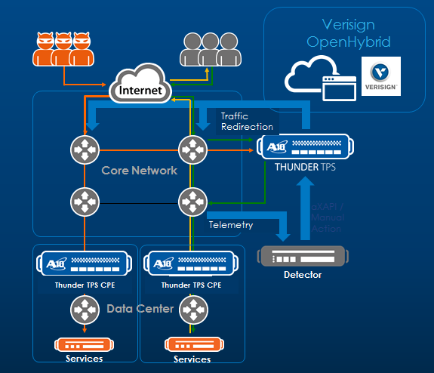
用戶端防禦架構 (CPE)
Real-time Detection
Flood Thresholds
UDP
TCP
HTTP
DNS
Protocol Anomalies
Behavioral Anomalies
Telemetry
Detector
L7 Scripts
Resource Starvation
網路層攻擊
應用層攻擊
Black Lists
Services
Notes:
Inline provides much more traffic statistics since we see the return traffic. Also, the need for 3rd party flow analysis is reduced or eliminated. They can provide extra value for real-time threshold tuning, reporting etc.
Can be used to scale firewall or existing DDoS mitigation device

Slide 17
ISP 端流量清洗中心(Clean Pipe)
頻寬型攻擊
網路層攻擊
User
Attacker
Bot
Thunder TPS
BGP Router
Flow
sFlow
BGP Route Injection
Genie ATM
Flow
Router
Web Server
Notes:
This is the classic deployment model. Popular when customers only want an extra element in path of traffic only when really necessary. But mostly done to oversubscribe mitigation vs uplink bandwidth, classic mitigation solutions can’t scale andare very expensive. Due to its capacity and performance, Thunder TPS is uniquely positioned to be in the path of traffic all the time for always-on protection
Partners for flow-based detection: FlowTraq and GenieNRM

Slide 18
雲端流量清洗中心(Cloud Clean Pipe)
Verisign
OpenHybrid
API Call
TPS
頻寬型攻擊
Data Center

Slide 19
DDoS 攻擊偵測與防禦
透過五道防護，有效阻絕複合型 DDoS 攻擊
異常封包檢測 :
Network level packet sanity check (conformance)
應用層檢測:
Network and application
黑白名單:
Network level high speed inspection and control
連線驗證:
Network and application level validation of client origination integrity
流量管控:
Network and application monitoring to rate limit traffic

Slide 20
異常封包檢測
Packet sanity check in hardware and software
Prevents volumetric attacks and protocol attacks
Network checks (L3-4) for standard behavior
Examples
TCP SYN & FIN,
TCP XMAS (URG + FIN + PSH flags),
LAND Attack (source IP = destination IP),
TCP Bad Checksum,
UDP Bad Checksum,
more…
Denied
Allowed
Packet Anomaly
Inspection
hping3 10.10.10.10 –s 80 –p 80 –S –a 10.10.10.10 –-flood

Slide 21
黑白名單
High speed inspection and control of good and bad sources
Prevents known bad clients
8 x 16 M entries list capacity
Network level enforcement (L3-4)
Examples
Import 3rd Black/White Lists,
Dynamic White List creates from SYN Cookie, SYN authentication & Action-on-ACK, DNS authentication
Dynamic Black List with scanning detection, TCP abnormal packets threshold, HTTP header filter, more…
Known Bad IP
Denied
Allowed
Large List Look-up
With Multiple Actions

Slide 22
透過 ThreatSTOP 提供
A10 威脅情報服務
Reputation Lists
Bad Actors
Honeypots
Malware Lists
Dshield Abuse.ch Shadowserver
More...
Correlate
Detect
Validate
Dynamic Threat Intelligence Cloud
保護網路以避免未來的威脅
封鎖非 DDoS 相關威脅，例如垃圾郵件與網路釣魚
提高 Thunder TPS 效率
Thunder TPS
Thunder TPS
Dynamic Threat Intelligence Updates
Thunder TPS
Thunder TPS
Powered by ThreatSTOP
22
Notes:
A10 Threat Intelligence Service is an optional service subscription for Thunder TPS. It takes information for many feeds that get correlated, and mixed with their own intelligence based on honeypots and customer logs

Slide 23
連線驗證
Validates client origination integrity
Bot detection
Prevents volumetric and protocol attacks
Network and application checks (L3-7)
Examples
TCP SYN authentication,
TCP SYN cookie,
UDP authentication,
DNS authentication,
HTTP Challenge,
TCP error packet limit, more…
Denied
Allowed

Slide 24
TCP SYN Cookie
TCP SYN
S=X
If Seq & Ack are valid,
then White List
S=Y, A=X+1
TCP SYN-ACK (SYN Cookie)
Valid TCP ACK
S=X+1, A=Y+1
TCP SYN
S=X
S=Z, A=X+1
TCP SYN-ACK
TCP ACK
S=X+1, A=Z+1
Data Traffic
Key(server) + client addr + client port + server addr + server port → hash = Y
If Key(server) + client addr + client port + server addr + server port → hash = Y , then valid

Slide 25
TCP Authentication
TCP SYN
If Seq & Ack are valid,
then White List & Send RST
TCP SYN-ACK
Valid TCP ACK
TCP RST
TCP SYN
TCP SYN-ACK
TCP ACK

Slide 26
HTTP Authentication
TCP 3-way Handshake
HTTP Request
Check HTTP Request
Valid : Forward
Invalid : Drop
HTTP 302 code w/ cookie
HTTP Request w/ cookie
TCP 3-way Handshake
HTTP Request

Slide 27
流量管控
Monitor and rate limit traffic
Network and application level enforcement (L3-7)
Configurable over-limit actions for TCP, UDP, HTTP and DNS
Rate limit per connection (TCP or UDP) for ultra-granular control
Bandwidth or packet rate control
Examples
Connection limit,
Connection rate limit,
Fragment rate limit,
Packet rate limit,
Bandwidth limit,
HTTP Request rate limit,
DNS request limit per DNS Record Type,
SSL request rate limit, more…
Rate and/or Connection
Limits for Predictable Load

Slide 28
偵測頻率( 0.1sec vs 1sec)
Rate interval = 1 sec
Rate limit = 10K / 1 sec = 1K / 0.1sec
Attack (Burst) : 10K / 0.1sec
Passed :10K , Dropped : 0K
Rate interval = 0.1 sec
Rate limit = 1K / 0.1sec = 10K / 1sec
Attack (Burst) : 10K / 0.1sec
Passed :1K , Dropped : 9K
dropped
10K
10K
dropped
5K
Passed
5K
1K
Passed
0.1sec
1sec
0.1sec
1sec

Slide 29
應用層行為檢測
Monitor and check traffic behavior
400+ global, destination-specific and behavioral counters
All counters available through GUI, CLI, sFlow export
Enforce specific values
Network and application checks (L3-7)
Examples
TCP template, HTTP template, DNS template, UDP template, SSL-L4 template, Scan detection, aFleX scripting, more…
HTTP Slowloris
SSL authentication as bot detection
SSL Renegotiation
Denied
Allowed
DPI and Application
Awareness for
L7 Protection

Slide 30
SSL Handshaking
Asymmetric Encryption (2048 bits)
Server public certificate (key)
Private Key (Signed by CA)
1. Request server public certificate
Server certificate Validation
2. Server public certificate
symmetric key
3. Send symmetric key
symmetric key
Symmetric Encryption (256 bits)
(Data)
SHA-256(SHA-2)

Slide 31
SSL Renegotiation
Server public certificate (key)
Private Key (Signed by CA)
Client Hello
Server Hello
Send Symmetric Key
Send Symmetric Key
Send Symmetric Key
Send Symmetric Key
Send Symmetric Key
TCP RST
TCP RST

Slide 32
SSL Authentication
Server public certificate (key)
Private Key (Signed by CA)
Client Hello
Server Hello
If pass SSL Authentication,
then White List & send RST
Send Symmetric Key
TCP RST
Client Hello
Server Hello
Send Symmetric Key
Encrypted Data

Slide 33
DNS Security
DNS authentication
Drop ANY query
any-check
DNS Query Check
malformed-query-check (basic or extended)
FQDN max label length per suffix
fqdn-label-length
FQDN request rate limit
fqdn-rate-limit (per suffix)
NXDOMAIN request rate limit
nxdomain-rate-limit
Filter
UDP/TCP payload filter (e.g. regex) can be used
Per record type request rate Limit
A
AAA
CNAME
MX
NS
SRV
Type value <1-65535> e.g. 255=ANY
Over limit action
Activate DNS authentication once request rate exceeded the limit
Triggered by
Per record type request rate limit
And more…

Slide 34
DNS NXDomain Mitigation
DNS Cache
NXDomain Requests
NXDomain Response
NXDomain Requests
NXDomain Response
NXDomain Requests
NXDomain Response
If NXDomain >= 3 per second ,
then Black List or Rate Limit
NXDomain Requests
X

Slide 35
HTTP Security
HTTP challenge
HTTP protocol malformed check
Bad chunk, Max length for content, header name, header line and request line, and max number of headers
Slow and low attack mitigation
idle-timeout
mss-timeout : R.U.D.Y / SlowPOST (long form submission)
request-header timeout : Slowloris
slow-read-drop : SlowREAD
Filter
Filter-header : Regex filter, Byte offset filter for HTTP header (up to 5 filters in one template)
Filter based on http-referer, user-agent
Black list action available
Request rate limit
Total HTTP request rate limit
Per URI request rate limit
Response rate limit (w/ response size)
Over limit action
Activate HTTP challenge once request rate exceeded the limit
Triggered by
Total HTTP request rate limit
Response rate limit
And more…

Slide 36
HTTP Slowloris
TCP 3-way Handshake
HTTP Request ( 1/2 )
HTTP Request ( 2/2 )
TCP 3-way Handshake
HTTP Request ( 1/2 )
HTTP Request ( 2/2 )
Request header timeout, Then drop or black list
HTTP Request ( 1/2 )
X

Slide 37
Slow READ ( TCP Zero Window)
TCP 3-way Handshake
HTTP Request ( window = 0 )
TCP 3-way Handshake
HTTP Request ( window = 0 )
TCP ACK ( window = 0 )
TCP ACK ( window = 0 )
Zero Window >= 3, Then drop or black list
TCP ACK ( window = 0 )
X

Slide 38
智慧型威脅偵測與防護
Smarter Detection
Dynamic Mitigation
Extended Policy Actions
Protected Zones
Automated baselining
Progressive countermeasures
Including Verisign escalation
Superset of “ddos dst”

Slide 39
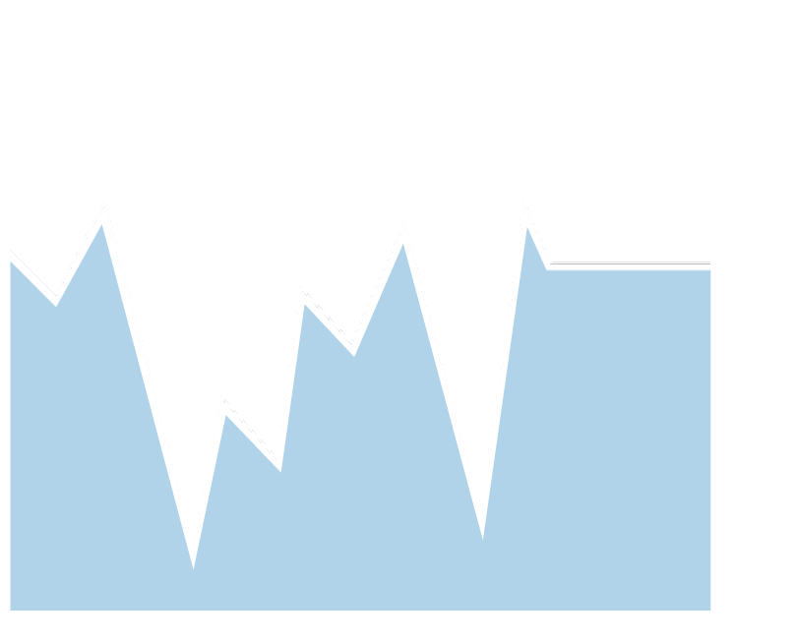
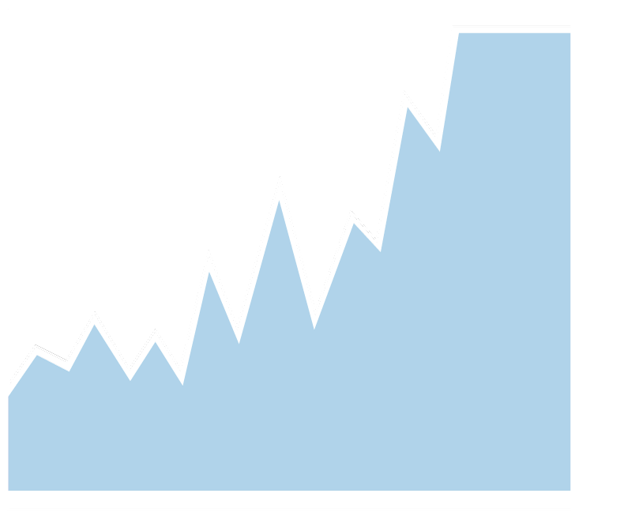
智慧型威脅偵測 : Automated Baselining
Sales Benefit
Sell to organizations with limited security staff
Main Features
Leverage multi-protocol counters providing deep visibility
Apply this baseline intelligently to trigger security policies

Slide 40
Baselining: Indicators and Threshold
Baselining /behavioral learning for detection
Building traffic pattern profiles (peacetime learning) for
Dst zone threshold
Per source threshold
Threshold for automatic escalation
Traffic pattern profile = zone-profile consists of multiple indicators with the threshold
Zone profile and individual threshold can be manually configured
TCP (incl. HTTP port)
Packet Rate SYN Rate FIN Rate RST Rate Small Window ACK Rate Empty ACK Rate | Small Payload Rate Bytes-to / Bytes-from SYN Rate / FIN Rate Session Miss Rate Packet Drop Rate Pkt Drop / Pkt Rcv’d Concurrent Sessions
UDP (incl. DNS port)
Packet Rate Packet Drop Rate Bytes-to / Bytes-from Pkt Drop / Pkt Rcv’d Concurrent Sessions
ICMP
Packet Rate Packet Drop Rate Bytes-to / Bytes-from Pkt Drop / Pkt Rcv’d
IP/Other
Packet Rate Packet Drop Rate Bytes-to / Bytes-from Pkt Drop / Pkt Rcv’d Fragment Rate
Notes:
Packet, session, and ratio metrics enable comprehensive profiling and facilitate detection of anomalies

Slide 41
動態防禦政策: Progressive countermeasures
可透過漸趨嚴格的對策來提高可疑流量的等級，以期盡可能減少誤判的發生
Thunder TPS
DDoS DST Zone
Mitigation Policy
Zone Threshold
Level 0
Per SRC Threshold
Level 1
Level 2
DST
Auto Learning (Baselining) or
Manual
Level 3
Level 4

Slide 42
Extended Policy Actions
Sales Benefit
More flexibility for DevOps, or easy automation for limited staff
Main Features
More elaborate action-lists
Logging
Capture packets
Drop the packet
Ignore – continue processing the packet
Reset the connection
Whitelist or blacklist the source
Custom script execution using bash

Slide 43
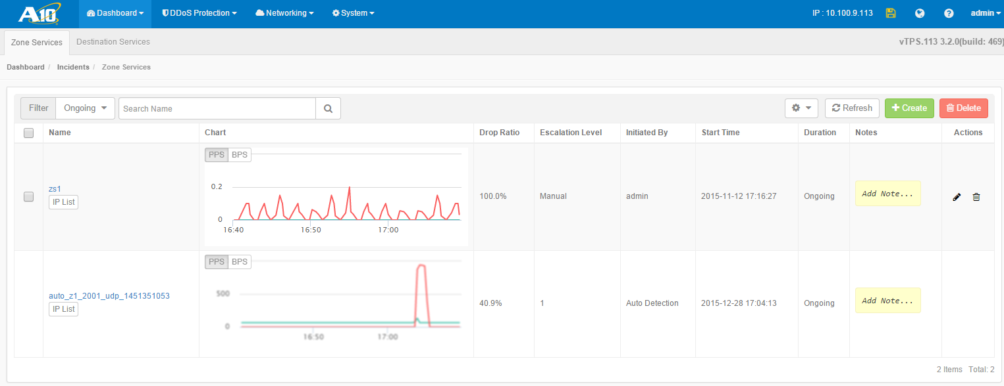
DDoS Dashboard - Incidents
List of incidents report for traffic visibility
Custom Incident
Auto created Incident

Slide 44
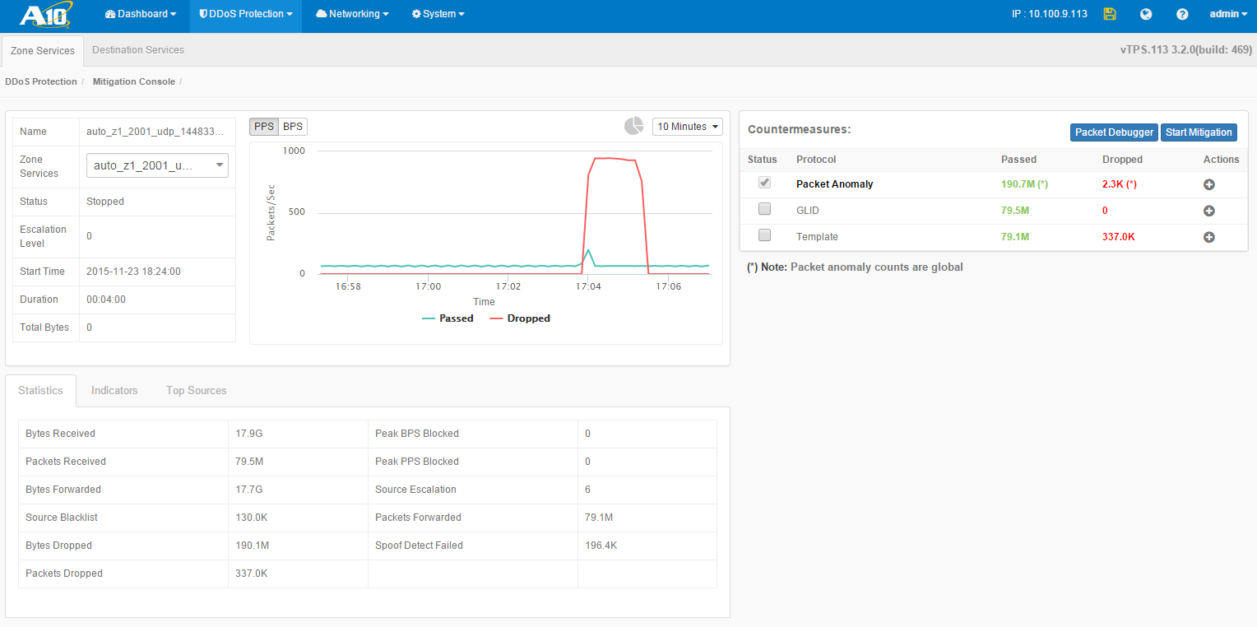
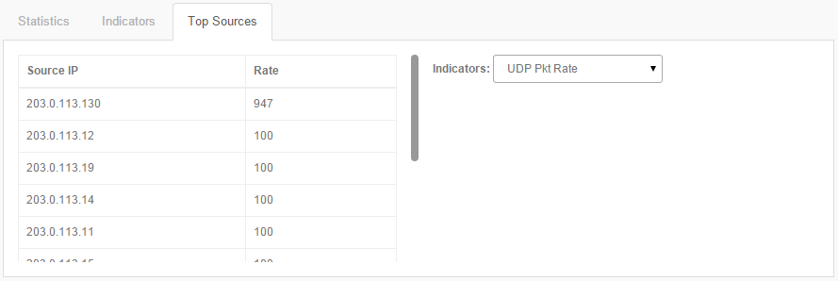
DDoS Protection – Mitigation Console
Traffic Summary of the incident
Packet Debugger
Easy-access Mitigation Rule Setting
Traffic stats, indicators and Top-K

Slide 45
Live Demo

