Slide 1
Configuring Juniper Networks Routers
Inno-Tech
Rex Lee

Slide 2
Agenda
Hardware Overview
JUNOS Software CLI Overview
Initial System Configuration
Routing Policy
OSPF
BGP

Slide 3
Hardware Overview

Slide 4
Agenda: Hardware Overview
Platform overview
Hardware architecture
ASIC and packet flow

Slide 5

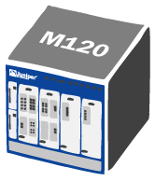


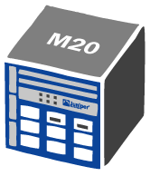
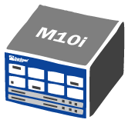
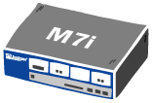
M-series Portfolio
Multi-Service Edge Router for Enterprise and Service Provider Applications
10G Support
320G
120G
Tbps +
40G
2.5G Support
5G
Campus/Enterprise
Med / Large PoP
10G PoP

Slide 6




T-series Portfolio
Designed for core routing and peering applications
1600G
Tbps +
640G
40G Support
320G
Small / Med Core
Med / Large Core
Large Core

Slide 7

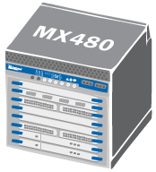
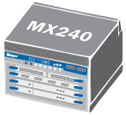
MX-series Portfolio
Optimized for Carrier Ethernet and
Ethernet Edge Requirements
960G
480G
10GE Support
240G
Small PoP
Sm/Med PoP
Medium PoP
Large PoP

Slide 8








Fundamentals of Juniper Advantage
JUNOS innovation:
  Modular control plane software
  Memory protected processes
Breakthrough architecture
  Performance, intelligence, flexibility
Routing
Engine
(aka “RE”)
JUNOS Software
S
e
r
v
i
c
e
P
l
a
n
e
Routing
Table
Programmable
Packet
Forwarding
Engine
(aka “PFE”)
ASIC(s)
Forwarding
Table
Switch Fabric
PIC
PIC
PIC
PIC
Deployed in 1000+ networks worldwide

Slide 9





Hardware Architecture of Routers
Common Processor
Forwarding
Plane
Control
Plane
Forwarding
Routing
Topology
  Programmable
  ASICs
  Scalable, Modular OS
Services
Services
Plane
  Hardware accelerated
‘Traditional’ CPU-Based Router
Juniper Networks Architecture

Slide 10
Separation of Control and Forwarding
RE
RT
FT
fxp1/bcm0
Packets in
FT
Packets out
PFE
All M-series and T-series platforms share the same basic design philosophy
  Clean separation of control and forwarding
Routing Engine maintains routing table (RT) and creates forwarding table (FT) from it
Packet Forwarding Engine receives FT from Routing Engine

Slide 11
Routing Engine Overview
JUNOS software resides in flash memory
  Backup copy available on hard drive
Provides forwarding table to the Packet Forwarding Engine
  Not directly involved with packet forwarding
  Runs various routing protocols
Implements CLI
  Operations
  Administration
  Maintenance
  Provisioning
Manages Packet Forwarding Engine

Slide 12
Packet Forwarding Engine Overview
Custom ASICs implement forwarding path
  No process switching (software-based handling of packet forwarding)
  Value-added services and features implemented in hardware
    Multicast
    Cos/queuing
    Firewall filtering
    Accounting
Divide-and-conquer architecture
  Each ASIC provides a piece of the forwarding puzzle

Slide 13
Packet Forwarding Engine Overview
System midplane or backplane
FPCs
  Hardware platform which accepts PICs
PICs
  Physical Interface Card
  Contains physical layer components
Switch Fabric
  M20—System Switching Board
  M40e—Switching Forwarding Module
  M5/M10—Forwarding Engine Board
  M7i/M10i—Compact Forwarding Engine Board
  M120—Forwarding Engine Board
  M320—Switching Interface Board
  MX—Switch Control Board
Internet Processor
ASIC
SCB/SFM/CFEB/FEB
Distributed Buffer
Manager ASIC
Distributed Buffer
Manager ASIC
Shared memory
Shared memory
I/O
Manager
ASIC
I/O
Manager
ASIC
FPC
FPC
PIC
PIC
PIC
PIC
PIC
PIC
PIC
PIC

Slide 14
PFE Components: M-series
Physical Interface Cards (PICs)
Flexible PIC Concentrators (FPCs)
The system midplane
For M5/M10, M7i/M10i, M20, and M40
  System Control
    M5/M10 routers – Forwarding Engine Board (FEB)
    M7i/M10i routers – Compact FEB(CFEB)
    M20 router – System Switching Board (SSB)
    M40 router – System Control Board (SCB)
For M40e and M160
  Switching and Forwarding Module (SFM)
  Miscellaneous Control Subsystem (MCS)
  Packet Forwarding Engine Clock Generator

Slide 15
PFE Components: T-series & M320
Physical Interface Cards (PICs)
T-series FPCs
  Contain one or two PFE complexes
Switching between PFEs performed by Switch Interface Boards (SIBs)
  Nonblocking crossbar switch matrix with high-speed lines to each FPC
  Switch fabric redundancy
    Four SIBs comprise a M320 switch fabric – four active
    Three SIBs comprise a T320 switch fabric – two active, one spare
    Five SIBs comprise a T640 switch fabric – four active, one spare
The system midplane

Slide 16
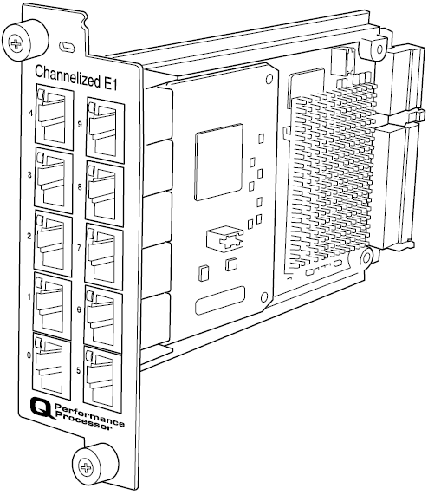
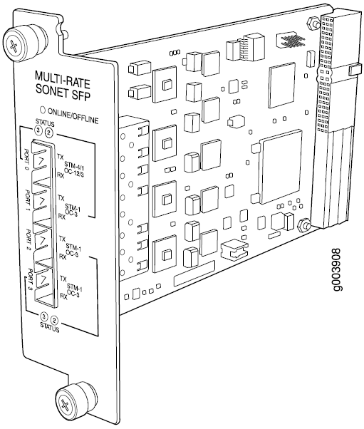
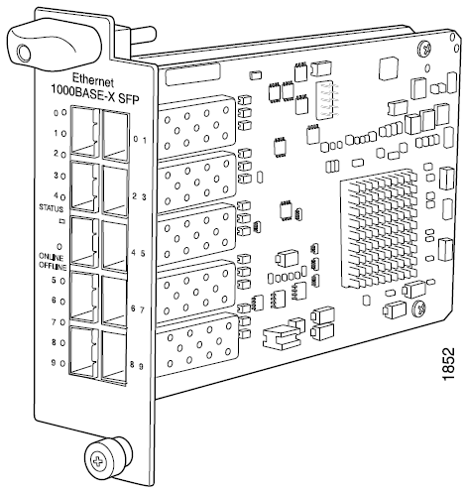
Physical Interface Cards
PICs currently support from 0 to 48 physical ports
  Some PICs support channelized and advanced CoS options
  IP Service PICs
Media-specific ASICs
Status indicators
Hot-swappable on all platforms except M20 and M40 routers
  Slight disruption to other PICs in same FPC on M-series router

Slide 17
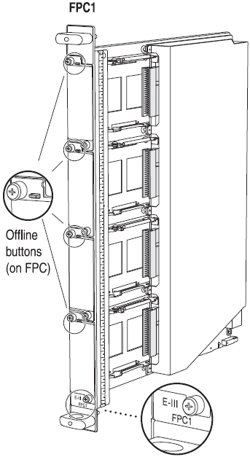
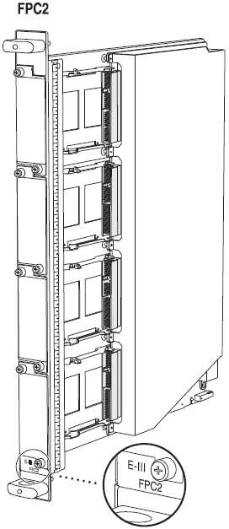
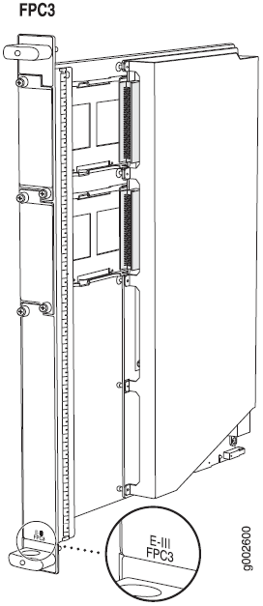
The Flexible PIC Concentrator
General FPC Features
  Supports from 1 to 4 PICs
  Hot-swappable on most platforms
  From 64MB to 1.2 GB of memory
    Pooled to create shared memory switch fabric on M-series platforms
High aggregate throughput rates*
  M5/M10, M7i/M10i, M20, M40 and M40e:6.4 Gbps per FPC
  M120: 20 Gbps per FPC2/FPC3
  M320: 40 Gbps per FPC3
  T640: 80 Gbps with FPC3
  T1600: 200 Gbps per FPC4
* The numbers quoted are two times the unidirectional (simplex) capacity of each FPC.

Slide 18
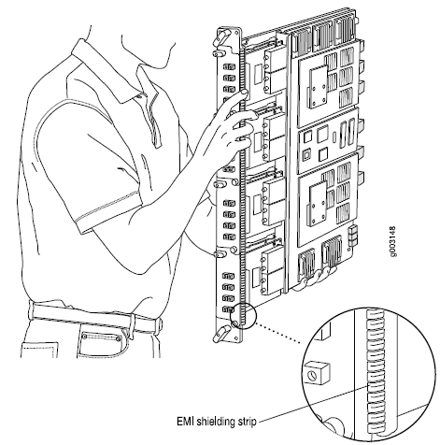
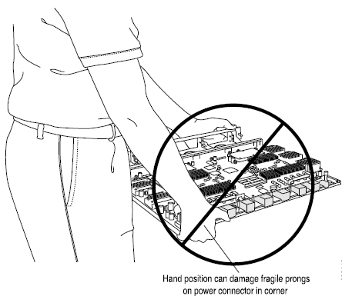
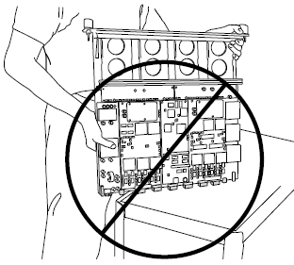
General Handling
FPCs are heavy and can be damaged with improper handling
  Fully loaded FPC3 weighs up to 32lbs/11.3kg
    Be prepared for the weight of the FPC when removing from the midplane
    Always handle appropriately

Slide 19
M-series System Boards
General System Board functions:
  Forwarding table updates and route lookups
  Management of ASICs and PFE hardware components
  Environmental monitoring
  Handling exception/control packets
Names vary by platform
  M5 and M10 – FEB
  M20 and M40 – SSB and SCB
  M7i and M10i – CFEB
Enhanced System Boards feature the Internet Processor II ASIC

Slide 20
M-series PFE ASICs
Internet Processor
Forwarding
table
PFE System
Controller
(SSB, SFM,
etc.)
Buffer Manager 1
Buffer Manager 2
FPC
I/O
Manager
M
E
M
I/O
Manager
M
E
M
I/O
Manager
M
E
M
PIC I/O
Manager
PIC I/O
Manager
PIC I/O
Manager
PIC I/O
Manager
PICs
PIC I/O
Manager
PIC I/O
Manager
PIC I/O
Manager
PIC I/O
Manager

Slide 21




T-series Architecture Overview
New, highly available architecture
  Designed to cater to new types of carrier-class IP/MPLS deployments
  Optimal architecture for new generation multi-chassis, multi-terabit platforms
  Distributed packet processing
  No single point of failure
  Any-to-any non blocking switch fabric
  Maintains packet priority and order across fabric
Routing Engine
Routing Engine
Switching
Fabric
FPC
FPC
FPC
FPC
PIC
PIC
PIC
PIC
FPC
PFE
PFE
4+1 SIB redundancy

Slide 22
Exception Packets
Exception packets
  Local delivery
  IP options
    Source route, router alert, etc.
  ICMP message generation
Generally processed by PFE control CPU
  Remaining traffic (local and control) sent to Routing Engine via internal link
    Rate limiting
    Hardware-based WRR ensures control traffic is not starved

Slide 23
JUNOS Software CLI Overview

Slide 24
Agenda: JUNOS Software CLI Overview
JUNOS software
Power up and power down
Gaining access
Operational modes and features
Configuration mode
Maintenance operation

Slide 25

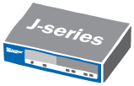
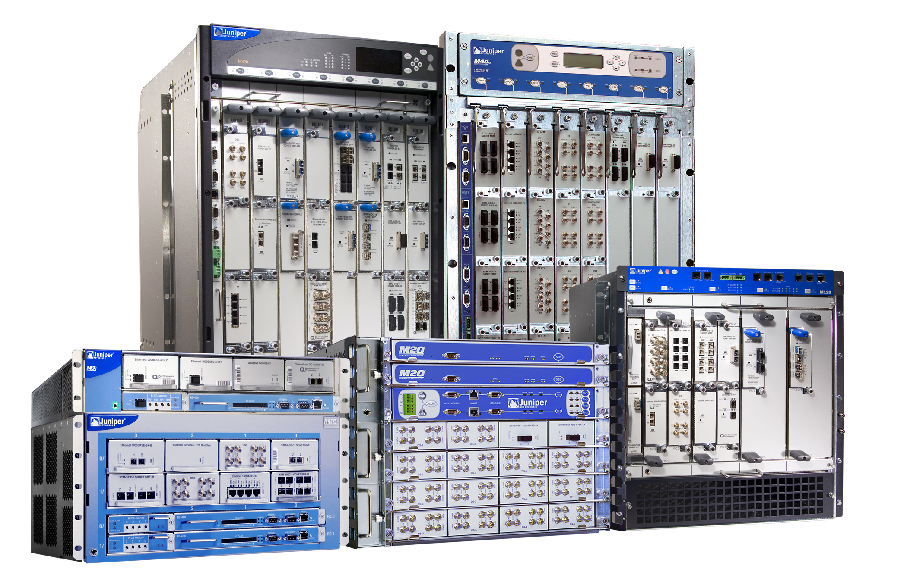
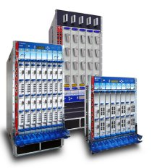
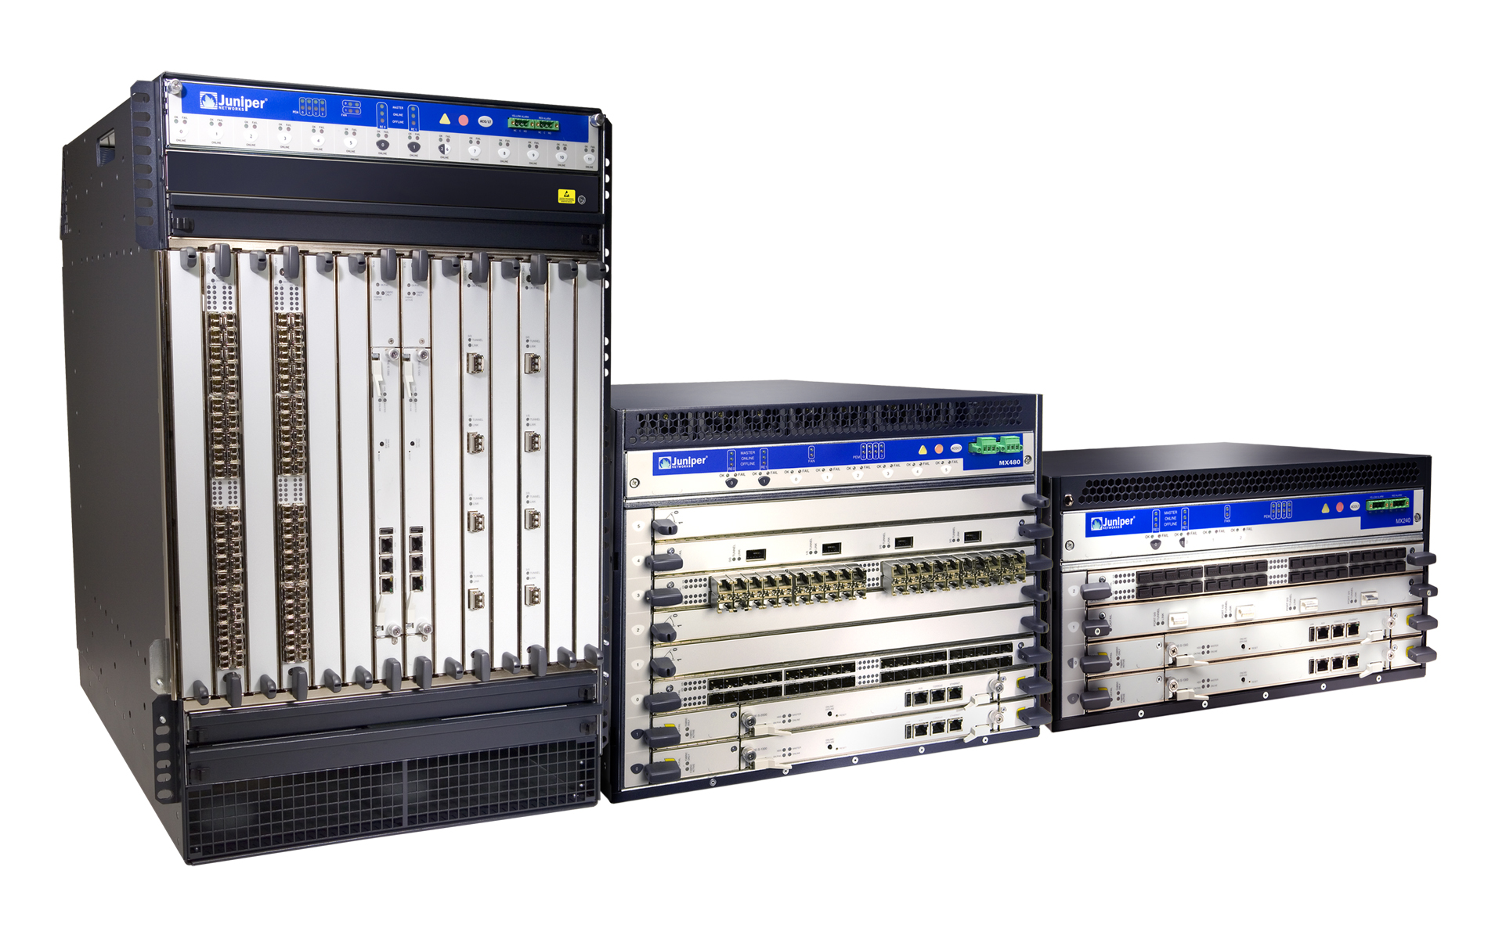

The JUNOS Software Difference
One OS
Deployed since 1998
  First high-performance network Operating System
10+ years of innovation and development
  4 releases per year
  Mbps to Tbps scale
  Thousands of features for diverse set of needs
  TL 9000 certification from QuEST Forum
Serving most demanding customers
  Top 40+ service providers
  High-performance enterprise and public sector accounts
One Release
8.5
9.0
9.1
Q407
Q108
Q208
One Architecture
Module
X
API
M-Series
MX-Series
T-Series

Slide 26
Software Features
JUNOS kernel
Command-line interface
Industrial-strength routing protocols
  BGP, IS-IS, OSPF
  IGMP, DVMRP, PIM, SDP/SAP
  Routing policy
Traffic engineering
Redundancy
  VRRP
  APS 1:1
Firewall filters
Notes:
The JUNOS software offers features important to Internet Service Providers (ISPs):
JUNOS kernel—Foundation used by all modules, protects modules from each other.
Command-line interface—Provides operations, administration, maintenance, and provisioning access to the router.
Routing protocols—Scalable, robust routing protocols for ISPs.
Traffic engineering—Allows you to automatically create traffic flows through your network based on a number of configurable constraints.
Redundancy—Provides redundant component management, virtual router support for Ethernet interfaces (using VRRP) and SONET Advanced Protection Switching (APS).
Firewall filters—Allows you to filter traffic as it flows through the router.

Slide 27
JUNOS Kernel
Fully independent software processes
  Routing, interface control, network management, chassis management, statistics, APS, VRRP, and so on
Protected memory environment
  Serious error in one module does not impact other modules or impact packet forwarding
  Serious errors result in automatic memory snapshot for examination by Juniper Networks TAC personnel
Designed to scale
Optimized for speed
Notes:
Software modules inside the JUNOS software (called processes) are separated by hardware-assisted memory protection, which prevents one software process from accessing memory being used by another. This arrangement allows the system to recover from errors quickly and divides the software debugging tasks into more manageable pieces.
For example, a failure in the network management software module does not impact any of the routing protocols or the forwarding performance.
Another feature allows detailed failure information to be saved for the Juniper Technical Assistance Center. If a module fails, the failure is logged, a “memory snapshot” is generated for use by the Juniper Technical Assistance Center, and the module is restarted automatically—without interrupting packet forwarding. The memory snapshot is a file describing the exact state of the system when the error occurred. The snapshot allows Juniper engineering personnel to re-create the conditions causing the failure.

Slide 28
Command Line Interface
Universal access to router
User authentication using login name and password with per-user restrictions
Line editor
  Command history
  Context-sensitive help
  Command completion
Multiple “undo” levels
Automatic system recovery when configuring remotely
Notes:
The JUNOS software command-line interface (CLI) is the interface to the software that you use whenever you access the router—whether from the console or through a remote network connection. The CLI, which automatically starts after logging in, provides commands that you use to perform various tasks, including configuring the JUNOS Internet software and monitoring and troubleshooting the software, network connectivity, and the router hardware.
You monitor and troubleshoot the software, network connectivity, and the router by entering CLI commands. The CLI is a straightforward command interface. You type commands on a single line, and the commands are executed when you press the Enter key. The CLI provides command help and command completion, and it also provides Emacs-style keyboard sequences that allow you to move around on a command line and scroll through a buffer that contains recently executed commands.
The CLI provides a “configure with confirmation” feature that automatically reverts to a known working configuration if you are accidentally disconnected when remotely configuring the router.

Slide 29
Routing Policy
Flexible policy language for import/export among neighbors and protocols
High degree of control over JUNOS routing table
Ability to test before enabling
Policy building blocks
  Subroutines
  Boolean expressions
Smooth restart after configuration changes
  Policy changes affect only prefixes/neighbors that have changed
Notes:
All routing protocols store their routing information in a common routing table that is maintained by the JUNOS software. From the collected routing information, the JUNOS software calculates the best routes to each destination. These routes are used to forward traffic through the router, and they can be advertised to neighbors using one or more routing protocols.
Routing policy allows you to control the routing information that is transferred between the routing protocols and the JUNOS software routing table. You can filter the routing information so that only some of it is transferred, and you can set properties associated with the routes.
The JUNOS routing policy is quite versatile and liberal in what it allows you to configure. You can create a wide variety of policies and apply them when routes are moving between the routing protocols and the routing table. But versatility is a two-way street: the JUNOS routing policy also allows you to define nonsensical policies and to apply them so that they have unintended effects. Therefore, it is essential that you design and apply routing policies carefully.
After you have designed routing policies, you should analyze them logically to ensure that they make sense. Before implementing policies, especially complex policies, you should test them to determine whether they will have the desired effect. To do this, use the test policy command.
You can create complex import and export statements by using logical operators to create boolean expressions that define how to evaluate multiple policies.
It is possible to evaluate one routing policy from within another. One use for this is to evaluate a set of common route filters from multiple policies.

Slide 30
Firewall Filters
Routing Engine
Packet Forwarding Engine
Forwarded traffic
Wirespeed filtering decision made by Internet Processor II in Packet Forwarding Engine
Protects Routing Engine and transit traffic
Can statistically sample filtered data
Notes:
Packet filtering is the ability to selectively control the flow of packets to or from an interface by examining information in each packet's header. The Internet Processor II ASIC controls inbound and outbound traffic based on complex user defined rules, called filters.

Slide 31
Firewall Filters
Filters packets based on match conditions
  IP source or destination address
  TCP or UDP source or destination port field
  IP protocol field
  ICMP packet type
  IP options
  TCP flags
Multiple match conditions
Grouping of match conditions (such as numeric ranges)
Filter actions
  Accept packet
  Discard packet
  Count packet
  Log packet
  Apply bandwidth policing rules to packet
Notes:
The firewall feature supports a number of match conditions. Each firewall filter consists of one or more terms. Each term consists of statements that define match conditions and actions to take if the conditions are matched.
When a filter matches, the packet can be discarded or accepted for routing. In addition, the packet can be counted, logged, or subjected to further rules enforcing bandwidth restrictions.
Firewall filters can be applied to an individual interface, or to several interfaces that have been logically grouped together.

Slide 32
Chassis Management
Alarms
  Can remap major and minor alarms
  Can disable specific alarms
  Cannot disable or remap environmental alarms
Slots
  Hold FPC disabled in slot for use as hot spare
Reference clock sources
  From onboard stratum 3 clock
  Loop timing from any incoming SONET stream
Notes:
For the different types of PICs, you can configure which conditions trigger alarms and whether they trigger a red or yellow alarm, or are ignored. Red alarm conditions light the red alarm LED on the router’s craft interface and trigger an audible alarm if one is connected to the contacts on the craft interface. Yellow alarm conditions light the yellow alarm LED on the router’s craft interface and trigger an audible alarm if one is connected to the craft interface.
You cannot disable or remap any safety-related alarm, such as fan, temperature, or power supply alarms.

Slide 33
Chassis Management
CLI and SNMP access to:
  Component status
  Environmental sensors
  FRU serial number and version
Notes:
Using SNMP or the CLI, you can display information about all chassis components.
The following items are visible using commands from the show chassis command hierarchy:
Chassis alarm status show chassis alarm
Chassis clock-source configuration show chassis clocks
Information currently on craft display show chassis display
Environmental information show chassis environment
Firmware version show chassis firmware
FPC and PIC status show chassis fpc
Hardware inventory show chassis hardware
MAC address show chassis mac-addresses
PFE control board status show chassis [feb | scb | sfm slot | ssb ]

Slide 34
JUNOS Software Management
Comes preinstalled
Upgradeable using CLI
Reinstall software
  From LS-120 or PCMCIA card
Recover software
  Boot from secondary storage
  Copy software image from secondary storage
Notes:
When you receive a Juniper Networks router, all the software is installed on the system. When you power on the router, the software and all the software processes start automatically. You simply need to configure the software and the router will be ready to participate in the network.
The software is installed on the router’s flash drive (a nonrotating drive) and hard drive (a rotating disk), and a copy of the software also is provided on external media, which can be inserted into the router’s LS-120 floppy disk drive on the M40 or the PCMCIA slot on all other Juniper Networks routers. Normally, when you power on the router, it runs the copy of the software that is installed on the flash drive.
Periodically, you might want to upgrade the router software as new features are made available or as software problems are fixed. You normally obtain upgraded software by downloading the upgrade packages onto your router or onto another system on your local network. Then you install the software upgrade on the router’s flash and hard drives.

Slide 35
JUNOS Software Architecture
Kernel
  Basic system support for all modules
  Manages interaction with the routing and forwarding tables
RPD—Routing protocol daemon
  Provides routing protocol intelligence to system
DCD—Device control daemon
  Manages all interface devices

Slide 36
JUNOS Software Architecture
MGD—Management daemon
  Configuration access to system
  CLI is client of MGD
SNMPD—Simple Network Management Protocol daemon
  Provides remote system status to third-party management software
CHASSISD—Chassis daemon
  Monitors and manages
    FPC slots
    Environmental components

Slide 37
JUNOS Software Architecture
JUNOS kernel starts first
JUNOS kernel
RE
PFE
Notes:
The Routing Engine kernel (JUNOS kernel) provides the underlying infrastructure for all the JUNOS software processes. In addition, it provides the link between the routing protocol process’ routing tables and the Routing Engine’s forwarding table, and it is responsible for all communication with the Packet Forwarding Engine, which include keeping the Packet Forwarding Engine’s copy of the forwarding table synchronized with the master copy in the Routing Engine.

Slide 38
JUNOS Software Architecture
PFE downloads microkernel from RE
JUNOS kernel
RE
PFE
PFE microkernel
Notes:
The PFE microkernel is a small and efficient supervisory program that runs on the SCB, SSB, and each plug-in FPC card. It supervises the operation of the PFE. Its duties include:
Managing the PFE forwarding table
Forwarding control traffic to the RE
Monitoring the chassis temperature sensors, cooling system, and craft interface
Collecting interface statistics
Supervising hot-swap events
The PFE microkernel is stored on the RE in /usr/share/pfe under the names scb.jbf and fpc.jbf. These files are part of the jpfe software upgrade package.

Slide 39
JUNOS Software Architecture
Both initialize in parallel
Interface
process
Chassis
process
JUNOS kernel
RE
PFE
PFE microkernel
Interface
process
ASICs
Chassis
process
Notes:
The JUNOS chassis process allows you to configure alarm management and the system reference clock. You configure various properties such as the primary reference clock source or the mappings between particular alarms and the severity of the alarm they eventually generate.
The chassis process keeps track of the state of each chassis component by gathering that information from its twin process running on the Packet Forwarding Engine, thus enabling the JUNOS software to track the status and condition of the router’s chassis components.
The JUNOS interface process allows you to configure and control the physical interface devices and logical interfaces present in a Juniper router. You configure various interface properties such as the interface location (that is, which slot the FPC is installed in and which location on the FPC the PIC is installed in), the interface encapsulation, and interface-specific properties.
You can configure the interfaces that are currently present in the router, as well as interfaces that are currently not present in the router but that you may be adding at a future time. The JUNOS interface process communicates, through the JUNOS kernel, with the interface process in the Packet Forwarding Engine, thus enabling the JUNOS software to track the status and condition of the router’s interfaces.

Slide 40
JUNOS Software Architecture
Routing
table
Routing
process
Interface
process
Chassis
process
Forwarding
table
JUNOS kernel
RE
PFE
PFE microkernel
Forwarding
table
Interface
process
Chassis
process
ASICs
Notes:
The JUNOS software routing protocol process controls the routing protocols that run on the Juniper router. The routing protocol process starts all configured routing protocols and handles all routing messages. The routing protocol process maintains one or more routing tables, which consolidate the routing information learned from all routing protocols into common tables.
From this routing information, the routing protocol process determines the active routes to network destinations and installs these routes into the Routing Engine’s forwarding table. The Packet Forwarding Engine’s forwarding table is automatically synchronized with the Routing Engine’s copy by the JUNOS kernel.
Finally, the routing protocol process implements routing policy, which allows you to control the routing information that is transferred between the routing protocols and the routing table.
Using routing policy, you can filter routing information so that only some of it is transferred, and you can also set properties associated with the routes.

Slide 41
JUNOS Software Architecture
SNMP and Management
Processes
CLI
Routing
table
Routing
process
Interface
process
Chassis
process
Forwarding
table
JUNOS kernel
RE
PFE
PFE microkernel
Forwarding
table
Interface
process
Chassis
process
ASICs
Notes:
The JUNOS software supports SNMP, which provides a mechanism for monitoring the state of a Juniper router. The software supports SNMP Version 1 and Version 2 (also known as Version 2c, or v2c). The JUNOS implementation of SNMP does not include any of the security features that were originally included the IETF SNMP drafts, but were later dropped because of the inability to standardize on a particular method. The SNMP software is controlled by the JUNOS SNMP and MIB II processes, which consist of an SNMP master agent and various subagents implementing Management Information Bases (MIBs).
Within the JUNOS software, a process-controlling process is responsible for starting and monitoring all the other software processes. If a software process should terminate for some reason, this management process makes all reasonable attempts to restart it and log any failure information for further investigation.

Slide 42
Additional Modules
ALARMD—Alarm daemon
  Manages system alarm notifications
APSD—Automatic Protection Switching daemon
SAMPLED—Traffic sampling daemon
VRRPD—Virtual Router Redundancy protocol daemon

Slide 43
Power up and Power down
Power up
  Connect all cables
  Turn on one power supply
  Turn on second power supply
    It can take up to 60 seconds for accurate power supply/PEM status indications
Power down
  Shut down JUNOS Internet software
    CLI request system halt command
  For redundant routing engine chassis
    request system halt both-routing-engines
  Turn off power supplies/remove power

Slide 44
JUNOS Boot Sequence
Hardware controlled
  Software notifies hardware when boot completes
Removable
media
Solid-state
flash disk
Rotating
disk
Halt
Success?
Success?
Success?
Done
Done
Done

Slide 45



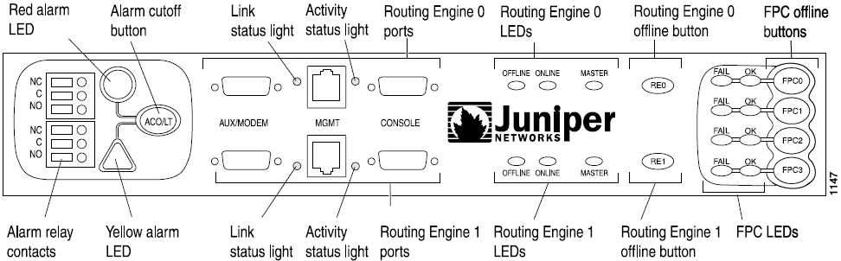
Access Router’s Management Ports
Console
  Db9 EIA-232 @ 9600 Bps, 8/N/1 (preconfigured)
Management port, using Telnet, SSH
  Requires configuration

Slide 46
Log In
Special treatment for “root” login
  Can only log in as root from console port
  Must create additional user with superuser privileges to log in via network ports
  Be sure to review security implications
Example session
  login: root
  Password:
  --- JUNOS 9.4R1.8 built 2009-02-08 15:50:45 UTC
  root% cli
  root>
  root> exit
  root% exit
  logout

Slide 47
Log In
Router administrator configures login ID and password for each user
Example session
  (ttyp0)
  login: jeff
  Password:
  --- JUNOS 9.4R1.8 built 2009-02-08 15:50:45 UTC
  jeff@host> configure
  Entering configuration mode
  [edit]
  jeff@host# exit
  Exiting configuration mode
  jeff@host>

Slide 48
CLI Modes and Feature Overview
Operational mode
  Monitor and troubleshoot the software, network connectivity, and router hardware
    jeff@host>
Configuration mode
  Configure the router, including interfaces, general routing information, routing protocols, user access, and system hardware properties
    [edit]
    jeff@host#

Slide 49
CLI Operational Mode
Commands are executed from the default CLI level(user@host>)
  Can be executed from configuration mode with run command
  Hierarchy of commands
Less Specific
clear
configure
monitor
set
show
bgp
chassis
interfaces
isis
ospf
route
version
brief
exact
protocol
table
terse
More Specific

Slide 50
Editing Command Lines
Move the cursor
  Ctrl-B Back one character
  Ctrl-F Forward one character
  Ctrl-A To beginning of line
  Ctrl-E To end of line
Delete characters
  Delete or
  backspace key Delete character before cursor
  Ctrl-D Delete character under cursor
  Ctrl-K Delete from cursor to end of line
  Ctrl-U Delete all characters
  Ctrl-W Delete entire word to left of cursor
Other keys
  Ctrl-L Redraw the current line
  Ctrl-P Move backwards through command history
  Ctrl-N Move forward through command history

Slide 51
Command completion
Command completion saves typing
  Typing entire command not necessary
  Type the minimum characters required and press space or tab key
Space bar completes a command
  jeff@host> sh<space>ow i<space>
  'i' is ambiguous.
  Possible completions:
  igmp Show information about IGMP
  interfaces Show interface information
  isis Show information about IS-IS
  jeff@host> show i
Tab key completes a variable

Slide 52
Context-Sensitive Help
Type a question mark (?) anywhere on command line
  jeff@host> ?
  Possible completions:
  clear Clear information in the system
  configure Manipulate software configuration information
  file Perform file operations
  help Provide help information
  ...
  jeff@host> clear ?
  Possible completions:
  arp Clear address resolution information
  bfd Clear Bidirectional Forwarding Detection information
  bgp Clear Border Gateway Protocol information
  cli Clear command-line interface settings
  firewall Clear firewall counters
  ...

Slide 53
Interpret Output
Error messages
  ^ displayed under error
  Message indicates type of error
Example
  [edit]
  jeff@host# load config-file<Enter>
  ^
  syntax error, expecting ‘merge’, ‘override’, or ‘replace’.
  [edit]
  jeff@host#

Slide 54
Using | (Pipe)
The pipe function is used to filter output
  Available in all modes and context
  jeff@host> show route | ?
  Possible completions:
  count Count occurrences
  display Show additional kinds of information
  except Show only text that does not match a pattern
  find Search for first occurrence of pattern
  hold Hold text without exiting the --More-- prompt
  last Display end of output only
  match Show only text that matches a pattern
  no-more Don't paginate output
  request Make system-level requests
  resolve Resolve IP addresses
  save Save output text to file
  trim Trim specified number of columns from start of line

Slide 55
Topic Help
The help topic command provides information on general concepts
  jeff@host> help topic vpls ?
  Possible completions:
  active-interface Primary interface for multihomed site
  ae Aggregated Ethernet configuration for VPLS
  ae-overview Aggregated Ethernet for VPLS overview
  bridging Integrated routing and bridging with VPLS
  encapsulation Configure interface encapsulation
  ...
  jeff@host> help topic vpls site
  Configuring the VPLS Site Name and Site Identifier
  When you configure BGP signaling for the VPLS routing instance, on each PE
  router you must configure each VPLS site that has a connection to the PE
  router. All the Layer 2 circuits provisioned for a VPLS site are listed as
  the set of logical interfaces (using the interface statement) within the
  site statement.
  ...

Slide 56
Getting Help on Configuration Syntax
The help reference command provides configuration-related information
  jeff@host> help reference vpls site
  site
  Syntax
  site site-name {
  interface interface-name {
  interface-mac-limit limit;
  }
  site-identifier identifier;
  site-preference preference-value;
  }
  Hierarchy Level
  [edit logical-routers logical-router-name routing-instances
  routing-instance-name protocols vpls],
  [edit routing-instances routing-instance-name protocols vpls]
  Release Information
  Statement introduced before JUNOS Release 7.4.

Slide 57
Getting Help on Configuration Syntax
The help apropos command provides configuration-related hierarchy
  jeff@host# help apropos bfd | match ospf | match set | except version
  set logical-routers <name> protocols ospf area <area_id> interface <interface_name> bfd-liveness-detection
  set logical-routers <name> protocols ospf3 area <area_id> interface <interface_name> bfd-liveness-detection
  set logical-routers <name> routing-instances <instance_name> protocols ospf area <area_id> interface <interface_name> bfd-liveness-detection
  set logical-routers <name> routing-instances <instance_name> protocols ospf3 area <area_id> interface <interface_name> bfd-liveness-detection
  set protocols ospf area <area_id> interface <interface_name> bfd-liveness-detection
  set protocols ospf3 area <area_id> interface <interface_name> bfd-liveness-detection
  set routing-instances <instance_name> protocols ospf area <area_id> interface <interface_name> bfd-liveness-detection
  set routing-instances <instance_name> protocols ospf3 area <area_id> interface <interface_name> bfd-liveness-detection

Slide 58
Configure the Router: Overview
CLI has separate configuration mode
You edit a copy of current configuration called the candidate configuration
Changes you make are visible to other CLI users
  Changes they make might conflict with your changes
Changes do not take effect until you commit them
When committed, candidate configuration becomes active and a new candidate is created

Slide 59
Candidate vs Active Configuration
commit
Candidate
configuration
Active
configuration
0
rollback n
1
2
...
Rollback files stored in
/config/juniper.conf.n (n=1-3)
/var/db/config/juniper.conf.n (n=4-49)

Slide 60
Entering Configuration Mode
Type configure or edit at the CLI prompt
jeff@host> configure
Entering configuration mode
[edit]
jeff@host#
To allow a single user to edit the configuration, type configure exclusive
Configure private allows the user to edit a private copy for the candidate configuration
  Multiple users can edit private candidate configurations simultaneously
  At commit time, the user’s private changes are merged back into the global configuration

Slide 61
Configuration Hierarchy
Create a hierarchy of configuration statements
  Enter command in CLI configuration
[edit]
jeff@host# set chassis alarm sonet lol red
  And the resulting configuration hierarchy is created…
[edit]
jeff@host# show
chassis {
alarm {
sonet {
lol red;
}
}
}

Slide 62
Statement Hierarchy
Configuration statements organized as a tree
  Similar to UNIX/Windows–style directories
Less Specific
top
chassis
firewall
interfaces
protocols
system
more…
alarm
clock
fpc
atm
e3
ethernet
sonet
t3
More Specific

Slide 63
Moving between Levels (1 of 3)
Moving between levels of the statement hierarchy
  edit functions like a change directory (cd) command
[edit]
jeff@host# edit chassis alarm ethernet
[edit chassis alarm ethernet]
jeff@host#
top
chassis
firewall
interfaces
protocols
system
more…
alarm
clock
fpc
atm
e3
ethernet
sonet
t3

Slide 64
Moving between Levels (2 of 3)
Using up command to move up a level
Using top command to move to the top of the hierarchy
[edit chassis alarm ethernet]
jeff@host# up
[edit chassis alarm]
jeff@host# top
[edit]
jeff@host#
top
top
chassis
firewall
interfaces
protocols
system
more…
alarm
clock
fpc
up
atm
e3
ethernet
sonet
t3

Slide 65
Moving between Levels (3 of 3)
Use the exit command to move back to where you just were
  exit at the top level exits configuration mode and puts you back into operational mode
  exit configuration-mode exits no matter where you are
[edit chassis alarm ethernet]
jeff@host# exit
[edit]
jeff@host# exit
Exiting configuration mode
jeff@host>

Slide 66
Move around the Hierarchy
The question mark is your friend
  [edit]
  jeff@host# edit ?
  Possible completions:
  > chassis Chassis configuration
  > interfaces Interface configuration
  > policy-options Routing policy option configuration
  > Protocols Routing protocol configuration
  > routing-options Protocol-independent routing option configuration
  > snmp Simple Network Management Protocol
  > system System parameters
  [edit]
  jeff@host# edit

Slide 67
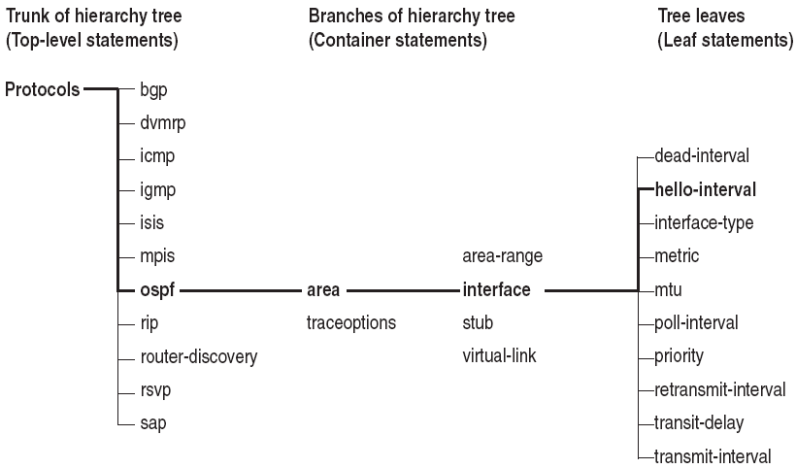
Configuration Statement Hierarchy Example

Slide 68
Move around the Hierarchy
[edit]
jeff@host# edit protocols ?
Possible completions:
> bgp BGP options
> dvmrp DVMRP options
> igmp IGMP options
> isis IS-IS configuration
> mpls Multiprotocol label switching options
> ospf OSPF configuration
...
[edit protocols]
jeff@host# edit protocols ospf ?
Possible completions:
<[Enter]> Execute this command
> area Configure an OSPF area
> graceful-restart Configure graceful restart attributes
> overload Set the overload mode (repel transit traffic)
> spf-options Configure options for SPF
> topology Topology parameters
> traceoptions Trace options for OSPF
> traffic-engineering Configure traffic engineering attributes
| Pipe through a command

Slide 69
Move around the Hierarchy
[edit]
jeff@host# edit protocols ospf
[edit protocols ospf]
jeff@host# edit ?
Possible completions:
> area Configure an OSPF area
> traceoptions Trace options for OSPF
[edit protocols ospf]
jeff@host# edit area 0
[edit protocols ospf area 0.0.0.0]
jeff@host# exit
[edit protocols ospf]
jeff@host# top
[edit]
jeff@host#

Slide 70
Modify the Configuration
Use the set command to add configuration statements
  set command changes configuration statements if they already exist
    [edit]
    jeff@host# set protocols ospf area 0 interface so-0/0/0 hello-interval 5
    [edit]
    jeff@host# set protocols ospf area 0 interface so-0/0/0 retransmit-interval 10
    [edit]
    jeff@host# set protocols ospf area 0 interface so-0/0/0 metric 10

Slide 71
Modify the Configuration
Optionally, move into the OSPF hierarchy and save some keystrokes
  [edit]
  jeff@host# edit protocols ospf area 0 interface so-0/0/0
  [edit protocols ospf area 0 interface so-0/0/0]
  jeff@host# set hello-interval 5
  [edit protocols ospf area 0 interface so-0/0/0]
  jeff@host# set retransmit-interval 10
  [edit protocols ospf area 0 interface so-0/0/0]
  jeff@host# set metric 10
  [edit protocols ospf area 0 interface so-0/0/0]
  jeff@host#

Slide 72
View the Candidate Configuration
Use the show command to see the candidate configuration
  Begins at current hierarchy level
  You can specify starting level
  Indented to match each hierarchy level
  [edit protocols ospf area 0.0.0.0]
  jeff@host# show
  interface so-0/0/0 {
  metric 15;
  retransmit-interval 10;
  hello-interval 5;
  }
  [edit protocols ospf area 0.0.0.0]
  jeff@host#

Slide 73
View the Candidate Configuration
[edit protocols ospf area 0.0.0.0]
jeff@host# top
[edit]
jeff@host# show protocols
isis {
interface all;
}
ospf {
area 0.0.0.0 {
interface so-0/0/0 {
metric 15;
retransmit-interval 10;
hello-interval 5;
}
}
}
[edit]
jeff@host#

Slide 74
Remove Statements
  [edit]
  jeff@host# edit protocols ospf area 0 interface so-0/0/0
  [edit protocols ospf area 0.0.0.0 interface so-0/0/0]
  jeff@host# delete hello-interval
  [edit protocols ospf area 0.0.0.0 interface so-0/0/0]
  jeff@host# delete retransmit-interval
  [edit protocols ospf area 0.0.0.0 interface so-0/0/0]
  jeff@host#
  [edit protocols ospf area 0.0.0.0 interface so-0/0/0]
  jeff@host# up
  [edit protocols ospf area 0.0.0.0]
  jeff@host# show
  interface so-0/0/0 {
  metric 15;
  }
  [edit protocols ospf area 0.0.0.0]
  jeff@host#

Slide 75
Identifying Configuration File Differences
Change the candidate configuration
  [edit chassis]
  jeff@host# set alarm sonet lol red
  [edit chassis]
  jeff@host# delete alarm sonet p11
Display differences between the candidate and active configurations
  [edit chassis alarm sonet]
  jeff@host# show | compare
  [edit chassis alarm sonet]
  + lol red;
  p11 yellow;
Compare arbitrary files
  jeff@host> file show filename 1 | compare filename 2
  jeff@host> show configuration | compare rollback number
[edit]
jeff@host# show | compare
[edit chassis]
+ alarm {
+ sonet {
+ lol red;
+ }
+ }

Slide 76
Activate a Configuration
Activate configuration changes using the commit command
    [edit]
    jeff@host# commit
    commit complete
    [edit]
    jeff@host#
Checks configuration before activating it
System never commits for you
  One exception: commit confirmed
    [edit]
    jeff@host# commit confirmed
    commit confirmed will be automatically rolled back in 10 minutes unless confirmed
    commit complete
    # commit confirmed will be rolled back in 10 minutes
    [edit]
    jeff@host#

Slide 77
Back out Changes
Use the rollback command to restore one of the last 49 previously committed configurations
rollback or rollback 0 resets the candidate configuration to the currently running configuration, which is the last version committed.
rollback 1 loads the configuration before that
and so on
Do commit after a rollback

Slide 78
Save Configuration Files
Current candidate configuration from current hierarchy level and below can be saved to ASCII file using save command
    [edit]
    jeff@host# save filename
File is saved to user’s home directory unless full path name is specified
Filename can be URL or in user@host notation
    [edit]
    jeff@host# save ftp://user:pass@nms.test.com/conf.txt

Slide 79
Save and Load Configuration Files
commit
Candidate
configuration
Active
configuration
0
rollback n
save
load
1
2
...

Slide 80
Load a Configuration File
Configuration information can come from an ASCII file prepared elsewhere
Use the load command to
  Override an existing configuration
  Merge new statements into existing configuration
  Replace existing statements in current configuration
Syntax
  load (replace | merge | override) filename
Changes candidate configuration only
You must commit to activate

Slide 81
Load a Configuration File
Example : Before load
interfaces {
lo0 {
unit 0 {
family inet {
address 127.0.0.1;
}
}
}
so-3/0/0 {
unit 0 {
family inet {
address 204.69.248.181/28;
}
}
}
}
interfaces {
replace:
so-3/0/0 {
unit 0 {
family inet {
address 10.0.0.1/28;
}
}
}
}

Slide 82
Load a Configuration File
Example : load override
interfaces {
so-3/0/0 {
unit 0 {
family inet {
address 10.0.0.1/28;
}
}
}
}

Slide 83
Load a Configuration File
Example : load replace
interfaces {
lo0 {
unit 0 {
family inet {
address 127.0.0.1;
}
}
}
so-3/0/0 {
unit 0 {
family inet {
address 10.0.0.1/28;
}
}
}
}

Slide 84
Load a Configuration File
Example : load merge
interfaces {
lo0 {
unit 0 {
family inet {
address 127.0.0.1;
}
}
}
so-3/0/0 {
unit 0 {
family inet {
address 10.0.0.1/28
address 204.69.248.181/28;
}
}
}
}

Slide 85
10,000–Foot View
Move around statement hierarchy using edit command
  Like UNIX cd command
Alter configuration using set command
Activate configuration using commit command

Slide 86
run is Cool
Use the run command to execute operational-mode CLI commands from within configuration
  [edit interfaces so-0/1/1]
  jeff@host# set unit 0 family inet address 192.168.1.2/24
  [edit interfaces so-0/1/1]
  jeff@host# commit
  Commit complete
  [edit interfaces so-0/1/1]
  jeff@host# run ping 192.168.1.254 rapid
  PING 192.168.1.254 (192.168.1.254): 56 data bytes
  !!!!!
  --- 192.168.1.254 ping statistics ---
  5 packets transmitted, 5 packets received, 0% packet loss
  round-trip min/avg/max/stddev = 1.487/1.968/3.418/0.743 ms

Slide 87
Analyzing Log and Trace Files
Log and trace files are stored in /var/log
  Use the show log file-name command to display contents
  messages file contains running commentary about system operation
  Be sure to make use of the CLI’s pipe functionality!
  jeff@host> show log messages | match fail
  Mar 8 20:21:35 sshd[15776]: Failed password for root from 58.64.142.80 port 36375 ssh2
  Mar 8 20:21:37 sshd[15778]: Failed password for root from 58.64.142.80 port 36480 ssh2
  Mar 8 20:21:38 sshd[15780]: Failed password for root from 58.64.142.80 port 36593 ssh2
  Mar 8 20:21:40 sshd[15782]: Failed password for root from 58.64.142.80 port 36703 ssh2
  Cascade instances of the CLI’s pipe function to evoke a logical AND type search:
  jeff@host> show log messages | match ge-1/1/3 | match TRAP
  Feb 18 08:45:51 mib2d[4322]: SNMP_TRAP_LINK_DOWN: ifIndex 46, ifAdminStatus up(1), ifOperStatus down(2), ifName ge-1/1/3
  Feb 18 09:13:24 mib2d[4322]: SNMP_TRAP_LINK_DOWN: ifIndex 46, ifAdminStatus up(1), ifOperStatus down(2), ifName ge-1/1/3
  Use quotes and the pipe (|) character to evoke a logical OR:
  jeff@host> show log message | match “fpc | sfm | kernel | panic”
  Mar 8 08:29:56 xntpd[4327]: kernel time sync enabled 6001
  Mar 8 08:47:00 xntpd[4327]: kernel time sync enabled 2001

Slide 88
Configure log files
Additional logging can be turned-on on a per-module basis
  use traceoptions flag keywords
  specify file name with
  traceoptions file file-name command
Example
  [edit protocols ospf]
  jeff@host# set traceoptions flag errors
  jeff@host# set traceoptions file ospf-log

Slide 89
Miscellaneous Log File Commands
Monitor a log/trace in real-time with the CLI’s monitor command
  jeff@host> monitor start filename
  Show updates to monitored file(s) until canceled, with piped output matching
  Use Esc-Q to enable/disable real-time output to screen
  Issue a monitor stop command to cease all monitoring
Log/trace file manipulation:
  Use the clear command to truncate (clear) log/trace files
  jeff@host> clear log filename
  Use the file delete command to delete log/trace files
  jeff@host> file delete filename

Slide 90
Log messages
lab@scorch> show log messages
Dec 15 03:03:11 scorch /kernel: at-5/2/0: Clearing SONET alarm(s) LOF
Dec 15 03:03:41 scorch /kernel: t3-4/0/0: loopback suspected; going to standby.
Dec 15 03:04:13 scorch /kernel: t3-4/0/0: loopback suspected; going to standby.
Dec 15 03:05:49 scorch last message repeated 3 times
Dec 15 03:06:21 scorch /kernel: t3-4/0/0: loopback suspected; going to standby.
Dec 15 03:06:52 scorch login: login from abc.juniper.net on ttyp0 as lab
Dec 15 03:06:53 scorch /kernel: t3-4/0/0: loopback suspected; going to standby.
Dec 15 03:07:02 scorch mgd[1792]: FEP_DDL_DBASE_LOGIN_EVENT: user lab entering configuration mode
Dec 15 03:07:09 scorch mgd[1792]: FEP_DDL_DBASE_LOGOUT_EVENT: user 'lab' exiting configuration mode
Dec 15 03:07:10 scorch inetd[313]: /usr/libexec/telnetd[1790]: exit status 0x100
Dec 15 03:07:25 scorch /kernel: t3-4/0/0: loopback suspected; going to standby.
Dec 15 03:07:57 scorch /kernel: t3-4/0/0: loopback suspected; going to standby.
lab@scorch> monitor start messages
*** messages ***
Dec 15 05:02:47 scorch login: login from gray.juniper.net on ttyp1 as lab
Dec 15 05:02:53 scorch mgd[2142]: FEP_DDL_DBASE_LOGIN_EVENT: user lab entering configuration mode
Dec 15 05:02:55 scorch mgd[2142]: FEP_COMMIT: user lab is performing a 'commit‘
lab@scorch> monitor stop messages

Slide 91
Interface Status
user@host> show interfaces terse
Interface Admin Link Proto Local Remote
at-0/0/0 up up
at-0/0/0.32767 up up
at-0/0/1 up down
so-0/1/0 up down
so-0/1/1 up down
so-0/1/2 up up
so-0/1/2.113 up up inet 192.168.13.1/24
mpls
so-0/1/3 up up
so-0/1/3.113 up up inet 192.168.13.3/24
mpls
dsc up up
fxp0 up up
fxp0.0 up up inet 192.168.1.56/24
fxp1 up up
fxp1.0 up up inet 10.0.0.4/8
inet6 fe80::200:ff:fe00:4/64
fec0::a:0:0:4/64
tnp 4
gre up up
ipip up up
lo0 up up
lo0.0 up up inet 127.0.0.1 --> 0/0
lo0.1 up up inet 10.254.254.1 --> 0/0

Slide 92
Interface Statistics
Display a very extensive information on the interface
jeff@host> show interfaces so-1/0/0 extensive
Monitor some interfaces statistics (automatic refresh)
jeff@host> monitor interfaces fxp0.0
Next='n', Quit='q' or ESC, Freeze='f', Thaw='t', Clear='c', Interface='i'
Seconds: 2 Time: 22:36:10
Delay: 0/0/0
Interface: fxp0.0, Enabled, Link is Up
Flags: SNMP-Traps
Encapsulation: ENET2
Local statistics: Current delta
Input bytes: 45949872 [264]
Output bytes: 5994959 [4641]
Input packets: 555526 [4]
Output packets: 65041 [5]
Traffic statistics:
Input bytes: 45949872 [264]
Output bytes: 5994959 [4641]
Input packets: 555526 [4]
Output packets: 65041 [5]
Protocol: inet, MTU: 1500, Flags: Is-Primary

Slide 93
Monitoring Traffic
The monitor traffic command is similar to a text-based sniffer or tcpdump utility for monitoring traffic flows involving the RE.
  Use this utility to track any packets destined to, or coming from, the Routing Engine over a particular interface.
  Use this troubleshooting tool to diagnose all sorts of problems.
  For example, determining why IGP adjacencies are not forming by verifying whether Hello packets are being sent and received.
  jeff@re1> monitor traffic interface ge-1/1/0.120 no-resolve
  verbose output suppressed, use <detail> or <extensive> for full protocol decode
  Address resolution is OFF.
  Listening on ge-1/1/0.120, capture size 96 bytes
  17:42:54.651911 In IP 10.0.4.6 > 224.0.0.5: OSPFv2, Hello, length 48
  17:42:57.213281 Out IP 10.0.4.5 > 224.0.0.5: OSPFv2, Hello, length 48
  ^C
  2 packets received by filter
  0 packets dropped by kernel
  jeff@re1>

Slide 94
LAN Topologies
Link-mode
  Fast Ethernet interfaces can cupport half or full duplex
  [edit]
  jeff@re1# set interfaces fe-0/0/0 link-mode ?
  Possible completions:
  full-duplex Full-duplex operation
  half-duplex Half-duplex operation
  [edit]
  jeff@re1#
  Gig-E interfaces only function in full-duplex mode
Tools
  ping
  show interfaces extensive - to check status of interface
  show interfaces media - to display media information
  show arp
  monitor traffic - similar to text-based tcpdump
  monitor interface - to display real-time statistics
  clear interface statistics

Slide 95
Fast Ethernet / Gigabit Ethernet
Use the set loopback command (local only)
  Verify the Ethernet hardware
  [edit]
  jeff@re1# set interfaces ge-0/0/0 gigether-options loopback
Ping a locally connected host/router
Use the show arp command
  jeff@re1:r10> show arp
  MAC Address Address Name Interface Flags
  00:19:e2:79:32:7e 10.0.4.6 10.0.4.6 ge-1/1/0.120 none
  00:19:e2:79:32:7d 10.0.4.13 10.0.4.13 ge-1/1/1.130 none
  00:00:5e:00:01:01 10.0.5.100 10.0.5.100 ge-1/1/1.210 permanentpublished
  Total entries: 3
Use ping testing for circuit error detection /verification
  user@host> ping rapid 10.0.12.2 pattern ffff count 100 bypass-routing interface ge-1/0/0.0 size 4442
  PATTERN: 0xffff
  PING 10.0.12.2 (10.0.12.2): 4442 data bytes
  !!!!!!!!!!!!!!!!!!!!!!!!!!!!!!!!!!!!!!!!!!!!!!!!!!!!!!!!!!!!!!!!!!!!!!!!!!!!!!!!!!!!!!
  --- 10.0.12.2 ping statistics ---
  100 packets transmitted, 100 packets received, 0% packet loss
  round-trip min/avg/max/stddev = 45.836/46.661/70.993/3.263 ms
FFFF: all ones;
0000: all zeros;
5555: alternating ones/zeros

Slide 96
Display Chassis Inventory
jeff@host> show chassis hardware
Hardware inventory:
Item Version Part number Serial number Description
Chassis JN112FC7AAFA MX960
Midplane REV 03 710-013698 TS3852 MX960 Backplane
FPM Board REV 03 710-014974 WW8133 Front Panel Display
PDM Rev 03 740-013110 QCS12485035 Power Distribution Module
PEM 0 Rev 04 740-013682 QCS12434099 PS 1.7kW; 200-240VAC in
PEM 1 Rev 04 740-013682 QCS1243409U PS 1.7kW; 200-240VAC in
PEM 2 Rev 04 740-013682 QCS12434015 PS 1.7kW; 200-240VAC in
PEM 3 Rev 04 740-013682 QCS1243407L PS 1.7kW; 200-240VAC in
Routing Engine 0 REV 09 740-013063 9009021395 RE-S-2000
Routing Engine 1 REV 09 740-013063 9009022156 RE-S-2000
CB 0 REV 03 710-021523 XD7519 MX SCB
CB 1 REV 03 710-021523 XD7957 MX SCB
CB 2 REV 03 710-021523 XF0428 MX SCB
FPC 0 REV 13 750-021679 XE9767 DPCE 40x 1GE R
CPU REV 03 710-022351 XF3168 DPC PMB
PIC 0 BUILTIN BUILTIN 10x 1GE(LAN)
PIC 1 BUILTIN BUILTIN 10x 1GE(LAN)
PIC 2 BUILTIN BUILTIN 10x 1GE(LAN)
PIC 3 BUILTIN BUILTIN 10x 1GE(LAN)
FPC 1 REV 10 750-021566 XF3439 DPCE 4x 10GE R
CPU REV 03 710-022351 XF2997 DPC PMB
PIC 0 BUILTIN BUILTIN 1x 10GE(LAN/WAN)
PIC 1 BUILTIN BUILTIN 1x 10GE(LAN/WAN)
PIC 2 BUILTIN BUILTIN 1x 10GE(LAN/WAN)
PIC 3 BUILTIN BUILTIN 1x 10GE(LAN/WAN)
Fan Tray 0 REV 05 740-014971 VS0076 Fan Tray
Fan Tray 1 REV 05 740-014971 VS0095 Fan Tray

Slide 97
Displaying Environmental Information
jeff@host> show chassis environment
Class Item Status Measurement
Temp PEM 0 Check
PEM 1 Check
PEM 2 OK 45 degrees C / 113 degrees F
PEM 3 OK 45 degrees C / 113 degrees F
Routing Engine 0 OK 44 degrees C / 111 degrees F
Routing Engine 1 OK 45 degrees C / 113 degrees F
CB 0 Intake OK 32 degrees C / 89 degrees F
CB 0 Exhaust A OK 37 degrees C / 98 degrees F
CB 0 Exhaust B OK 35 degrees C / 95 degrees F
CB 0 ACBC OK 33 degrees C / 91 degrees F
CB 0 SF A OK 42 degrees C / 107 degrees F
CB 0 SF B OK 37 degrees C / 98 degrees F
CB 1 Intake OK 32 degrees C / 89 degrees F
CB 1 Exhaust A OK 38 degrees C / 100 degrees F
CB 1 Exhaust B OK 35 degrees C / 95 degrees F
CB 1 ACBC OK 32 degrees C / 89 degrees F
CB 1 SF A OK 40 degrees C / 104 degrees F
CB 1 SF B OK 36 degrees C / 96 degrees F
CB 2 Intake OK 29 degrees C / 84 degrees F
CB 2 Exhaust A OK 30 degrees C / 86 degrees F
CB 2 Exhaust B OK 31 degrees C / 87 degrees F
CB 2 ACBC OK 30 degrees C / 86 degrees F
CB 2 SF A OK 37 degrees C / 98 degrees F
CB 2 SF B OK 32 degrees C / 89 degrees F
Fans Top Fan Tray Temp OK 29 degrees C / 84 degrees F
Top Tray Fan 1 OK Spinning at normal speed
Top Tray Fan 2 OK Spinning at normal speed
Top Tray Fan 3 OK Spinning at normal speed
Top Tray Fan 4 OK Spinning at normal speed
Top Tray Fan 5 OK Spinning at normal speed
Top Tray Fan 6 OK Spinning at normal speed
Bottom Fan Tray Temp OK 28 degrees C / 82 degrees F
Bottom Tray Fan 1 OK Spinning at normal speed
Bottom Tray Fan 2 OK Spinning at normal speed
Bottom Tray Fan 3 OK Spinning at normal speed
Bottom Tray Fan 4 OK Spinning at normal speed
Bottom Tray Fan 5 OK Spinning at normal speed
Bottom Tray Fan 6 OK Spinning at normal speed

Slide 98
Display Routing Engine Status
    jeff@host> show chassis routing-engine
    Routing Engine status:
    Slot 1:
    Current state Master
    Election priority Backup (default)
    Temperature 38 degrees C / 100 degrees F
    CPU temperature 43 degrees C / 109 degrees F
    DRAM 3584 MB
    Memory utilization 10 percent
    CPU utilization:
    User 0 percent
    Background 0 percent
    Kernel 3 percent
    Interrupt 1 percent
    Idle 97 percent
    Model RE-S-2000
    Serial ID 9009021395
    Start time 2009-06-18 10:42:04 UTC
    Uptime 3 hours, 56 minutes, 8 seconds
    Last reboot reason Router rebooted after a normal shutdown.
    Load averages: 1 minute 5 minute 15 minute
    0.00 0.00 0.00

Slide 99
Display System Information
Display system and uptime, and the user who committed the current configuration
    jeff@host> show system uptime
    Current time: 2009-06-18 14:40:35 UTC
    System booted: 2009-06-18 10:42:09 UTC (03:58:26 ago)
    Protocols started: 2009-06-18 10:42:51 UTC (03:57:44 ago)
    Last configured: 2009-06-18 12:32:20 UTC (02:08:15 ago) by root
    2:40PM up 3:58, 2 users, load averages: 0.01, 0.00, 0.00
Display system software version
    jeff@host> show version
    Hostname: host
    Model: mx960
    JUNOS Base OS boot [9.4R1.8]
    JUNOS Base OS Software Suite [9.4R1.8]
    JUNOS Kernel Software Suite [9.4R1.8]
    JUNOS Crypto Software Suite [9.4R1.8]
    JUNOS Packet Forwarding Engine Support (M/T Common) [9.4R1.8]
    JUNOS Packet Forwarding Engine Support (MX Common) [9.4R1.8]
    ...

Slide 100
One very useful command
jeff@host> request support information
  root@host> show system uptime no-forwarding
  Current time: 2009-06-18 14:41:40 UTC
  System booted: 2009-06-18 10:42:09 UTC (03:59:31 ago)
  Protocols started: 2009-06-18 10:42:51 UTC (03:58:49 ago)
  Last configured: 2009-06-18 12:32:20 UTC (02:09:20 ago) by root
  2:41PM up 4 hrs, 2 users, load averages: 0.00, 0.00, 0.00
  root@host> show version detail no-forwarding
  Hostname: host
  Model: mx960
  JUNOS Base OS boot [9.4R1.8]
  JUNOS Base OS Software Suite [9.4R1.8]
  JUNOS Kernel Software Suite [9.4R1.8]
  JUNOS Crypto Software Suite [9.4R1.8]
  JUNOS Packet Forwarding Engine Support (M/T Common) [9.4R1.8]
  JUNOS Packet Forwarding Engine Support (MX Common) [9.4R1.8]
  JUNOS Online Documentation [9.4R1.8]
  JUNOS Voice Services Container package [9.4R1.8]
  JUNOS Services AACL Container package [9.4R1.8]
  JUNOS Services LL-PDF Container package [9.4R1.8]
  JUNOS AppId Services [9.4R1.8]
  JUNOS IDP Services [9.4R1.8]
  ……

Slide 101
Reboots and Shutdowns
Always gracefully shutdown JUNOS software before removing power!
  Rebooting the system:
  jeff@host> request system reboot ?
  Possible completions:
  <[Enter]> Execute this command
  at Time at which to perform the operation
  in Number of minutes to delay before operation
  media Boot media for next boot
  message Message to display to all users
  other-routing-engine Reboot the other Routing Engine
  | Pipe through a command
  Shutting down the system:
  jeff@host> request system halt ?
  Possible completions:
  <[Enter]> Execute this command
  at Time at which to perform the operation
  both-routing-engines Halt both Routing Engines
  in Number of minutes to delay before operation
  media Boot media for next boot
  message Message to display to all users
  other-routing-engine Halt other Routing Engine
  | Pipe through a command

Slide 102
Software Upgrade
Back up the router’s software:
    jeff@host> request system snapshot
Download the software package
Copy the package to the router:
    jeff@host> file copy ftp://username:prompt@ftp.test.com/filename /var/tmp/filename
Add new software:
    jeff@host> request system software add /var/tmp/jinstall-9.4R1.8-domestic-signed.tgz
    ...
    Saving the config files ...
    NOTICE: uncommitted changes have been saved in /var/db/config/juniper.conf.pre-install
    Installing the bootstrap installer ...
    WARNING: A REBOOT IS REQUIRED TO LOAD THIS SOFTWARE CORRECTLY. Use the
    WARNING: 'request system reboot' command when software installation is
    WARNING: complete. To abort the installation, do not reboot your system,
    WARNING: instead use the 'request system software delete jinstall'
    WARNING: command as soon as this operation completes.
Reboot the routing engine:
    jeff@host> request system reboot
    Reboot the system ? [yes,no] (no) yes
After the routing engine boot up, verify the current version
Notes:
jeff@MX960-RE0> request routing-engine login other-routing-engine

--- JUNOS 9.4R1.8 built 2009-02-08 15:50:45 UTC
{backup}
jeff@MX960-RE1> show system switchover
Graceful switchover: On
Configuration database: Ready
Kernel database: Ready
Peer state: Steady State
{backup}
jeff@MX960-RE1>
{master}
jeff@MX960-RE0> request system snapshot
Verifying compatibility of destination media partitions...
Running newfs (899MB) on removable-compact-flash media / partition (ad2s1a)...
Running newfs (100MB) on removable-compact-flash media /config partition (ad2s1e)...
Copying '/dev/ad0s1a' to '/dev/ad2s1a' .. (this may take a few minutes)
Copying '/dev/ad0s1e' to '/dev/ad2s1e' .. (this may take a few minutes)
The following filesystems were archived: / /config
{master}
jeff@MX960-RE0>
{master}
jeff@MX960-RE0> show task replication
Stateful Replication: Enabled
RE mode: Master
Protocol Synchronization Status
OSPF Complete
{master}
jeff@MX960-RE0>

Slide 103
Password Recovery
Power-cycle the router
From concole, interrupt the boot routine:
    Hit [Enter] to boot immediately, or space bar for command prompt.
    Booting [/kernel] in 1 second...(space bar)
Enter into single-user mode:
    Type '?' for a list of commands, 'help' for more detailed help.
    OK boot -s
Enter recovery mode:
    Enter full pathname of shell or 'recovery' for root password recovery or RETURN for /bin/sh: recovery
Enter configuration mode and either delete or change the root authentication password
Commit the changes, and exit configuration mode
Reboot the router
The system now reboots and changes made to root authentication are activated
Notes:
jeff@M320-re1> show version
Hostname: M320-re1
Model: m320
JUNOS Base OS boot [9.1R2.10]
JUNOS Base OS Software Suite [9.1R2.10]
JUNOS Kernel Software Suite [9.1R2.10]
JUNOS Crypto Software Suite [9.1R2.10]
JUNOS Packet Forwarding Engine Support (M/T Common) [9.1R2.10]
JUNOS Packet Forwarding Engine Support (M320) [9.1R2.10]
JUNOS Online Documentation [9.1R2.10]
JUNOS Routing Software Suite [9.1R2.10]
JUNOS Installation Software [9.4R1.8]
jeff@M320-re1>
jeff@M320-re1> request system software ?
Possible completions:
abort Abort software upgrade
add Add extension or upgrade package
delete Remove extension or upgrade package
in-service-upgrade In-service software upgrade
rollback Attempt to roll back to previous set of packages
validate Verify package compatibility with current configuration
jeff@M320-re1> request system software delete ?
Possible completions:
<package-name> Name of package
force Force removal of package (ignore warnings)
jbase JUNOS Base OS Software Suite [9.1R2.10]
jcrypto JUNOS Crypto Software Suite [9.1R2.10]
jdocs JUNOS Online Documentation [9.1R2.10]
jinstall JUNOS Installation Software [9.4R1.8]
jkernel JUNOS Kernel Software Suite [9.1R2.10]
jpfe JUNOS Packet Forwarding Engine Support (M320) [9.1R2.10]
jpfe-common JUNOS Packet Forwarding Engine Support (M/T Common) [9.1R2.10]
jroute JUNOS Routing Software Suite [9.1R2.10]
junos JUNOS Base OS boot [9.1R2.10]
jeff@M320-re1> request system software delete jinstall ?
Possible completions:
<[Enter]> Execute this command
force Force removal of package (ignore warnings)
| Pipe through a command
jeff@M320-re1> request system software delete jinstall
Removing package 'jinstall' ...
Deleting saved config files ...
Deleting bootstrap installer ...
jeff@M320-re1> show version
Hostname: M320-re1
Model: m320
JUNOS Base OS boot [9.1R2.10]
JUNOS Base OS Software Suite [9.1R2.10]
JUNOS Kernel Software Suite [9.1R2.10]
JUNOS Crypto Software Suite [9.1R2.10]
JUNOS Packet Forwarding Engine Support (M/T Common) [9.1R2.10]
JUNOS Packet Forwarding Engine Support (M320) [9.1R2.10]
JUNOS Online Documentation [9.1R2.10]
JUNOS Routing Software Suite [9.1R2.10]
jeff@M320-re1>

Slide 104
Initial System Configuration

Slide 105
Agenda: Initial System Configuration
User authentication and authorization
Configuration groups
System logging and tracing
Interface configuration
Initial configuration checklist

Slide 106
User Authentication
Local
  Name and password
  Individual accounts and home directories
  Per-user command class permissions
RADIUS/TACACS+
  Supports authentication, per-class authorization, and extended regular expressions that alter the permissions associated with the user’s login class
Authentication order can be specified
  By default, fall back to local authentication when RADIUS or TACACS+ fails

Slide 107
Login Class Permissions
Each nonroot user is associated with a login class
  Each login class can be associated with one or more permission flags
    Sample permissions include access, configuration, and clear
    Individual commands can be allowed or denied with regular expressions
Default login classes and permissions
  operator
    Clear, network, reset trace, view
  read-only
    View
  super-user (also known as superuser)
    All
  unauthorized
    None

Slide 108
Login Class Configuration Example
This configuration defines two nonroot users in the local database
  The ops user has limited permissions, while the lab user has all possible permissions
  [edit system login]
  jeff@host# show
  class ops {
  permissions [ clear network view view-configuration ];
  }
  user lab {
  class super-user;
  authentication {
  encrypted-password "$1$.NsYRFPl$PLRfr3cBG26cJAOu1"; ## SECRET-DATA
  }
  }
  user ops {
  class ops;
  idle-timeout 20;
  authentication {
  encrypted-password "$1$scmwG5bG$27fb/TG9RGjfDKGC0"; ## SECRET-DATA
  }
  }
Definition of permissions for the ops login class
Predefined login class with all permissions granted
A custom login class

Slide 109
RADIUS Authentication Example
Use authentication-order to specify the sequence in which a user should be authenticated
  Local password is the default
Pop quiz: Based on this configuration , can the lab user log in if the RADIUS server is unreachable?
  [edit system]
  jeff@host# show
  host-name host;
  authentication-order [ radius password ];
  root-authentication {
  encrypted-password "$1$DOglPbzh$rlNfSAOX.3pGRn2V5NhMa/"; ## SECRET-DATA
  }
  radius-server {
  192.168.1.206 secret "$9$km5FCtOcyKn/yKM8dVqmf"; ## SECRET-DATA
  }
  login {
  user lab {
  class super-user;
  }
  }

Slide 110
TACACS+ Authentication Example
Using TACACS+ as authentication and accounting:
  [edit system]
  jeff@host# show
  host-name host;
  authentication-order [ tacplus password ];
  root-authentication {
  encrypted-password "$1$cu9XlsA7$7CUrLeFVZIRnSgQflz1"; ## SECRET-DATA
  }
  tacplus-server {
  10.10.10.35 {
  port 49;
  secret "$9$C-XppIc8LNVb2KMgJGU.mAp0"; ## SECRET-DATA
  timeout 5;
  single-connection;
  }
  }
  accounting {
  events [ login change-log interactive-commands ];
  destination {
  tacplus {
  server {
  10.10.10.35 {
  secret "$9$ahGkP/9pOBEFnhreKx7JGD"; ## SECRET-DATA
  timeout 5;
  single-connection;
  }
  }
  }
  }
  }

Slide 111
Configuration Groups
Groups of statements that you can apply to different sections of configuration
  Shortcut method of applying the same parameters to many parts of a configuration
  Required for redundant RE support
Target area of configuration inherits information from source of configuration data
  groups {
  group-name {
  configuration-data;
  }
  }

Slide 112
Configuration Groups Example
[edit]
jeff@host-re0# show groups re0
system {
host-name host-re0;
}
interfaces {
fxp0 {
unit 0 {
family inet {
address 192.168.1.1/24;
}
}
}
}
[edit]
jeff@host-re0# show groups re1
system {
host-name host-re1;
}
interfaces {
fxp0 {
unit 0 {
family inet {
address 192.168.1.2/24;
}
}
}
}
[edit]
jeff@host-re0# set apply-groups [ re0 re1 ]

Slide 113
System Logging and Tracing
Logging and tracing allows you to monitor system and protocol events
  System logging
    Standard UNIX syslog syntax and options
    Primary destination is /var/log/messages
  Tracing operations
    Protocol-specific information, for example, BGP of OSPF
    General routing and interface behavior

Slide 114
System Logging Facilities
The facility determines the type/class of events that should be logged
  You can think of syslog facilities as categories of logging
    any All facilities
    authorization Authorization system
    change-log Configuration change log
    conflict-log Configuration conflict log
    daemon Various system processes
    firewall Firewall filtering system
    interactive-commands Commands executed by the UI
    kernel Kernel
    pfe Packet Forwarding Engine
    user User processes

Slide 115
Syslog Severity Levels
Setting a severity level causes router to log all messages at or above the specified priority
  Logging at the critical level also causes alert and emergency messages to appear
emergency alert critical error warning notice info debug none
Disables logging of that facility
Equal to or more severe
Severity level:
  alert Conditions that should be corrected immediately
  any All levels
  critical Critical conditions
  emergency Panic conditions
  error Error conditions
  Info Informational messages (the default)
  none No messages
  notice Conditions that should be handled specially
  warning Warning messages

Slide 116
Writing to a Local File
Use the file keyword to write entries to the named file on the local hard drive
  Log and trace files are housed in /var/log
  file filename {
  facility severity-level;
  archive {
  files number;
  size size;
  }
  }
The file to which the entries are written
What should be logged
Archive settings for log history

Slide 117
Other Syslog Output Options
Write to:
  A host
  host hostname {
  facility level;
  }
  A user
  user (username | *) {
  facility level;
  }
  The console
  console {
  facility level;
  }
[edit]
jeff@host# load factory-default
warning: activating factory configuration
[edit]
jeff@host # show
## Last changed: 2009-07-06 12:15:12 UTC
system {
syslog {
user * {
any emergency;
}
file messages {
any notice;
authorization info;
}
file interactive-commands {
interactive-commands any;
}
}
## Warning: missing mandatory statement(s): 'root-authentication'
}
[edit]
jeff@host #

Slide 118
Syslog Configuration Example
[edit system syslog]
jeff@host# show
/* send all daemon at level info and above, and anything warning and above, to host nms.test.com */
host nms.test.com {
any warning;
daemon info;
}
/* send all error messages to file “errors” with explicity priority */
file errors {
any error;
explicit-priority;
}
/* send all security-related information to file “security” */
file security {
authorization info;
interactive-commands info;
}
/* send generic messages (authorization at level notice and above, the rest at level warning and above) to file “messages” */
file messages {
any warning;
authorization notice;
archive {
size 10m;
files 20;
}
}

Slide 119
Tracing Example
Tracing is normally used to troubleshoot routing protocol operation
  Configure with the traceoptions statement under the protocol to be traced
  [edit protocol isis]
  jeff@host# show
  traceoptions {
  file isis-trace;
  flag error;
  flag hello detail;
  }
  level 1 disable;
  interface fe-0/0/2.0;
  interface lo0.0;
  }
The trace file used to store trace output
What is being traced, and at what level of detail

Slide 120
Permanent Interfaces
Router has several permanent interfaces
  Out-of-band management interface is called fxp0
    Requires configuration
  Internal Routing Engine-to-Packet Forwarding Engine connection is called fxp1/bcm0
  Internal RE-to-RE connection is fxp2 or em0
    Internal interfaces do not require any configuration; do not attempt to modify these interfaces!
RE
Internal link between RE and PFE
RT
FT
fxp1/bcm0
Packets in
FT
Packets out
PFE

Slide 121
Transient Interfaces
System uses standard names for all interfaces
Based on
  Interface port Type
  FPC slot number
  PIC slot number within FPC
  Port number within PIC
so-5/2/3

Slide 122
Interface Media Types
Common media types:
  at ATM over SONET/SDH ports
  fe Fast Ethernet ports
  so SONET/SDH ports
  ge Gigabit Ethernet ports
  xe 10 Gigabit Ethernet ports
  ae Aggregated Ethernet ports
Various IP services and internally generated interface types:
  gr Generic route encapsulation tunnel interface
  lo Loopback interface

Slide 123
FPC Slot Numbering
M40e/M320—Numbered from left to right
0
1
2
3
4
5
6
7
M7i/M10i—Numbered from top to bottom
Craft Interface
0
1
2
3

Slide 124
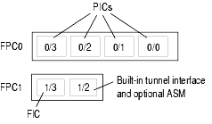
PIC Slot Numbers
0
M40e/M320—Numbered from top to bottom
1
2
3
M7i/M10i—Numbered from right to left
3
2
1
0

Slide 125
Port Numbering
M40e/M320
  Top to bottom
  Right to left
2
0
3
1
M7i/M10i
  Right to left
  Bottom to top
3
2
1
0

Slide 126
Logical Units
Logical units are like sub-interfaces in other equipment
  Except in JUNOS software, a logical unit is always required
    Also used to support multipoint technologies like Frame Relay, ATM, or VLANs
  Interface unit number is separate in meaning from the actual circuit identifier; can be any arbitrary value
    Suggested convention is to keep them the same
PPP/HDLC encapsulations support only one logical unit
  Must config unit unmber as zero for these encapsulations
Multiple protocol addresses are supported on a single logical unit
so-5/2/3.43

Slide 127
Configure Interfaces
Standard configuration statement hierarchy
  interfaces {
  interface-name {
  physical-properties;
  […]
  unit unit-number {
  logical-properties;
  […]
  }
  }
  }
Physic properties are configured at the device level
Logical properties are configured at the logical unit level

Slide 128
Interfaces Properties
Physical properties
  Clocking
  Scrambling
  Frame check sequence (FCS)
  Maximum transmission unit (MTU)
  Keepalives
  Other link characteristics
Logical properties
  Protocol family (Internet, ISO, MPLS)
  Addresses (IP address, ISO NET address)
  Virtual circuits (VCI/VPI, DLCI)
  Other characteristics

Slide 129
Configure Physical Properties
Configure physical properties of the interface using the set command from the [edit] hierarchy:
  [edit]
  jeff@host# set interface ge-1/0/3 vlan-tagging
  [edit]
  jeff@host# set interface ge-1/0/3 mtu ?
  Possible completions:
  <mtu> Maximum transmit packet size (256..9192)
Or, park yourself in the interfaces section of the hierarchy and set many options
  jeff@host> configure
  [edit]
  jeff@host# edit interfaces ge-1/0/3
  [edit interfaces ge-1/0/3]
  jeff@host# set vlan-tagging
  [edit interfaces ge-1/0/3]
  jeff@host# commit

Slide 130
Logical Interface Settings
Logical settings
  Protocol family (Internet, ISO, MPLS)
    Protocol MTU
    IP address
    Other protocol options
  Virtual circuit identifiers (VCI.VPI DLCI)
  Other according to circuit characteristics

Slide 131
Configure Logical Properties
Using the set command to configure a logical interface using the unit number:
  [edit]
  jeff@host# set interface ge-1/0/3 unit 40 vlan-id 40
Or park yourself at the unit level:
  jeff@host> configure
  [edit]
  jeff@host# edit interfaces ge-1/0/3 unit 40
  [edit interfaces ge-1/0/3 unit 40]
  jeff@host# set vlan-id 40
  [edit interfaces ge-1/0/3 unit 40]
  jeff@host# commit

Slide 132
Configure Protocol Families
Each major protocol is called a family
  Multiple families can live on one logical interface
  Internet protocol has TCP, UDP, and ICMP as family members
Supported protocol families are:
  IP (inet)
  IPv6 (inet6)
  International Standards Organization (iso)
  Traffic engineering (mpls)
Internet protocol family (inet) Allows you to set
  IP address: address A.B.C.D/prefix_length
  MTU size: mtu bytes

Slide 133
Protocol Family Example
Sample configuration for the inet family:
  jeff@host> configure
  [edit]
  jeff@host# edit interfaces ge-1/0/3
  [edit interfaces ge-1/0/3]
  jeff@host# set unit 0 family inet address 1.1.1.1/24
Display as:
  [edit interfaces ge-1/0/3]
  jeff@host# show
  unit 0 {
  family inet {
  address 1.1.1.1/24;
  }
  }
  Use display set to convert configuration stanza to set commands
  [edit interfaces ge-1/0/3]
  jeff@host# show | display set
  set unit 0 family inet address 1.1.1.1/24

Slide 134
Disabling and Deactivating
Use deactive to cause the related stanza to be ignored
  [edit]
  jeff@host# deactivate interfaces ge-0/1/2
  [edit]
  jeff@host# show interfaces ge-0/1/2
  ##
  ## inactive: interfaces ge-0/1/2
  ##
  unit 0 {
  family inet {
  address 10.0.12.1/24;
  }
  }
Setting an interface or logical unit to disable signals JUNOS software to treat that interface as administratively down
  [edit]
  jeff@host# set interfaces ge-0/1/2 disable
  [edit]
  jeff@host# show interfaces ge-0/1/2
  disable;
  unit 0 {
  family inet {
  address 10.0.12.1/24;
  }
  }

Slide 135
Initial Configuration Check List
The following items are normally configured at initial system installation:
  Root password
  Host name
  Domain name and DNS server address
  System logging
  Out-of-band management interface
  Default and backup routers for management network
  Configure system services for remote access
  User accounts
  System time
  Loopback and transient interfaces
  Remaining configuration needed to place the router into service (protocols, firewall filters, etc.)

Slide 136
Initial Configuration (1 of 6)
Amnesiac indicates a factory default configuration
Log in as root
  [...]
  Amnesiac (ttyd0)
  login: root
  --- JUNOS 8.5R4.3 built 2008-08-12 23:16:55 UTC
  root%
Start CLI
  root% cli
  root>
Enter configuration mode
  root> configure
  [edit]
  root#
Configure root password
  Plain text
  root# set system root-authentication plain-text-password
  Pre-encrypted password
  root# set system root-authentication encrypted-password encrypted
  Secure shell (SSH) key
  root# set system root-authentication ssh-rsa key
Do not enter a clear text password in this mode!

Slide 137
Initial Configuration (2 of 6)
Configure router name
  [edit]
  root# set system host-name host
Configure router domain name
  [edit]
  root# set system domain-name host.test.com
Configure name server address
  [edit]
  root# set system name-server ns-address
Commit changes so far
  [edit]
  root# commit
  Commit complete
  [edit]
  root@host#
Note host name takes effect after the commit

Slide 138
Initial Configuration (3 of 6)
Configure management interface IP address and prefix
  [edit]
  root@host# set interface fxp0 unit 0 family inet address ip-address/prefix-length
Define a back up router
  Used when routing daemon is not running
  Required when using redundant Routing Engines
  [edit]
  root@host# set system backup-router gateway-address
Define static route for OoB management network
  [edit]
  root@host# set routing-options static route ip-address/prefix-length next-hop OoB-next-hop-address no-readvertise

Slide 139
Initial Configuration (4 of 6)
Configure system services for remote access
  [edit]
  root@host# set system services ssh
  [edit]
  root@host# set system services telnet
Configure
  Use predefined login classes, or create your own
  [edit system login]
  root@host# show
  user op {
  full-name “The OP”;
  uid 2003;
  class super-user;
  authentication {
  encrypted-password “$1$KIlji3eh$n4n66p37q1IUrrOh.7rbM/"; ## SECRET-DATA
  }
  }
The user Id is created automatically when not explicit configured

Slide 140
Initial Configuration (5 of 6)
Configure time zone and manually set the time of day
  Configure time zone:
  [edit]
  root@host# set system time-zone Asia/Taipei
  Set date and time manually
  root@host> set date?
  Possible completions:
  <time> New date and time (YYYYMMDDhhmm.ss)
  ntp Set system date and time using Network Time Protocol servers
  root@host> set date 200906182340
  Thu Jun 18 23:40:00 GMT+8 2009
Or, configure NTP
  [edit]
  root@host# set system ntp server 220.130.158.52

Slide 141
Initial Configuration (6 of 6)
Configure loopback and transient interfaces
  [edit interface]
  root@host# set lo0 unit 0 family inet address 10.0.0.1
  [edit]
  root@host# set ge-0/2/0 unit 0 family inet address 10.0.12.1/24
Configure remaining items required to place the router into service
  Routing protocols (OSPF, IS-IS, BGP, PIM, etc)
  Routing policies
  Firewall filters to secure the local router and possible attached devices
Loopback interface must use a /32

Slide 142
Basic System Configuration Sample
[edit] edit system
[edit system] set host-name hostx
[edit system] set time-zone Asia/Taipei
[edit system] set domain-name abc.com
[edit system] set name server 168.95.1.1
[edit system] set ntp server 220.130.158.52
[edit system] set authentication-order radius
[edit system] set login user lab class super-user authentication
plain-text-password [Enter] lab123
[edit system] set services telnet
[edit system] set syslog file lab-log interactive-commands any
[edit system] top
[edit] set chassis alarm management-ethernet link-down ignore
[edit] set snmp community public authorization read-only
[edit] commit

Slide 143
Basic Interface Configuration Sample
[edit] edit chassis
[edit chassis] set aggregated-devices ethernet device-count 6
[edit chassis] top
[edit] edit interfaces
[edit interfaces]
set ge-3/0/6 description "##CL9999999##"
set ge-3/0/6 gigether-options 802.3ad ae2
set ge-3/0/7 description "##CL9999999##"
set ge-3/0/7 gigether-options 802.3ad ae2
set ae2 description "##CL9999999##"
set ae2 unit 0 family inet address 4.3.2.1/30
[edit interfaces] top
[edit] edit logical-routers r1 interfaces
[edit logical-routers r1 interfaces]
set ge-1/3/0 unit 21 vlan-id 21 family inet address 10.0.5.1/24 vrrp-group 1 virtual-address 10.0.5.200 priority 110 track interface ge-1/3/0.13 priority-cost 30

Slide 144
Logical Router
Overview

Slide 145
Logical Routers - Design
Up to 16 LRs supported
(includes the default router: “lr-0”)
Independent routing planes
Isolated with separate processes & memory space
Security / Filtering
Interface Mgmt
CoS/QoS, Diffserv, TE
Chassis Mgmt
rpd “lr-1”
rpd “lr-15”
SNMP, CLI, XML API
default rpd “lr-0”
Traffic Engineering
Operating System Kernel
IPv4 / IPv6 Stack

Slide 146
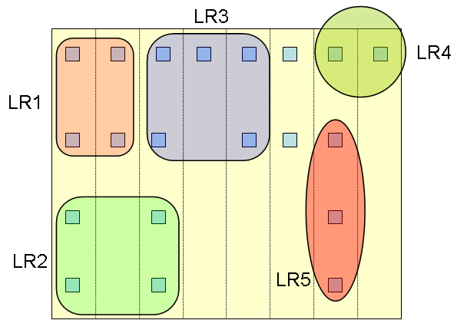
Logical Router - Concept

Slide 147
Logical Routers – Configuration & Operation
Create Logical Router:
  [edit]
  user@host# set logical-router lrx
In configuration mode, move to Logical Router level. The hierarchy prompt appears as:
  [edit]
  user@host# edit logical-router lrx
  [edit logical-routers lrx]
  user@host# set ?
  Possible completions:
  ……
  > interfaces
  > policy-options
  > protocols
  > routing-options
  ……
  [edit logical-routers lrx]
  user@host# top
  [edit]
  user@host#
Change operation view to Logical Router. The LR name string is added as a suffix to the prompt:
  user@host> set cli logical-router lrx
  Logical router: lrx
  user@host:lrx> configure
  [edit]
  user@host:lrx#
Change operation view back to Default Router:
  user@host> set cli logical-router lrx
  Logical router: lrx
  user@host:lrx> clear cli logical-router
  user@host>
All edits by LR do not effect the main configuration

Slide 148
Routing Policy

Slide 149
Agenda: Routing Policy
Policy overview
Import vs. export policies
Routing policy syntax
Default policies
Route filters and match types
Monitoring policy operation

Slide 150
Policy Overview
Controls routing information transferred into and out of the routing table
  Can ignore or change incoming routing information
  Can suppress or change outgoing routing information
Policies are made up of match/action pairs
  Match conditions can be protocol specific

Slide 151
When to apply policy
Apply policy when:
  You do not want to import all learned routes into the routing table
  You do not want to advertise all learned routes to neighboring routers
  You want one protocol to receive routes from another protocol
  You want to modify information (attribute) associated with a route

Slide 152
Import and Export
Policy filtering is done with respect to the JUNOS routing table
Export policy is applied to active paths in routing table
Neighbors
Neighbors
Import Policy #1
Routing
Table
Export Policy #1
Routes
Routes
Import Policy #2
Export Policy #2
Protocol
Route Selection
Policy
Protocol
PFE
Forwarding
Table

Slide 153
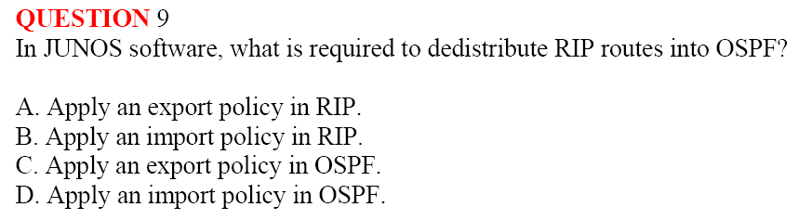
Import and Export
Policy filtering is done with respect to the JUNOS routing table
Export policy is applied to active paths in routing table
Neighbors
Neighbors
Import Policy #1
Routing
Table
Export Policy #1
Routes
Routes
Import Policy #2
Export Policy #2
Protocol
Route Selection
Policy
Protocol
PFE
Forwarding
Table

Slide 154
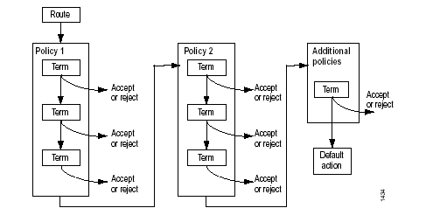
Routing Policy Flow
Policy con be chained together
Evaluation normally proceeds left to right until a terminating action is reached
  Terminating actions are accept or reject
Individual policies can contain a collection of terms
  Flow control actions such as next-policy supported

Slide 155
Generic Policy Syntax
Basic policy syntax:
policy-options {
policy-statement policy-name {
term term-name {
from {
match-conditions;
}
then {
action;
}
}
final-action;
}
}
A policy
can have multiple terms

Slide 156
Match Conditions
Policies typically contain some form of match criterion
Possibilities include:
  Neighbor address
  Protocol (source of information)
    BGP, direct, IS-IS, local, MPLS, OSPF, PIM, RIP, static, etc.
  Routing protocol information
    OSPF area ID
    IS-IS level number
    BGP attributes
  Regular expression-based matched for AS path and communities

Slide 157
Match Actions
The action associated with a given term/policy is performed for matching routes:
  Terminating actions
    Accept route
    Reject (or suppress) route
  Flow control actions
    Skip to next policy
    Skip to next term
  Modify attributes actions
    Metric
    Preference
    Color
    Next-hop address

Slide 158
Applying Policies
Apply Routing Policies to Routing Protocols
BGP
  Global import and export statements
  Group import and export statements
  Peer import statements (peers in a group share a common export policy)
IS-IS
  Global export statement.
OSPF
  Global export statement.
RIP
  Default and neighbor import statements and group export statement

Slide 159
Applying Policies
Most routing protocols have global import and export filtering points
Link-state protocols (IS-IS and OSPF) have only export filtering points
  protocols {
  isis {
  export [ policy-list ];
  }
  ospf {
  export [ policy-list ];
  }
  bgp {
  export [ policy-list ];
  import [ policy-list ];
  }
  }
Notes:
To apply routing policies to a routing protocol, include the import and export statements when configuring the routing protocol at the [edit protocols protocol-name] hierarchy level:
import [ policy-names ];
export [ policy-names ];
You can specify the names of one or more routing policies in each of these statements. Policies are evaluated in the order you specify them in the import and export statements; that is, from left to right. The terms within each policy are evaluated in order, from first to last. The first matching policy is applied to the route. If the policy action contains an accept or reject control action, no more policy terms or policies are evaluated. If you do not specify accept or reject and if there are more terms in the policy, the next term is evaluated. If there are no further terms in the current policy, the next policy is evaluated.
In the import statement, you list the names of policies to be evaluated when routes are imported into the routing table from the routing protocol. You can define one or more import policies. If no match for a route is found, the default action is for the routing table to import the route.
In the export statement, you list the name of policies to be evaluated when routes are being exported from the routing table into a dynamic routing protocol. Only active routes are exported from the routing table. You can define one or more export policies. If no match for a route is found, all protocols export the routes that were learned from that same protocol. In addition, IGPs export the set of direct routes matching the interfaces on which they are explicitly configured.

Slide 160
Default policies
Every protocol has a default policy
  The default policy is applied implicitly at the end of the policy chain
IS-IS and OSPF
  Import: Accept all routes learned from that protocol
    Technically, accept all LSPs/LSAs flooded by that protocol
  Export: Reject everything
    LSP/LSA flooding announces (IS-IS/OSPF) learned and local routes
RIP
  Import all learned RIP routes, export nothing
    RIP requires export policy to announce RIP (or other) routes
BGP
  Import all routes learned from BGP neighbors
  Export all active routes learned from BGP neighbors to all BGP neighbors
    EBGP-learned routes are exported to all BGP peers
    IBGP-learned routes are exported to all EBGP peers (assumes IBGP full mesh)

Slide 161
A Policy Example
Write a policy statement at the [edit policy-options] hierarchy:
  [edit policy-options]
  jeff@host# show policy-statement advertise-ospf
  term pick-ospf {
  from protocol ospf;
  then accept;
  }
Apply the policy to one or more routing protocol in the import, export, or both directions:
  [edit protocols bgp]
  jeff@host# set export advertise-ospf

Slide 162
Another Policy Example
Specifying multiple conditions in a from statement means that all criteria must match before the action is taken
  [edit]
  jeff@host# show policy-options
  policy-statement isis-level2 {
  term find-level2-routes {
  from {
  protocol isis;
  level 2;
  }
  then accept;
  }
  }
Logical AND function

Slide 163
Applying Policy
You must apply policies before they can take effect
Link-state protocols (IS-IS and OSPF) have only export filtering points
BGP and RIP support both import and export policies
  [edit protocols]
  jeff@host# show
  bgp {
  import bgp-import;
  export bgp-export;
  }
  ospf {
  export red-static;
  }

Slide 164
Apply Routing Policy to BGP
BGP has three filtering point per direction:
  Global
  Groups of neighbors
  Individual neighbors
Only the most specific policies are applied to a particular peer
  Neighbor policy overrides group and global policies
  Group policy overrides global policy

Slide 165
BGP Policy Application Example
protocols {
bgp {
export local-customers;
group meganet-inc {
type external;
peer-as 47;
import [ martian-filter long-prefix-filter as-47-filter ];
neighbor 1.2.2.4;
neighbor 1.2.2.5;
}
group problem-child {
type external;
peer-as 54;
export kill-private-addresses;
import [ as-47-filter long-prefix-filter martian-filter ];
neighbor 1.2.2.6;
neighbor 1.2.2.7;
neighbor 1.2.2.8 {
import [ reject-unwanted as-666-routes ];
}
}
}
}

Slide 166
Useful JUNOS software Commands
Configure Multiple Policies
[edit protocol protocol-name]
user@host# set export [ policy-name1 policy-name2 ]
insert
[edit protocol protocol-name]
user@host# insert export policy-name1 before|after policy-name2
rename
[edit policy-options]
user@host# rename policy-statement policy-name1 to policy-statement policy-name2
[edit policy-options policy-statement policy-name]
user@host# rename term term-name1 to term term-name2

Slide 167
Route Filters
Use route filters to match an individual route (or groups of routes)
  You can specify multiple route filters within a single term
  General syntax in the form of:
  term term-name {
    from {
      route-filter prefix/prefix-length match-type <actions>;
    }
    <then actions>;
  }
Route filter evaluation has special rules according to the match type
  Evaluation of route filters has special rules
  Match types specify different sets of routes:
  Exact, orlonger, longer, upto, through, prefix-length-range

Slide 168
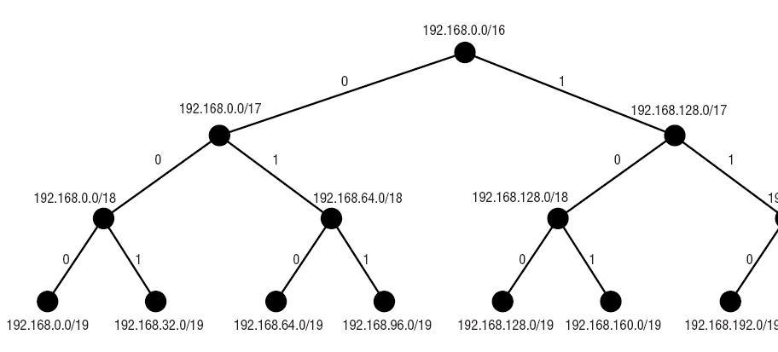
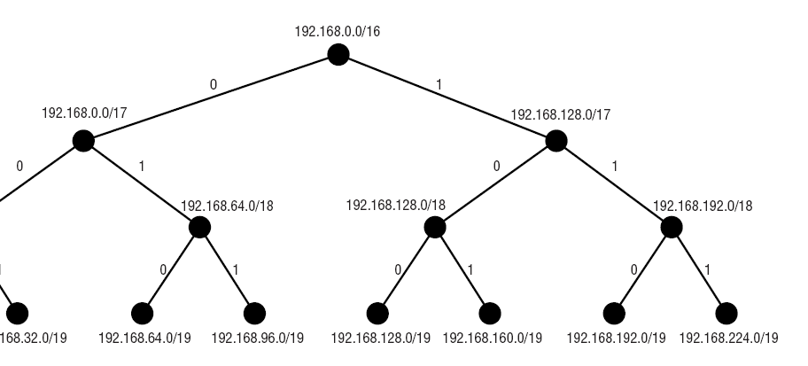
Portion of the radix tree

Slide 169
Match Types—exact
Exactly match a single prefix and prefix length
term sample {
    from route-filter 192.168/16 exact;
    then accept;
  }
Includes
192.168.0.0/16
Excludes
Everything else

Slide 170
Match Types—orlonger
Greater than or equal to
Match a range of routes having the
most-significant bits in common as described by the prefix length
term sample {
    from route-filter 192.168/16 orlonger;
    then accept;
  }
Includes
192.168.0.0/16 192.168.12.4/30
192.168.0.0/17 192.168.12.128/32
192.168.4.0/24
Excludes
192.0.0.0/8 192.169.1.0/24
192.170.0.0/16

Slide 171
Match Types—longer
Match a range of routes having the
most-significant bits in common as described by the prefix length, except the exact match
Greater than
term sample {
    from route-filter 192.168/16 longer;
    then accept;
  }
Includes
192.168.12.4/30
192.168.0.0/17 192.168.12.128/32
192.168.4.0/24
Excludes
192.0.0.0/8 192.169.1.0/24
192.170.0.0/16 192.168.0.0/16

Slide 172
Match Types—upto
Match a range of routes having the
most-significant bits in common as described by the first prefix length, but not exceeding the second prefix length
term sample {
    from route-filter 192.168/16 upto /24;
    then accept;
  }
Includes
192.168.0.0/16
192.168.0.0/17
192.168.4.0/24
Excludes
192.0.0.0/8 192.169.1.0/24
192.170.0.0/16 192.168.5.4/30
192.168.12.128/32

Slide 173
Match Types—through
Match the first specified prefix and mask exactly
Match the second specified prefix and mask exactly
Match all prefixes directly between the two prefixes
term sample {
    from route-filter 192.168/16 through 192.168.16/20;
  }
Includes
192.168.0.0/16
192.168.0.0/17 192.168.0.0/19
192.168.0.0/18 192.168.16.0/20
Excludes
Everything else

Slide 174
Match Types—prefix-length-range
Match only routes that start with the same prefix and have a mask between the two values specified (inclusive match)
term sample {
    from route-filter 192.168/16 prefix-length-range /20-/24;
  }
Includes
192.168.0.0/20
192.168.64.0/21
192.168.128.0/24
Excludes
10.0.0.0/16
192.167.0.0/17 200.123.45.0/24
192.168.128.0/18 192.168.24.89/32

Slide 175
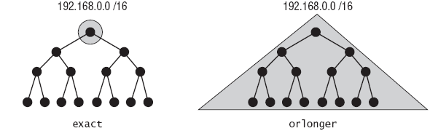
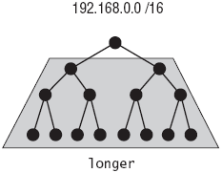
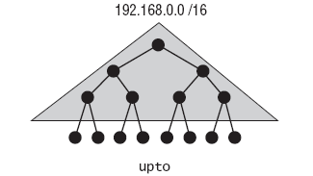
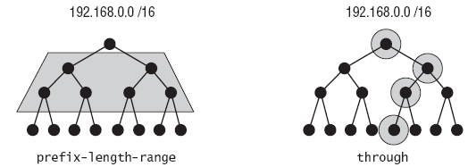
Match types summary
Given a starting prefix of 192.168/16, what matches with each option?

Slide 176
Route Filter Actions
term term-name {
from {
route-filter dest-prefix match-type <actions>;
route-filter dest-prefix match-type <actions>;
route-filter dest-prefix match-type <actions>;
[…]
}
<then actions>;
}
Only one route filter in al given term can be considered a match
  Longest-match lookup is performed on the prefix being evaluated
If an action is specified to a route filter, it takes effect immediately
  The global then portion of the term is ignored
    If specific actions are not defined, the then portion of the term is executed for matching prefixes
Longest-
Match
Lookup

Slide 177
Test Your Knowledge (1 of 2)
Which action is taken when 10.0.67.43/32 is evaluated by this policy?
  policy-statement pop-quiz {
  from {
  route-filter 10.0.0.0/16 orlonger accept;
  route-filter 10.0.67.0/24 orlonger;
  route-filter 10.0.0.0/8 orlonger reject;
  }
  then {
  metric 10;
  accept;
  }
  }

Slide 178
Test Your Knowledge (2 of 2)
Which action is taken when 10.0.55.2/32 is evaluated by this policy?
  policy-statement pop-quiz {
  from {
  route-filter 10.0.0.0/16 orlonger accept;
  route-filter 10.0.67.0/24 orlonger;
  route-filter 10.0.0.0/8 orlonger reject;
  }
  then {
  metric 10;
  accept;
  }
  }

Slide 179
Monitoring policy operation
The show route receive-protocol and show route advertising-protocol commands:
  Display routing updates received before import and after export policy processing, respectively
Import
Policy
Export
Policy
Neighbors
Neighbors
Routes
Routing
Table
Routes
Protocol
Protocol
show route receive-protocol bgp neighbor
Show routes before import policy
show route advertising-protocol bgp neighbor
Show routes after export policy

Slide 180
Routing Protocol

Slide 181
Routing Tables
JUNOS have five default routing tables:
inet.0 for unicast routes
inet.1 for the multicast forwarding cache
inet.2 for MBGP routes for Reverse Path Forwarding(RPF)
inet.3 for Multiprotocol Label Switching (MPLS)
mpls.0 for MPLS label switching

Slide 182
Routing Table Protocols
Within JUNOS software, there are many sources of routing information
  Referred to as protocols in the routing table
Default protocols are:
  Direct
  Local
  Static
  RSVP
  LDP
  OSPF
  IS-IS
  RIP
  Aggregate
  BGP

Slide 183
Protocol Preference
Each protocol has a default preference value
Preference is a measure of desirability
  Used as a tie‑breaker
  Protocols with a lower preference are preferred
Used when the same prefix is installed in the routing table by multiple protocols
Default preference values are:
  Direct = 0
  Local = 0
  Static = 5
  RSVP = 7
  LDP = 9
  OSPF = 10
  ISIS = 15
  RIP = 100
  Aggregate = 130
  BGP = 170

Slide 184
The Main Routing Table; inet.0
user@host> show route
inet.0: 49 destinations, 49 routes (49 active, 0 holddown, 0
hidden)
+ = Active Route, ‑ = Last Active, Both
10.0.11.0/24 *[Direct/0] 1d 08:19:20
> via at‑0/l/0.100
10.0.11.1/32 *[Local/0] 1d 08:19:20
Local
192.168.1.0/24 *[BGP/170] 00:06:08, localpref 100
AS path: I I
> to 10.0.11.2 via at‑0/l/0.100
192.168.16.0/21 *[Static/5] 00:02:40
Discard
[Aggregate/130] 00:36:17
Reject
192.168.20.0/24 *[Static/5] 00:06:12
Reject

Slide 185
Static Routes
Manually configured routes added to the routing table
Once active, remain in the routing table until deleted
Configured at the routing‑options hierarchy level
[edit]
routing‑options {
static {
defaults {
static‑options;
}
route destination‑prefix {
next‑hop;
static‑options;
}
}

Slide 186
Static Route Configuration
Static routes require a next‑hop to be configured
  Valid options are IP address, Discard, and Reject
Defaults section affects all static routes
Qualified‑next‑hop option allows independent preference for static routes to the same destination
routing‑options
static {
defaults {
preference 250;
}
route 192.168.20.0/24 next‑hop 10.0.0.1;
route 192.168.21.0/24 discard;
route 192.168.22.0/24 reject;
}
}

Slide 187
Load Balancing
The JUNOS Software default is to randomly choose one of the multiple equal‑cost paths to a destination
The next‑hop address for that path is installed into the forwarding table
This default can be changed to allow multiple next‑hop addresses into the forwarding table
Load balancing functions vary, according to the version of the Internet Protocol ASIC in the router
  Internet Processor I ASIC, traffic is forwarded per‑packet in a round‑robin fashion among the multiple next hops
  Internet Processor II ASIC, traffic is forwarded based on individual traffic flows; packets for each individual flow are kept on a single interface

Slide 188
Load Balancing Example
Create a policy that instructs the IP ASIC to load balance traffic
Apply that policy to the forwarding table within routing‑options
[edit]
routing‑options {
forwarding‑table {
export please‑load‑balance;
}
policy‑options {
policy‑statement please‑load‑balance {
term balance {
then {
load‑balance per‑packet;
}
}

Slide 189
OSPF

Slide 190
Link-State Protocols
Also known as shortest path, Dijkstra Algorithm
Algorithm based on graph theory, providing better loop avoidance
Local computation means faster convergence
Link-state protocols include
  OSPF
  IS-IS
  ATM PNNI
  IBM APPN
  MPLS CSPF

Slide 191
Fundamental Link-state Concepts
Adjacency
Information flooding
Link-state database
SPF calculation

Slide 192

SPF Calculation Example
Example Topology
Link-state Database
R2
R1-R2, 1
R1-R5, 2
R2-R1, 2
R2-R3, 1
R2-R4, 2
R3-R2, 3
R3-R4, 2
R4-R2, 4
R4-R3, 4
R4-R5, 4
R4-R6, 2
R5-R1, 3
R5-R4, 5
R5-R6, 3
R6-R4, 1
R6-R5, 2
2
1
R1
2
1
R3
3
2
2
R4
3
R5
4
5
4
4
3
2
R6
2
1

Slide 193
SPF Calculation Example
Loop-free, lowest-cost path to every node
R2
2
1
R1
2
R3
Path
1
3
2
R2-R2, 0
2
R2-R3, 1
R4
R2-R1, 2
3
R5
4
R2-R4, 2
5
4
4
R1-R5, 4
3
2
R4-R6, 4
R6
2
1

Slide 194
OSPF Protocol Review
OSPF is a link‑state IGP that routes packets within a single AS
OSPF reliably floods LSAs to distribute link‑state information once an adjacency is formed
Each router uses these LSAs to create a complete database for the network
OSPF uses the SPF algorithm within the database to calculate the best route to every node in the network
OSPF is defined in:
  RFC 2328, OSPF Version 2
  RFC 1587, The OSPF NSSA Option

Slide 195
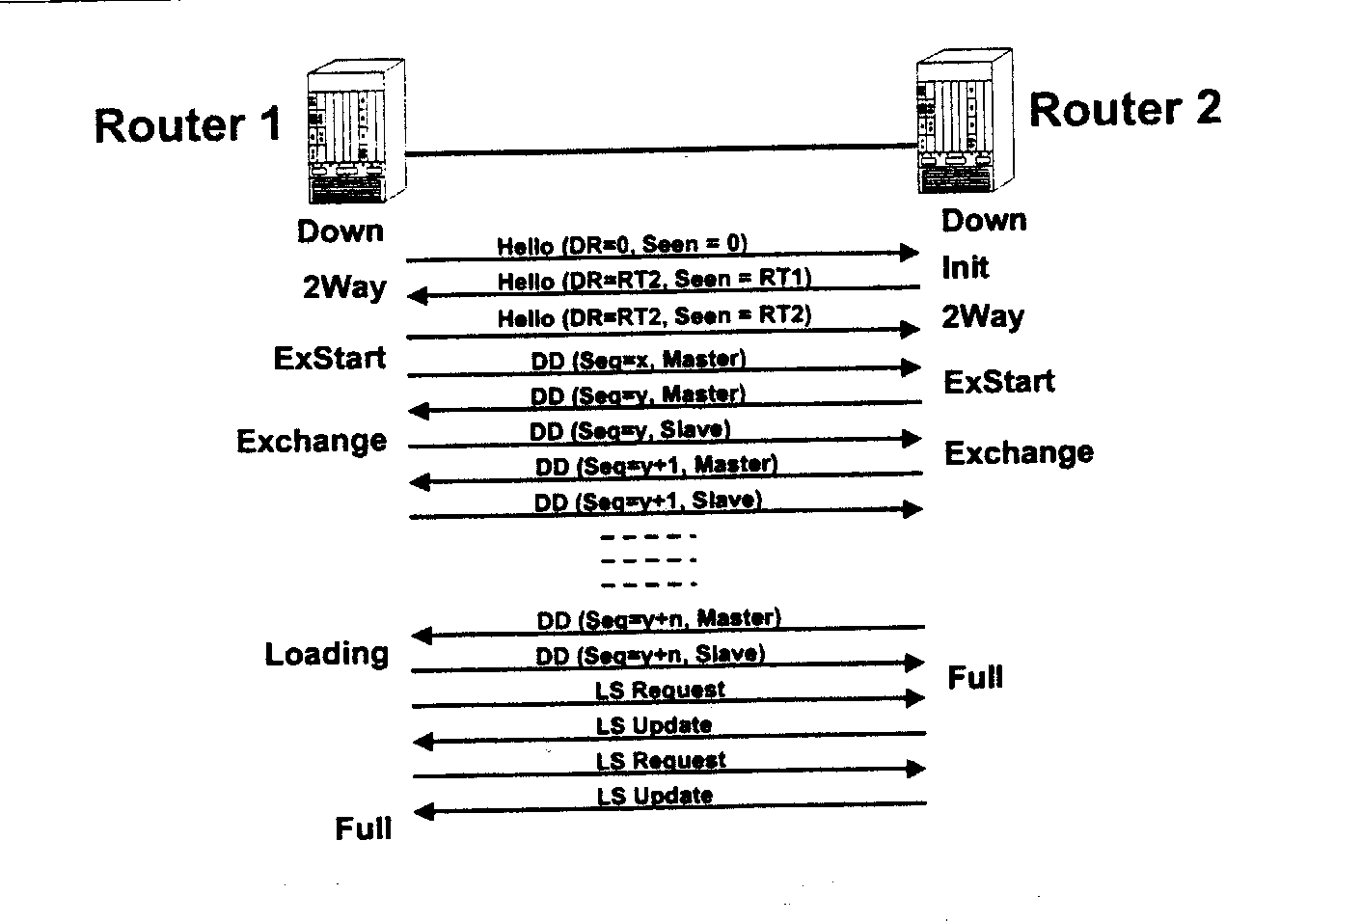
Adjacency Formation

Slide 196
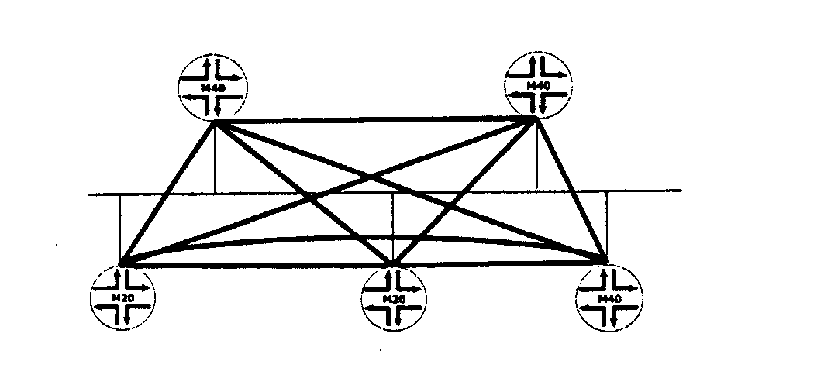
Adjacency Optimization: The DR
By default, OSPF will attempt to form an adjacency with all neighbors discovered on all interfaces
On a broadcast media like Ethernet, this is sub‑optimal
  Would require a "full‑mesh" of adjacencies

Slide 197
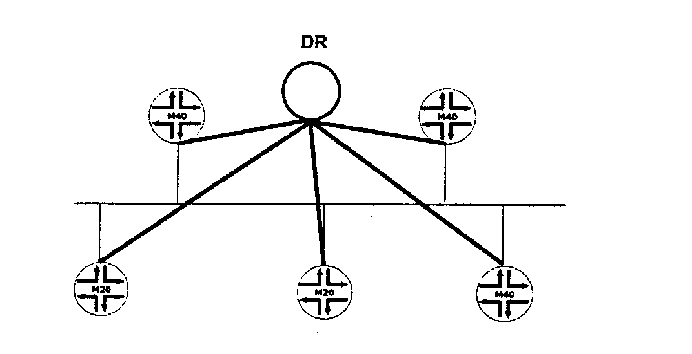
Adjacency Optimization: The DR (cont)
A single router is elected to represent the segment
Significantly reduce OSPF traffic on segment
Minimize OSPF processes (or something)

Slide 198
Designated Router Election
Every OSPF router has a DR election priority
  Range is 0‑255
  JUNOS Software default is 128
Priority is the first tie‑breaker in a DR election
If 2 routers share the highest priority, the router with the highest router ID (RID) is elected
The election of a DR is a non‑deterministic event
  An existing DR will not be replaced
  First router on the segment within 40 seconds wins

Slide 199
Backup Designated Router
If a DR fails, a new DR needs to be elected
  The default 40‑second wait time means the segment is unreachable within that period
To ease the transition, a backup designated router (BDR) is elected on every segment
The BDR watches and waits for a DR failure
Election rules are the same as for the DR

Slide 200
OSPF Neighbors vs. Adjacencies
user@host> show ospf neighbor extensive
Address Intf State ID Pri Dead
l72.16.30.254 ge‑0/0/0.0 Full 10.250.240.8 12 30
area 0.0.0.5, opt 0x42, DR 172.16.30.254, BDR 172.16.30.253
Up 00:10:50, adjacent 00:10:50
172.16.30.253 qe‑0/0/0.0 Full 10.250.240.35 128 30
area 0.0.0.5, opt 0x42, DR 172.16.30.254, BDR 172.16.30.253
Up 00:10:50, adjacent 00:10:52
172.16.30.252 ge‑0/0/0.0 2Way 10.250.240.32 64 38
area 0.0.0.5, opt 0x42, DR 172.16.30.254, BDR 172.16.30.253
Up 00:08:10

Slide 201
OSPF Packet Types
OSPF systems send five types of packets:
  Hello packets (Type 1)
  Database description packets (Type 2)
  Link‑state request packets (Type 3)
  Link‑state update packets (Type 4)
  Link‑state acknowledgment packets (Type 5)
Link‑state advertisements are reliably flooded via:
  Link‑state requests
  Link‑state updates
  Link‑state acknowledgments

Slide 202
OSPF Hello Packets
Routers periodically send multicast Hello packets out all OSPF interfaces, to establish and maintain neighbor relationships
Sent to 224.0.0.5 ‑ All OSPF Routers
Hello packets consist of the OSPF header plus:
  Network mask
  Hello interval
  Options
  Router priority
  Router dead interval
  Designated router
  Backup designated router
  Neighbor

Slide 203
Database Description Packets
Exchanged during adjacency formation
Determine which router will be in charge of the database exchange
Describe the contents of the link‑state database
Consist of:
  OSPF header
  Sequence
  LSA header

Slide 204
Link‑State Request Packets
Sent when router detects database is stale
Request precise version of database
Consist of:
  OSPF header
  Database information

Slide 205
Link‑State Update Packets
Carry one or more link‑state advertisements (LSAs)
Multicast on physical networks that support multicast or broadcast mode
  224.0.0.5 (All OSPF Routers) or 224.0.0.6 (All DR Routers)
All received link‑state updates are acknowledged
  Retransmissions are sent unicast
Consist of:
  OSPF header
  Number of advertisements
  Link‑state advertisements

Slide 206
Link‑State Acknowledgment Packets
Sent in response to link‑state update packets
Acknowledge successful receipt of the update packets
Can include responses to multiple update packets
Consist of:
  OSPF header
  Link‑state advertisement header

Slide 207
The Link State Database
Every router in an OSPF network maintains a copy
  LSD on all routers must match within an area
Made up of received link‑state advertisements
Contains all known information
Shortest‑path first (SPF) algorithm uses the LSD as input data to calculate network paths

Slide 208

LSA Packet Types
The Link-State Database consists of various of LSA types
      Type LSA
      1 Router LSA
      2 Network LSA
      3 Network Summary LSA
      4 ASBR Summary LSA
      5 AS External LSA
      6 Group Membership LSA
      7 Not-so-stubby Area LSA
      8 External Attributes LSA
      9-11 Opaque LSAs

Slide 209
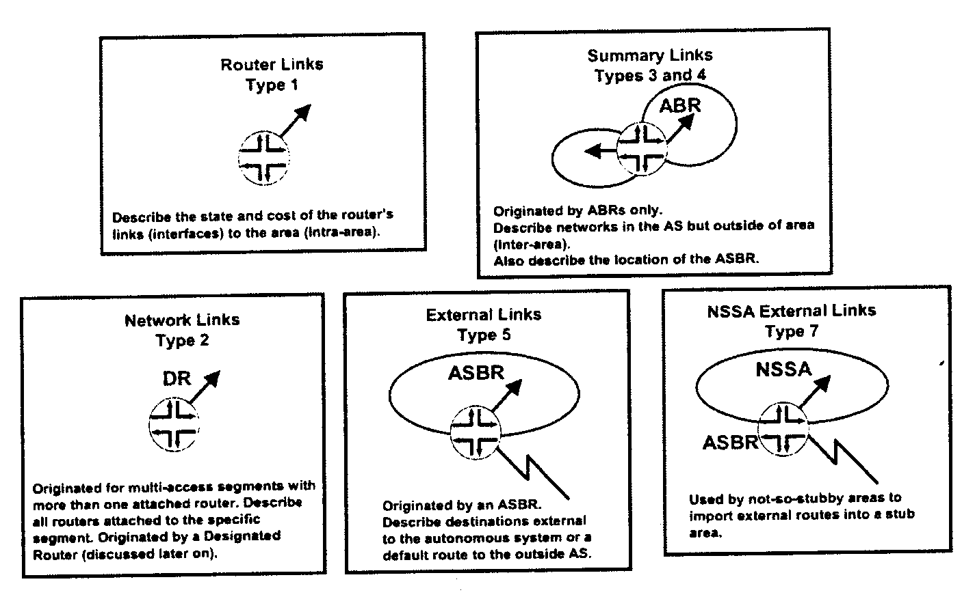
LSA Packet Types

Slide 210
OSPF Scalability
Every router must flood LSAs and maintain an identical LSD
  As more routers are added to the network, these requirements place a load on the protocol
  Resources are spent constantly flooding new information and rerunning the SPF calculation
Solution is to shrink the size of the LSD
  Hierarchy in the network is needed
  OSPF areas are created

Slide 211
OSPF Areas
Areas
  Single AS can be divided into smaller groups called areas
  This reduces the LSD because LSA flooding is now constrained to the area
  Routers maintain a separate LSD on a per‑area basis
  Each LSD within an area must still be identical on all routers
There is a special OSPF area called the backbone area
  Backbone area (0.0.0.0) distributes routing information between areas
  All other OSPF areas must connect to the backbone area
  All user traffic from one area to another must traverse the backbone

Slide 212
OSPF Router Terminology
Internal router has all OSPF links in the same area
  Within area 0, called a backbone router
  Within a non‑backbone area, called an area router
Area border routers (ABRs)
  Routers that belong to more than one area are called area border routers
  Connect OSPF areas to the backbone area 0
Autonomous system boundary routers (ASBRs)
  Routers that inject routing information from outside the OSPF domain are called AS boundary routers

Slide 213
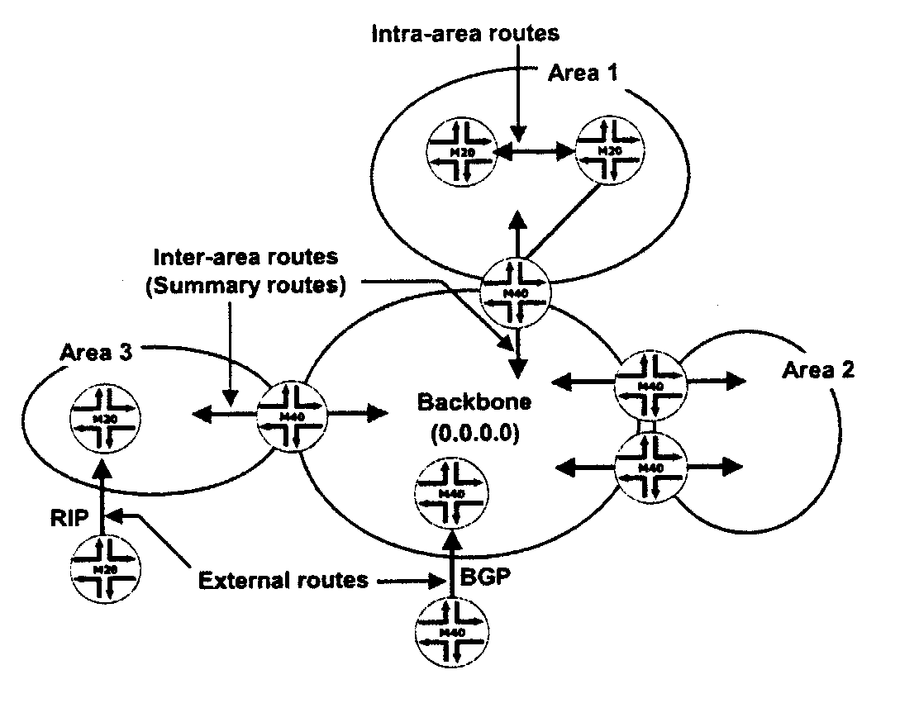
OSPF Area Relationships
ABR
ABR
ASBR
ABR
ASBR
ABR

Slide 214
OSPF Area Types
Stub areas
  Do not carry external routes
  Virtual links cannot be configured across
  Cannot contain ASBR
Totally stubby areas
  Stub area that only receives the default route from the backbone
Not‑so‑stubby areas
  Allows limited importing of external routes
Transit areas
  Used to pass traffic from one adjacent area to the backbone, or to another area if the backbone is more than two hops away from an area

Slide 215
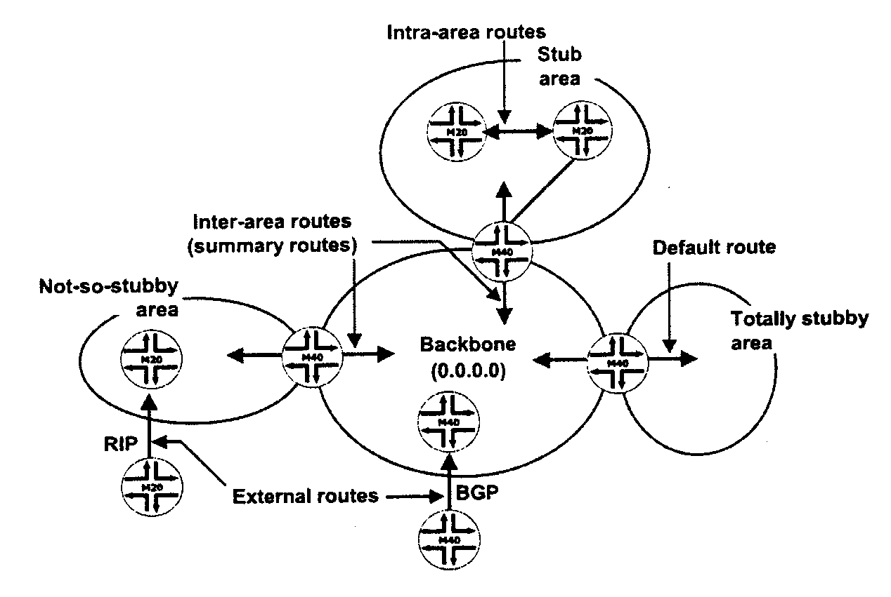
OSPF Area Types

Slide 216
Agenda: OSPF
JUNOS Software OSPF Support
OSPF configuration
OSPF monitoring and troubleshooting

Slide 217
JUNOS Software OSPF Support
OSPF Version 2, including:
  Virtual links
  Stub areas, not-so-stubby areas (NSSA), and totally stubby areas
  Authentication
  Summarization
  Traffic engineering (LSA Type 10 support)
  Graceful restart
  External prefix limits
  Interacts with Bidirectional Forwarding Detection for rapid convergence

Slide 218
Cisco Administrative Distance vs Juniper Networks Protocol Preference
Cisco
  Connected 0
  Static Route 1
  EBGP 20
  OSPF (all types) 110
  IS-IS (all types) 115
  RIP 120
  IBGP 200
Juniper
  Direct 0
  Static Route 5
  OSPF-Internal 10
  IS-IS Level 1 internal 15
  IS-IS Level 2 internal 18
  RIP 100
  OSPF External 150
  IS-IS Level 1 external 160
  IS-IS Level 2 external 165
  BGP 170

Slide 219
Configuring OSPF – Single Area
The minimum configuration needed for a single OSPF area network:
  [edit]
  jeff@host# set protocols ospf area 0 interface ge-0/0/0
  [edit]
  jeff@host# show protocols
  ospf {
  area 0.0.0.0 {
  interface ge-0/0/0.0;
  }
  }

Slide 220
Configuring OSPF – Multiple Area
Configuration a ABR:
  [edit]
  jeff@host# show protocols
  ospf {
  area 0.0.0.0 {
  interface ge-0/0/0.0;
  }
  }
  [edit]
  jeff@host# set protocols ospf area 1 interface xe-0/1/1.100 passive
  [edit]
  jeff@host# show protocols
  ospf {
  area 0.0.0.0 {
  interface ge-0/0/0.0;
  }
  area 0.0.0.1 {
  interface xe-0/1/1.100 {
  passive;
  }
  }
  }

Slide 221
Router ID selection
You can set RID manually under routing-option, although explicit configuration is not necessary
  JUNOS software uses the first non-127/8 address it finds as the RID
  lo0 is the first interface activated, so a non-127/8 configured here serves as the RID
    JUNOS software automatically advertises a stub route to the RID, so you do not need to run OSPF (passive or active) on the interface that sources the RID
  If JUNOS software does not find a suitable address on lo0, it examines the next interface activated (normally fxp0)
    fxp0 does not support transit traffic, so sourcing the RID from fxp0 can result in the inability to ping the RID
  [edit]
  jeff@host# set protocols ospf area 0 interface fxp0 disable

Slide 222
OSPF Monitoring and Troubleshooting
Various show commands exist to provide detailed information on the operation of OSPF
  show ospf interface
  show ospf neighbor
  show ospf routes
  show ospf database
OSPF tracing

Slide 223
Displaying OSPF Interface Parameters
Use show ospf interface to display the OSPF parameters associated with an interface
  jeff@host> show ospf interface ?
  Possible completions:
  <[Enter]> Execute this command
  brief Show brief status
  detail Show detailed status
  extensive Show extensive status
jeff@host> show ospf interface brief
Interface State Area DR ID BDR ID Nbrs
as1.0 Down 0.0.0.0 0.0.0.0 0.0.0.0 0
at-0/3/1.35 PtToPt 0.0.0.0 0.0.0.0 0.0.0.0 1
lo0.5 DRother 0.0.0.0 0.0.0.0 0.0.0.0 0
ge-0/2/0.57 BDR 0.0.0.20 10.0.9.7 10.0.3.5 1
ge-0/2/1.56 BDR 0.0.0.20 10.0.9.6 10.0.3.5 1

Slide 224
Displaying OSPF Adjacency Information
Use show ospf neighbor to display OSPF parameters adjacency information
  jeff@host> show ospf neighbor ?
  Possible completions:
  <[Enter]> Execute this command
  brief Show brief status
  detail Show detailed status
  extensive Show extensive status
jeff@host> show ospf neighbor
Address Interface State ID Pri Dead
10.0.2.2 at-0/3/1.35 Full 10.0.3.3 128 38
10.0.8.10 ge-0/2/0.57 Full 10.0.9.7 128 39
10.0.8.5 ge-0/2/1.56 Full 10.0.9.6 128 31
Clearing OSPF adjacency
  jeff@host> clear ospf neighbor 10.0.2.2

Slide 225
Troubleshooting Adjacency Problems
Problem:
  No neighbor
    Physical and data link layer connectivity
    Mismatched IP subnet/mask, area number, area type, authentication, hello/dead interval, or network type
  Stuck in 2-way state
    Normal for DR-other neighbors
  Stuck in exchange start
    Mismatched IP MTU
jeff@re1> show interfaces at-1/3/0.321
Logical interface at-1/3/0.321 (Index 107) (SNMP ifIndex 167)
Flags: Point-To-Point SNMP-Traps 0x4000 Encapsulation: ATM-SNAP
Input packets : 0
Output packets: 0
Protocol inet, MTU: 4470
Addresses, Flags: Is-Preferred Is-Primary
Destination: 10.0.21/24, Local: 10.0.21.1, Broadcast: 10.0.21.255
VCI 0.321
host1#show ip interface atm 12/0.1 delta
atm12/0.1 is up, line protocol is up
Network Protocols: IP
Internet address is 00.200.1.1/255.255.255.0
Broadcast address is 255.255.255.255
Operational MTU = 9180 Administrative MTU = 0
Operational speed = 155520000 Administrative speed = 0
Discontinuity Time = 1251181
Router advertisement = disabled

Slide 226
Displaying OSPF Route Information
Use show ospf route command display routes learned from, and advertised to, OSPF
  jeff@host> show ospf route ?
  Possible completions:
  <[Enter]> Execute this command
  brief Show brief status
  detail Show detailed status
  extensive Show extensive status
jeff@host> show ospf route detail
Prefix Path Route NH Metric NextHop Nexthop
Type Type Type Interface addr/label
10.0.3.3 Intra Area/AS BR IP 6 at-0/3/1.35
10.0.3.4 Intra Area/AS BR IP 12 at-0/3/1.35
10.0.9.6 Intra AS BR IP 1 ge-0/2/1.56 10.0.8.5
10.0.9.7 Intra AS BR IP 1 ge-0/2/0.57 10.0.8.10
10.0.2.0/30 Intra Network IP 6 at-0/3/1.35
10.0.2.4/30 Intra Network IP 12 at-0/3/1.35
10.0.3.3/32 Intra Network IP 6 at-0/3/1.35
10.0.3.4/32 Intra Network IP 12 at-0/3/1.35
10.0.3.5/32 Intra Network IP 0 lo0.5
10.0.4.0/22 Inter Network IP 26 at-0/3/1.35
10.0.8.0/23 Inter Discard IP 16777215
10.0.8.0/30 Intra Network IP 2 ge-0/2/0.57 10.0.8.10
ge-0/2/1.56 10.0.8.5
10.0.8.4/30 Intra Network IP 1 ge-0/2/1.56
10.0.8.8/30 Intra Network IP 1 ge-0/2/0.57

Slide 227
Displaying Routes Learned from OSPF
Use show route protocol ospf command display routes learned from OSPF
  Command does not list OSPF interface routes
jeff@host> show route protocol ospf
inet.0: 15 destinations, 16 routes (15 active, 0 holddown, 0 hidden)
+ = Active Route, - = Last Active, * = Both
10.0.2.0/30 [OSPF/10] 00:03:38, metric 6
> via at-0/3/1.35
10.0.2.4/30 *[OSPF/10] 00:03:38, metric 12
> via at-0/3/1.35
10.0.3.3/32 *[OSPF/10] 00:03:38, metric 6
> via at-0/3/1.35
10.0.3.4/32 *[OSPF/10] 00:01:50, metric 12
> via at-0/3/1.35
10.0.4.0/22 *[OSPF/10] 00:03:38, metric 26
> via at-0/3/1.35
10.0.8.0/23 *[OSPF/10] 00:03:53, metric 16777215
Discard
10.0.8.0/30 *[OSPF/10] 00:03:07, metric 2
to 10.0.8.10 via ge-0/2/0.57
> to 10.0.8.5 via ge-0/2/1.56
224.0.0.5/32 *[OSPF/10] 00:03:58, metric 1
MultiRecv

Slide 228
Displaying Entries in the OSPF LSDB
Use show ospf database command display entries in the OSPF LSDB
jeff@host> show ospf database ?
Possible completions:
<[Enter]> Execute this command
advertising-router Router ID of advertising router
area OSPF area ID
asbrsummary Summary AS boundary router link-state advertisements
brief Display brief output (default)
detail Display detailed output
extensive Display extensive output
external External link-state advertisements
instance Name of OSPF instance
link-local Link local link-state advertisements
lsa-id Link-state advertisement ID
netsummary Summary network link-state advertisements
network Network link-state advertisements
nssa Not-so-stubby area link-state advertisements
opaque-area Opaque area-scope link-state advertisements
router Router link-state advertisements
summary Display summary output

Slide 229
Displaying the OSPF LSDB Brief Entries
jeff@host> show ospf database brief
OSPF link state database, Area 0.0.0.0
Type ID Adv Rtr Seq Age Opt Cksum Len
Router 10.0.3.3 10.0.3.3 0x80000006 583 0x22 0x6e02 72
Router 10.0.3.4 10.0.3.4 0x80000004 584 0x22 0x3889 48
Router *10.0.3.5 10.0.3.5 0x80000005 108 0x22 0x7c2b 60
Network 10.0.2.5 10.0.3.3 0x80000002 583 0x22 0x8c6d 32
Summary 10.0.4.0 10.0.3.3 0x80000002 110 0x22 0x11fb 28
Summary *10.0.8.0 10.0.3.5 0x80000002 657 0x22 0x2ee8 28
ASBRSum *10.0.9.6 10.0.3.5 0x80000001 657 0x22 0xd53a 28
ASBRSum *10.0.9.7 10.0.3.5 0x80000001 657 0x22 0xcb43 28
OSPF link state database, Area 0.0.0.20
Type ID Adv Rtr Seq Age Opt Cksum Len
Router *10.0.3.5 10.0.3.5 0x80000005 658 0x22 0x6033 48
Router 10.0.9.6 10.0.9.6 0x80000005 659 0x22 0xb7dd 48
Router 10.0.9.7 10.0.9.7 0x80000005 659 0x22 0xfa8d 48
Network 10.0.8.2 10.0.9.7 0x80000003 109 0x22 0xecec 32
Network 10.0.8.5 10.0.9.6 0x80000002 661 0x22 0x7070 32
Network 10.0.8.10 10.0.9.7 0x80000002 663 0x22 0x4297 32
Summary *10.0.2.0 10.0.3.5 0x80000001 688 0x22 0x8d8e 28
Summary *10.0.2.4 10.0.3.5 0x80000002 580 0x22 0x9f71 28
Summary *10.0.3.3 10.0.3.5 0x80000001 688 0x22 0x769e 28
Summary *10.0.3.4 10.0.3.5 0x80000001 580 0x22 0xa865 28
Summary *10.0.3.5 10.0.3.5 0x80000002 191 0x22 0x24f3 28
Summary *10.0.4.0 10.0.3.5 0x80000001 688 0x22 0x43c2 28
ASBRSum *10.0.3.3 10.0.3.5 0x80000001 688 0x22 0x68ab 28
ASBRSum *10.0.3.4 10.0.3.5 0x80000001 580 0x22 0x9a72 28

Slide 230
Displaying the OSPF LSDB Extensive Entries
jeff@host> show ospf database 10.0.9.6 extensive
OSPF link state database, Area 0.0.0.0
Type ID Adv Rtr Seq Age Opt Cksum Len
ASBRSum *10.0.9.6 10.0.3.5 0x80000001 790 0x22 0xd53a 28
mask 0.0.0.0
TOS 0x0, metric 1
Gen timer 00:18:24
Aging timer 00:46:49
Installed 00:13:10 ago, expires in 00:46:50, sent 00:13:08 ago
Last changed 00:13:10 ago, Change count: 1, Ours
OSPF link state database, Area 0.0.0.20
Type ID Adv Rtr Seq Age Opt Cksum Len
Router 10.0.9.6 10.0.9.6 0x80000005 792 0x22 0xb7dd 48
bits 0x2, link count 2
id 10.0.8.5, data 10.0.8.5, Type Transit (2)
TOS count 0, TOS 0 metric 1
id 10.0.8.2, data 10.0.8.1, Type Transit (2)
TOS count 0, TOS 0 metric 1
Aging timer 00:46:47
Installed 00:13:11 ago, expires in 00:46:48, sent 00:13:09 ago
Last changed 00:13:11 ago, Change count: 2

Slide 231
Clearing the OSPF Database
Use clear ospf database command clear entries in the OSPF LSDB
jeff@host> clear ospf database ?
Possible completions:
<[Enter]> Execute this command
advertising-router Router ID of advertising router
area OSPF area ID
asbrsummary Summary AS boundary router link-state advertisements
external External link-state advertisements
instance Name of OSPF instance
link-local Link local link-state advertisements
lsa-id Link-state advertisement ID
netsummary Summary network link-state advertisements
network Network link-state advertisements
nssa Not-so-stubby area link-state advertisements
opaque-area Opaque area-scope link-state advertisements
purge Purge database entries instead of deleting them
router Router link-state advertisements

Slide 232
Tracing OSPF
A typical OSPF tracing configuration:
        [edit protocols ospf]
        jeff@host# show
        traceoptions {
        file ospf-trace;
        flag error detail;
        flag hello detail;
        flag lsa-update detail;
        }
  Monitor the resulting ospf-trace log file using monitor start log-file-name or the show log log-file-name command

Slide 233
BGP

Slide 234
Agenda: BGP
JUNOS software support for BGP
Basic BGP configuration
Monitoring BGP operation

Slide 235
JUNOS Software Support for BGP
RFCs and drafts supported:
  RFC 1771, A Border Gateway Protocol 4 (BGP-4)
  RFC 1772, Application of the Border Gateway Protocol in the Internet
  RFC 1965, Autonomous System Confederations for BGP
  RFC 1966, BGP Route Reflection: An Alternative to Full-Mesh IBGP
  RFC 1997, BGP Communities Attribute
  RFC 2270, Using a Dedicated AS for Sites Homed to a Single Provider
  RFC 2283, Multiprotocol Extensions for BGP-4
  RFC 2385, Protection of BGP Sessions via the TCP MD5 Signature Option
  RFC 2439, BGP Route Flap Damping
  RFC 2545, Use of BGP-4 Multiprotocol Extensions for IPv6 Inter-Domain Routing
  RFC 2796, BGP Route Reflection
  RFC 2858, Multiprotocol Extensions for BGP-4
  RFC 3065, Autonomous System Confederations for BGP
  RFC 3107, Carrying Label Information in BGP-4
  RFC 4271, A Border Gateway Protocol 4 (BGP-4)
  Internet draft draft-ietf-ppvpn-rfc2547bis-00.txt, BGP/MPLS VPNs (expires January 2002)
  Internet draft draft-kato-bgp-ipv6-link-local-00.txt, BGP4+ Peering Using IPv6 Link-local Address (expires April 2002)
  Internet draft draft-ietf-idr-restart-06.txt, Graceful Restart Mechanism for BGP (expires July 2003)
  Internet draft draft-ietf-mpls-bgp-mpls-restart-03.txt, Graceful Restart Mechanism for BGP with MPLS (expires August 2004)

Slide 236
JUNOS Software BGP Routing Table
BGP routes are placed in the JUNOS software main routing table (inet.0)
Routing table stores:
  Routing information learned from update messages
  Routing information that passes sanity check (for instance, AS loop detection)
  Local routing information selected by applying local policies to routes received in update messages

Slide 237
JUNOS Software BGP Route Selection
Can the BGP next hop be resolved?
Prefer the highest local preference value
Prefer the shortest AS-path length
Prefer the lowest origin value
Prefer the lowest MED value
Prefer routes learned using EBGP over routes learned using IBGP
Prefer routes with the lowest IGP metric
Prefer paths with the shortest cluster length
Prefer routes from the peer with the lowest RID
Prefer routes from the peer with the lowest peer ID

Slide 238
BGP Route Advertisement Rules
Advertise only the active BGP routes to peers
  BGP next-hop attribute must be reachable
Never forward IBGP routes to IBGP peers
  Prevents loops
Withdraw routes if active BGP routes become unreachable
Default BGP Advertisement Rules
  IBGP advertises route learned from EBGP
  EBGP advertises any route learned from IBGP or EBGP
  IBGP does not advertise any routes learned via IBGP

Slide 239
A Basic BGP Configuration
      [edit]
      jeff@host# show
      protocols {
      bgp {
      group external-peer1 {
      type external;
      peer-as 1;
      neighbor 10.0.3.6;
      }
      group internal-peers {
      type internal;
      local-address 192.168.24.1;
      neighbor 192.168.6.1;
      neighbor 192.168.16.1;
      }
      }
      }
      routing-options {
      autonomous-system 64;
      }

Slide 240
Monitoring BGP Operation
Several commands display a wide variety of BGP information, either from the protocol itself or from BGP routes
jeff@host> show bgp ?
Possible completions:
group Show the BGP group database
neighbor Show the BGP neighbor database
replication BGP NSR replication state between master and backup
summary Show overview of BGP information

Slide 241
Displaying BGP Group Information
View information about a BGP group
jeff@host> show bgp group
Group Type: Internal AS: 65001 Local AS: 65001
Name: internal Index: 0 Flags: <Export Eval>
Export: [ ibgp ]
Options: <Cluster NoClientReflect Confed>
Holdtime: 0
Total peers: 2 Established: 0
10.0.9.6+179
10.0.9.7+179
Group Type: External Local AS: 65001
Name: c-bgp Index: 1 Flags: <Export Eval>
Export: [ ibgp ]
Options: <Confed>
Holdtime: 0
Total peers: 2 Established: 1
10.0.2.2+179
10.0.2.10
inet.0: 2/2/0
Groups: 2 Peers: 4 External: 2 Internal: 2 Down peers: 3 Flaps: 0
Table Tot Paths Act Paths Suppressed History Damp State Pending
inet.0 2 2 0 0 0 0

Slide 242
Displaying BGP Neighbors
View information about a BGP neighbor
jeff@host> show bgp neighbor 10.0.2.2
Peer: 10.0.2.2+179 AS 65000 Local: 10.0.2.1+54737 AS 65001
Type: External State: Established Flags: <ImportEval Sync>
Last State: OpenConfirm Last Event: RecvKeepAlive
Last Error: None
Export: [ ibgp ]
Options: <Preference PeerAS Multipath Refresh Confed>
Holdtime: 90 Preference: 149
Number of flaps: 0
Peer ID: 10.0.3.3 Local ID: 10.0.3.5 Active Holdtime: 90
Keepalive Interval: 30 Peer index: 0
BFD: disabled, down
Local Interface: at-0/3/1.35
NLRI advertised by peer: inet-unicast
NLRI for this session: inet-unicast
Peer supports Refresh capability (2)
Table inet.0 Bit: 10000
RIB State: BGP restart is complete
Send state: in sync
Active prefixes: 2
Received prefixes: 2
Suppressed due to damping: 0
Advertised prefixes: 3
Last traffic (seconds): Received 5 Sent 21 Checked 18
Input messages: Total 11 Updates 3 Refreshes 0 Octets 310
Output messages: Total 12 Updates 3 Refreshes 0 Octets 357
Output Queue[0]: 0

Slide 243
Displaying BGP Neighbor Information
Use the show bgp summary command to view information about all BGP neighbor
jeff@host> show bgp summary
Groups: 1 Peers: 2 Down peers: 0
Table Tot Paths Act Paths Suppressed History Damp State Pending
bgp.l3vpn.0 4 4 0 0 0 0
bgp.l3vpn.2 0 0 0 0 0 0
bgp.mvpn.0 0 0 0 0 0 0
Peer AS InPkt OutPkt OutQ Flaps Last Up/Dwn State|#Active/Received/Damped...
10.0.0.1 999 5 3 0 1 18 Establ
bgp.l3vpn.0: 2/2/0
bgp.l3vpn.2: 0/0/0
bgp.mvpn.0: 0/0/0
10.0.0.2 999 6 5 0 1 50 Establ
bgp.l3vpn.0: 2/2/0
bgp.l3vpn.2: 0/0/0
bgp.mvpn.0: 0/0/0

Slide 244
BGP Route Advertisements Commands
Use the show route receive-protocol bgp peer-address to view routes received by a peer before policy is applied
jeff@host> show route receive-protocol bgp 10.0.2.2
inet.0: 12 destinations, 13 routes (12 active, 0 holddown, 0 hidden)
Prefix Nexthop MED Lclpref AS path
* 192.168.30.0/24 10.0.2.2 200 (65000)
Use the show route advertising-protocol bgp peer-address to view routes advertised to a specific peer
jeff@host> show route advertising-protocol bgp 10.0.2.10
inet.0: 16 destinations, 17 routes (16 active, 0 holddown, 0 hidden)
Prefix Nexthop MED Lclpref AS path
* 192.168.30.0/24 10.0.2.2 200 (65000) I
* 192.168.50.0/24 Self 100 I

Slide 245
Viewing Details for BGP Routes
Use the detail switch to display BGP route attributes
jeff@host> show route protocol bgp 192.168.30/24 detail
inet.0: 18 destinations, 19 routes (18 active, 0 holddown, 0 hidden)
192.168.30.0/24 (1 entry, 1 announced)
*BGP Preference: 149/-201
Next hop type: Indirect
Next-hop reference count: 3
Source: 10.0.2.2
Next hop type: Router, Next hop index: 468
Next hop: 10.0.2.2 via at-0/3/1.35, selected
Protocol next hop: 10.0.2.2
Indirect next hop: 8a2d000 262143
State: <Active Int Ext>
Local AS: 65001 Peer AS: 65000
Age: 3:00 Metric2: 0
Task: BGP_65000.10.0.2.2+179
Announcement bits (3): 3-KRT 5-BGP RT Background 6-Resolve tree 1
AS path: (65000) I
Localpref: 200
Router ID: 10.0.3.3

Slide 246
Tracing BGP
A typical BGP tracing configuration:
        [edit protocols bgp]
        jeff@host# show
        traceoptions {
        file bgp-trace;
        flag open detail;
        flag update detail;
        }
  Monitor the resulting bgp-trace log file using monitor start log-file-name or the show log log-file-name command

Slide 247
LAB

Slide 248

Physical Layout / IP assignment
3
2
1
0
M7i
1GE
0/
0
1GE
CON SOLE
MGMT
MGMT:
座號 | 1 | 2 | 3 | 4 | 5 | 6 | 7
lr | r1 | r2 | r3 | r4 | r5 | r6 | r7
switch (hob)

Slide 249
Initial LAB Configuration Requirements
Log all interactive CLI commands to a file: user-log
Create user accounts and permissions:
Ensure that all users are first authenticated through RADIUS, and then local password if RADIUS server become unreachable
Use a SNMP community value of public for read-only access
Ensure that the router display the correct value for local time. NTP service is provided by 220.130.158.52
Configure the router to ignore management interface link status
User/Password | Permissions | Notes
root/root123 | superuser | console only
user/pass123 | superuser | telnet, ssh with password, and console
ops/ops123 | network only | only authorized to view the output of show interface and conduct ping testing

Slide 250
Basic System Configuration
[edit] edit system
[edit system] set host-name hostx
[edit system] set time-zone Asia/Taipei
[edit system] set domain-name abc.com
[edit system] set name server 168.95.1.1
[edit system] set ntp server 220.130.158.52
[edit system] set authentication-order radius
[edit system] set login user lab class super-user authentication
plain-text-password [Enter] lab123
[edit system] set services telnet
[edit system] set syslog file lab-log interactive-commands any
[edit system] top
[edit] set chassis alarm management-ethernet link-down ignore
[edit] set snmp community public authorization read-only
[edit] commit

Slide 251
Initial lab topology
ge-1/3/0.21
10.0.4.12/30
r1
ge-1/3/0.13
ge-0/0/0.13
r3
r6
.1
.14
.13
ge-0/0/0.35
ge-0/0/0.56
.2
.5
.5
.1
ge-1/3/0.23
.5
ge-1/3/0.35
ge-1/3/0.56
10.0.8.4/30
ge-1/3/0.67
.1
ge-0/0/0.12
ge-0/0/0.34
10.0.2.0/30
.1
.6
10.0.5/24
10.0.4.4/30
r5
10.0.8.0/30
10.0.4.0/30
10.0.2.4/30
.10
.9
ge-0/0/0.67
ge-1/3/0.12
ge-1/3/0.34
10.0.2.8/30
10.0.8.8/30
Loopbacks
r1 = 10.0.6.1
r2 = 10.0.6.2
r3 = 10.0.3.3
r4 = 10.0.3.4
r5 = 10.0.3.5
r6 = 10.0.9.6
r7 = 10.0.9.7
ge-0/0/0.23
ge-1/3/0.45
ge-0/0/0.57
.2
.6
.2
.6
.2
.9
.10
r7
r2
10.0.4.8/30
r4
ge-0/0/0.45
ge-1/3/0.57
ge-0/0/0.24
ge-1/3/0.24
.10
.9
ge-0/0/0.21

Slide 252
Interface LAB Configuration Requirements
Router | Interface | Logical Unit/L2 | Comment
r1 | ge-0/0/0 | 12 | 10.0.4.5/30
 | ge-1/3/0 | 21 | 10.0.5.1/24 VRRP group1, VIP 10.0.5.200, master when link to r3 is up
 | ge-1/3/0 | 13 | 10.0.4.14/30
 | lo0 | 1 | 10.0.6.1/32
r2 | ge-0/0/0 | 24 | 10.0.4.10/30
 | ge-0/0/0 | 23 | 10.0.4.2/30
 | ge-0/0/0 | 21 | 10.0.5.2/24 VRRP backup for r1
 | ge-1/3/0 | 12 | 10.0.4.6/30
 | lo0 | 2 | 10.0.6.2/32
r3 | ge-0/0/0 | 13 | 10.0.4.13/30
 | ge-1/3/0 | 23 | 10.0.4.1/30
 | ge-0/0/0 | 34 | 10.0.2.5/30
 | ge-0/0/0 | 35 | 10.0.2.2/30
 | lo0 | 3 | 10.0.3.3/32
Router | Interface | Logical Unit/L2 | Comment
r4 | ge-1/3/0 | 24 | 10.0.4.9/30
 | ge-1/3/0 | 34 | 10.0.2.6/30
 | ge-0/0/0 | 45 | 10.0.2.9/30
 | lo0 | 4 | 10.0.3.4/32
r5 | ge-1/3/0 | 35 | 10.0.2.1/30
 | ge-1/3/0 | 45 | 10.0.2.10/30
 | ge-1/3/0 | 56 | 10.0.8.6/30
 | ge-0/0/0 | 57 | 10.0.8.9/30
 | lo0 | 5 | 10.0.3.5/32
r6 | ge-0/0/0 | 56 | 10.0.8.5/30
 | ge-1/3/0 | 67 | 10.0.8.1/30
 | ge-0/0/0 | 68 | 172.16.40.2/30
 | lo | 6 | 10.0.9.6/32
r7 | ge-1/3/0 | 57 | 10.0.8.10/30
 | ge-0/0/0 | 67 | 10.0.8.2/30
 | ge-0/0/0 | 78 | 172.16.40.6/30
 | lo0 | 7 | 10.0.9.7/32

Slide 253
Basic Interface Configuration
[edit] edit interfaces
[edit interfaces] set ge-0/0/0 vlan-tagging
[edit interfaces] set ge-1/3/0 vlan-tagging
[edit interfaces] top
[edit] edit logical-system r5 interfaces
[edit logical-routers r5 interfaces]
set ge-1/3/0 unit 35 vlan-id 35 family inet address 10.0.2.1/30
set ge-1/3/0 unit 45 vlan-id 45 family inet address 10.0.2.10/30
set ge-1/3/0 unit 56 vlan-id 56 family inet address 10.0.8.6/30
set ge-0/0/0 unit 57 vlan-id 57 family inet address 10.0.8.9/30
set lo0 unit 5 family inet address 10.0.3.5/32
[edit logical-routers r5 interfaces] top
[edit] edit logical-system r1 interfaces
[edit logical-routers r1 interfaces]
set ge-1/3/0 unit 21 vlan-id 21 family inet address 10.0.5.1/24 vrrp-group 1 virtual-address 10.0.5.200 priority 110 track interface ge-1/3/0.13 priority-cost 30

Slide 254

OSPF lab topology
Area 1
Area 0
Area 20
172.16.40.0/30
ge-1/3/0.21
10.0.4.12/30
ge-0/0/0.68
r6
.2
r1
ge-1/3/0.13
ge-0/0/0.13
r3
r6
r1
r3
ge-0/0/0.56
.1
.14
.13
ge-0/0/0.35
.2
.5
.5
.1
ge-1/3/0.23
.5
ge-1/3/0.35
ge-1/3/0.56
10.0.8.4/30
ge-1/3/0.67
.1
ge-0/0/0.12
ge-0/0/0.34
10.0.2.0/30
.1
.6
.1
ge-3/1/0.68
r5
10.0.5/24
10.0.4.4/30
r5
10.0.8.0/30
10.0.4.0/30
10.0.2.4/30
.5
.9
ge-3/1/0.78
.10
ge-0/0/0.67
ge-1/3/0.12
ge-1/3/0.34
10.0.2.8/30
10.0.8.8/30
ge-0/0/0.23
ge-1/3/0.45
ge-0/0/0.57
.2
Loopbacks
r1 = 10.0.6.1
r2 = 10.0.6.2
r3 = 10.0.3.3
r4 = 10.0.3.4
r5 = 10.0.3.5
r6 = 10.0.9.6
r7 = 10.0.9.7
.6
.2
.6
.2
.9
.10
r7
.6
r2
10.0.4.8/30
r4
ge-0/0/0.45
ge-1/3/0.57
r7
r2
r4
ge-0/0/0.24
ge-1/3/0.24
ge-0/0/0.78
.10
.9
172.16.40.4/30
ge-0/0/0.21
RIP
(192.168.0-3)

Slide 255
OSPF LAB Configuration Requirements, 1
Set up the routers according to the OSPF lab topology
RID based on lo0 address and reachable via OSPF for all routers.
Loopback addresses from the backbone must appear as summary LSAs in area 20.
Ensure that all Gigabit Ethernet interfaces are automatically assigned a metric of 10

Slide 256
OSPF LAB Configuration Requirements, 2
The 10.0.5/24 subnet between r1 and r2 must appear in area0 as an external route. Ensure no adjacencies can be established over this subnet.
Set the metric of the 10.0.5/24 route to reflect an initial value of 10 plus OSPF internal cost
Ensure that r1 never generates a network LSA.

Slide 257
OSPF LAB Configuration Requirements, 3
Configure r6 and r7 to advertise 10.0.5/24 to the RIP router.
Advertise the 172.16.40.x RIP router subnets as OSPF internal routes, while ensuring that no adjacency can be established over these interfaces.
Ensure the 10.0.5/24 subnet can be reachable from the RIP router using its loopback address(192.168.0.80)

Slide 258
OSPF LAB Configuration Requirements, 4
No type 3 or type 5 LSAs in area 1.
Area 0 must use md5 authentication with a secret of jnx.
Summarize all routes (internal and external) into the backbone area.

Slide 259
IBGP lab topology
Static Routes
r1 = 192.168.10/24
192.168.100/24
r2 = 192.168.20/24
192.168.100/24
r3 = 192.168.30/24
r4 = 192.168.40/24
r5 = 192.168.50/24
r6 = 192.168.60/24
r7 = 192.168.70/24
RR
cluster
1.1.1.1
AS 65412
r1
r3
r6
Sub-Confed
65000
Sub-Confed
65001
r5
RR
cluster
2.2.2.2
Loopbacks
r1 = 10.0.6.1
r2 = 10.0.6.2
r3 = 10.0.3.3
r4 = 10.0.3.4
r5 = 10.0.3.5
r6 = 10.0.9.6
r7 = 10.0.9.7
r2
r4
r7
RR
cluster
1.1.1.1
IBGP
C-BGP

Slide 260
IBGP LAB Configuration Requirements, 1
Deploy two confederations using AS 65000 and 65001.
Use route reflection in each confederation. Use exactly two unique cluster IDs and three route reflectors.
You must use loopback-based IBGP peering within each cluster, and interface peering for C-BGP links.

Slide 261
IBGP LAB Configuration Requirements, 2
Authenticate all IBGP sessions with key jnx.
Redistribute the static routes shown in lab topology into IBGP, and using communities, ensure that all routers prefer r2’s 192.168.100/24 IBGP route.
Redistribute a summary of the RIP routes into IBGP from both r6 and r7.

Slide 262
Thank You
Rex_lee@inno-tech.com.tw

Slide 263
The equivalent IOS/JunOS command
Category
IOS Command
JUNOS Command
Basic CLI and Systems Management Commands
clock set
set date
ping
ping
reload
request system reboot
send
request message
show clock
show system uptime
show environment
show chassis environment
show history
show cli history
show ip traffic
show system statistics
show logging
show log
show log file name

Slide 264
The equivalent IOS/JunOS command, Cont’d
Category
IOS Command
JUNOS Command
Show processes
show system processes
show running config
show configuration
show tech-support
request support information
show users
show system users
show version
show version
show chassis hardware
terminal length
set cli screen-length
terminal width
set cli screen-width
trace
traceroute
Interface Commands
clear counters
clear interface statistics
show interfaces
show interfaces
show interfaces detail
show interfaces extensive
show ip interface
show interfaces
show interfaces detail
show interfaces extensive

Slide 265
The equivalent IOS/JunOS command, Cont’d
Category
IOS Command
JUNOS Command
show ip interface brief
show interfaces terse
Routing Protocol-Independent Commands
clear arp-cache
clear arp
show arp
show arp
show ip route
show route
show ip route summary
show route summary
show route-map
show policy
show policy policy-name
show tcp
show system connections
OSPF Commands
show ip ospf database
show ospf database
show ip ospf interface
show ospf interface
show ip ospf neighbor
show ospf neighbor

Slide 266
The equivalent IOS/JunOS command, Cont’d
Category
IOS Command
JUNOS Command
IS-IS Commands
clear clns neighbors
clear isis adjacency
clear isis *
clear isis database
show clns neighbor
show isis adjacency
show isis database
show isis database
show isis route
show isis topology
show isis routes
Show isis spf-log
Show isis spf log
BGP Commands
clear ip bgp
clear bgp neighbor
clear ip bgp dampening
clear bgp damping
show ip bgp
show route protocol bgp
show ip bgp community
show route community

Slide 267
The equivalent IOS/JunOS command, Cont’d
Category
IOS Command
JUNOS Command
show ip bgp dampened paths
show route damping decayed
show ip bgp neighbors
show bgp neighbor
show ip bgp neighbors address advertised-routes
show route advertising-protocol bgp address
show ip bgp neighbors address received-routes
show route receive-protocol bgp address
show ip bgp peer-group
show bgp group
show ip bgp regexp
show route aspath-regex
show ip bgp summary
show bgp summary

Slide 268
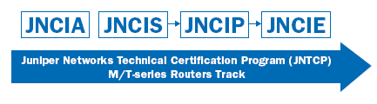
Some extra resources ...
JNTCP M-series Study Guides
  http://www.juniper.net/training/certification/books.htm
Simulator
  Download
  http://jncie.wordpress.com/2008/12/16/juniper-and-cisco-interoperability-simulator-ijunos-download/
  How-to
  http://jncie.wordpress.com/2008/09/09/how-to-use-ijunos-for-juniper-cisco-interoperability-practice/
????
4099
641
383

