Slide 1
PyCon Taiwan 2013 Tutorial
Justin Lin
caterpillar@openhome.cc
http://openhome.cc

Slide 2
Course Objectives
Learning Python ecosystem
Languages, tools, libraries…
Understanding core culture of Python communities
Coding styles, paradigms, documents, communities …
Making a connection with PyConTW 2013
Be pythonic

Slide 3
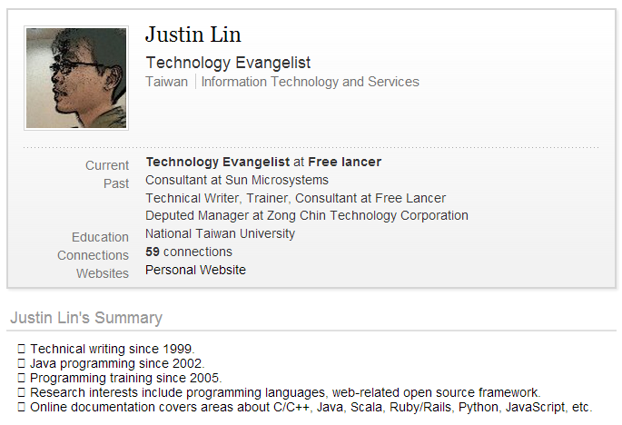
Instructor？
http://www.linkedin.com/in/caterpillar

Slide 4
Student？
Understanding cultures and ecosystem of a language takes me about three to six months. How about wrapping up what I have learned from Python ecosystem before mid-March and considering the agenda of PyConTW to build up a six-hour course?
PyCon Taiwan 2013 Tutorial Invitation
．．．
對我而言，要瞭解語言後的文化與生態系，約莫是三到六個月的時間，若以我至三月中前對 Python 生態系的瞭解過程與心得，配合 PyConTW 的議程，將之濃縮為六個小時的課程，你覺得如何？
．．．

Slide 5
Schedule
The 1st class
Preface (currently here)
Picking and Installing an Interpreter
Implementations
Preparing Course Environment
Where’re My Libraries?
What’s the Relationship among Distutils, Distribute and Pip?
Hello! World!
Introduction to Unicode Support
Basic Input and Output
Integrated Development Environment
Reference

Slide 6
The 2nd class
Learning Python language
Built-in Types
Numerical Types
String Type
List Type
Set Type
Dict Type
Tuple Type
if, for, while and for Comprehensions
if..else
for and while
for Comprehensions
Functions, Modules, Classes and Packages
Functions
Modules
Classes
Packages
References

Slide 7
The 3rd class
The Community
Documentation
DocStrings
Official Documentation
PyDoc
EpyDoc
Data Management Functions
Built-in Functions
reduce
Persistence
marshal, pickle, cPickle
DBM
shelve
DB-API 2.0（PEP 249）
References

Slide 8
The 4th class
Libraries vs Frameworks
Inversion of Control
Do We Need a Framework?
Getting Started with Django
Creating a Project
Creating a Database and an App
Playing API with the Python shell
Writing Your First View
Controller? or Views?
URLconf
References

Slide 9
The 5th class
Using the Template System
Writing Templates
Removing Hardcoded URLs in Templates
Namespacing URL Names
Writing a Simple Form
A Bit About CSRF
A Cross-Site Request Forgery Example
CSRF Countermeasures
Testing
assert
doctest
References

Slide 10
The 6th class
unittest（Testing Continued）
Test Case
Test Fixture
Test Suite
Test Runner
Profiling
timeit
cProfile（profile）
PyCon Taiwan
PyCon Taiwan 2012
PyCon Taiwan 2013
References

Slide 11
Picking and Installing an Interpreter
2.x vs 3.x
Python 3.0 (a.k.a. "Python 3000" or "Py3k") final was released on December 3rd, 2008.
Python 3.3.0 was released on September 29th, 2012.
Python 2.7.3 was released on April 9, 2012.
Python 2.7.x is highly recommended unless you have a strong reason not to.
As more and more modules get ported over to Python3, the easier it will be for others to use it.

Slide 12
Implementations
CPython（www.python.org）
Is written in C.
Compiles Python code to intermediate bytecode.
Provides the highest level of compatibility with Python packages and C extension modules.
PyPy（pypy.org）
Features a JIT (just-in-time) compiler.
Aims for maximum compatibility with the reference CPython implementation while improving performance.

Slide 13
Jython（www.jython.org）
An implementation of Python for the JVM.
Compiles Python code to Java byte code.
Can import and use any Java class the same as a Python module.
IronPython（ironpython.net）
An open-source implementation of the Python programming language which is tightly integrated with the .NET Framework.
Can use the .NET Framework and Python libraries.
Other .NET languages can use Python code just as easily.

Slide 14
Preparing Course Environment
Ubuntu 12.04 LTS
The Slide and lab files.
Sublime Text 2.0.1
Python 2.7.3
Distribute
Pip
Virtualenv
sudo apt-get install git
git clone https://github.com/JustinSDK/PyConTW2013Tutorial.git
wget http://c758482.r82.cf2.rackcdn.com/Sublime%20Text%202.0.1.tar.bz2
tar -xf "Sublime Text 2.0.1.tar.bz2"
sudo mv "Sublime Text 2" /usr/lib
sudo ln -s "/usr/lib/Sublime Text 2/sublime_text" /usr/bin/st2

Slide 15
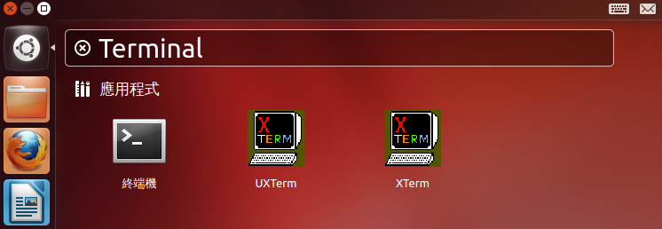
Exercise 0
Installing Python 2.7.3
Ubuntu 12.04 comes with Python 2.7.3 out of the box.
All you have to do is to open a terminal and python!

Slide 16
Exercise 1
Installing Distribute, Pip and Virtualenv
Distribute extends the packaging and installation facilities provided by the distutils in the standard library.
Run the python script available below:
http://python-distribute.org/distribute_setup.py
~$ mkdir scripts
~$ cd scripts
~/scripts$ wget http://python-distribute.org/distribute_setup.py
~/scripts$ sudo python distribute_setup.py

Slide 17
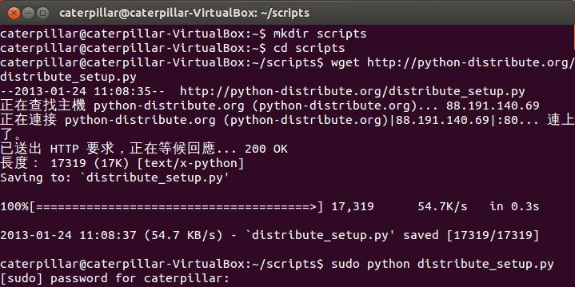
What You Should See
~

Slide 18
The new``easy_install`` command you have available is considered by many to be deprecated, so we will install its replacement: pip.
The virtualenv kit provides the ability to create virtual Python environments that do not interfere with either each other, or the main Python installation.
~/scripts$ sudo easy_install pip
~/scripts$ sudo pip install virtualenv

Slide 19
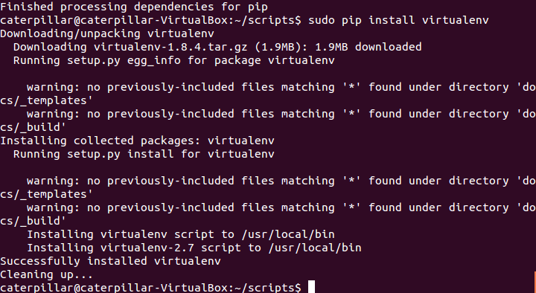
What You Should See
~

Slide 20
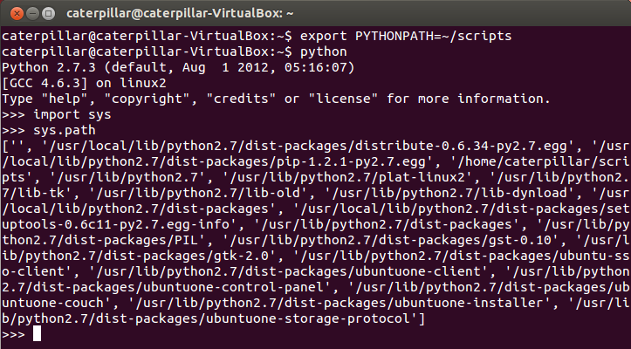
Where’re My Libraries?
The sys.path is a list of strings that specifies the search path for modules.
Use the environment variable PYTHONPATH to augment the default search path for module files.

Slide 21
What’s the Relationship among Distutils, Setuptools, Distribute and Pip?
Distutils
The Python standard library for building and installing additional modules.
For simple installation scenarios.
Basic steps:
Untar the downloaded file (e.g. tar xzvf Django-X.Y.tar.gz)
Change into the directory. Basically, all you need is setup.py.
sudo python setup.py install
Setuptools
Extends distutils.
Is de facto standard of Python community.
Has problems of slow development, messy code…

Slide 22
Distribute
Extends distutils.
Is intended to replace Setuptools as the standard method for working with Python module distributions.
Provides a backward compatible version to replace Setuptools and makes all distributions that depend on Setuptools work as before.
So, once setuptools or distribute is installed, easy_install is prepared.
The easy_install command is considered by many to be deprecated due to lack of unstallation command, svn-only support…
Pip
An easy_install replacement.
Allows for uninstallation of packages, and is actively maintained, unlike easy_install.
Virtualenv is its good partner.
Basic commands:
pip install [PACKAGE_NAME]
pip unstall [PACKAGE_NAME]

Slide 23
Hello! World!
The virtualenv kit provides the ability to create virtual Python environments that do not interfere with either each other, or the main Python installation.
Create a virtual Python environment:
virtualenv --distribute venv
Activate the environment:
source bin/activate
Deactivate the environment:
deactivate

Slide 24
Exercise 2
Create and activate a virtual Python environment.
Prompt a use to provide a filename, read the file and print the content in the terminal. Consider the character encoding problems.
~/scripts$ virtualenv --distribute venv
~/scripts$ cd venv
~/scripts/venv$ source bin/activate

Slide 25
What You Should See

Slide 26
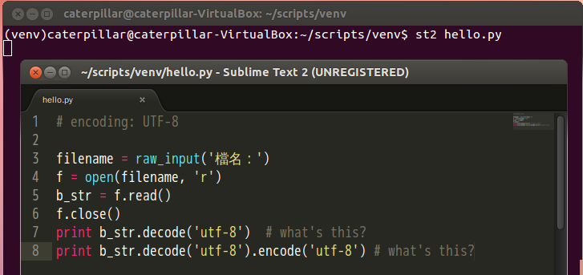
~/scripts/venv$ st2 hello.py
~/scripts/venv$ st2 hello

Slide 27
What You Should See

Slide 28
Introduction to Unicode Support
Default encoding of Ubuntu: UTF-8.
Python 2:
Strings are actual byte sequence representing the data.
Unicode literals are written as strings prefixed with the 'u' or 'U' character
Encoding declaration
# coding=UTF-8
text = '測試'
print len(text) # print "6"
# coding=UTF-8
text = u'測試'
print type(text) # print "<type 'unicode'>"
print len(text) # print "2"

Slide 29
Python 2:
decode interprets the string using the given encoding and returns a unicode instance.
encode returns an 8-bit string version of the Unicode string.
Python 3: Unicode by default.
encode returns a bytes instance representing byte sequence.
decode returns a str instance representing the Unicode string.
Python 3 interactive shell

Slide 30
Basic Input and Output
Read a file:
Write a file:
Import a module
import sys
file = open(sys.argv[1], 'r')
content = file.read()
print content
file.close()
Command line arguments. sys.argv[0] is the python source file.
import sys
file = open(sys.argv[1], 'w')
file.write('test')
file.close()

Slide 31
Three ways for reading all content in a file:
import sys
file = open(sys.argv[1], 'r')
while True:
line = file.readline()
if not line: break
print line
file.close()
import sys
file = open(sys.argv[1], 'r')
for line in file.readlines():
print line
file.close()
import sys
for line in open(sys.argv[1], 'r'):
print line
The best way to read a file is never read.

Slide 32
Integrated Development Environment
Sometimes, it‘s just the flavor problem.
PyCharm / IntelliJ IDEA
http://www.jetbrains.com/pycharm/
PyDev / Eclipse plugin
http://pydev.org/
Komodo IDE
http://www.activestate.com/komodo-ide
Spyder
http://code.google.com/p/spyderlib/
WingIDE
http://wingware.com/
NINJA-IDE
http://www.ninja-ide.org/
Python Tools for Visual Studio
http://pytools.codeplex.com/

Slide 33
References
Implementations
http://www.python.org/download/releases/3.0/
http://www.python.org/download/releases/2.7.3/
http://docs.python-guide.org/en/latest/starting/which-python/
Preparing course environment
http://docs.python-guide.org/en/latest/starting/install/linux/
Where’re my libraries?
http://docs.python.org/2/using/cmdline.html
What’s the relationship among distutils, Distribute and Pip?
http://docs.python.org/2/library/distutils.html
http://pypi.python.org/pypi/distribute
http://pypi.python.org/pypi/pip
http://blog.yangyubo.com/2012/07/27/python-packaging/
http://www.openfoundry.org/tw/tech-column/8536-introduction-of-python-extension-management-tools
Hello! World!
http://openhome.cc/Gossip/Python/IOABC.html
http://openhome.cc/Gossip/Encoding/
http://openhome.cc/Gossip/Encoding/Python.html

Slide 34
Learning Python Language
What’re the essential elements of a language?
How to encapsulate your code?
Focus on the essence of Python, not nuts and bolts.
Built-in types, variables and operators
Functions, classes, modules and packages
Algorithms + Data Structures = Programs
-- Niklaus E. Wirth -- The chief designer of Pascal

Slide 35
Built-in Types
Every thing is an object.
Python, however, does not impose object-oriented programming as the main programming paradigm.
Numerical types
int, long, float, bool, complex
String type
Container types
list, set, dict, tuple

Slide 36
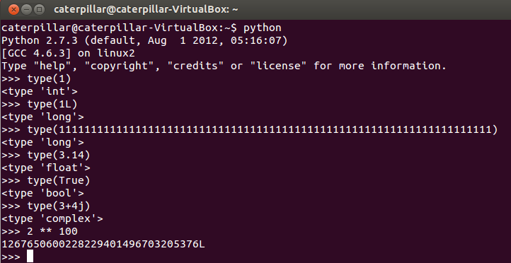
Numerical Types
int, long, float, bool, complex
The type function returns the type of any object.
Change to long type automatically

Slide 37
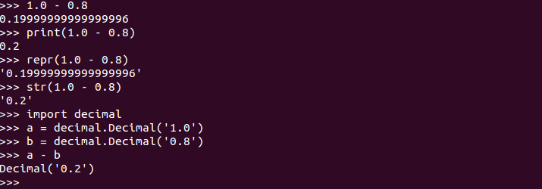
What You Should Know
Different results in different versions
Python float division:
Float decision, repr and str:
Call __repr__ function of an object
Call __str__ function of an object

Slide 38
__repr__ computes the “official” string representation of an object.
__str__ compute the “informal” string representation of an object.
__repr__ is to be unambigous and __str__ is to be readable.
The decimal module provides support for decimal floating point arithmetic.

Slide 39
String Type
'' and "" are the same in Python and replaceable.
Use a raw string if you want to represent '\' itself.
A raw string

Slide 40
A string is immutable.
len returns the string length. Use for to iterate a string. in tests if a string contains a substring. + is for concatenating two strings. * replicates a string.

Slide 41
String Slicing
[] can be specified an index to get a character from a string. A negative index is counted from the last element.
The most useful power of [] is slicing.
Begin, inclusive. 0 if omitted.
End, exclusive, the string length if omitted.
Gap
Reverse it

Slide 42
String Formatting
Old string formatting operations
New string formatting operations (after Python 2.6)

Slide 43
List Type
An ordered and mutable collection.
[1, 2, 3] creates a list with elements 1, 2, and 3 in the index 0, 1 and 2.
Shares common operations with strings.
len returns the list length. Use for to iterate a list. in tests if a list contains an element. + is for concatenating two lists. * replicates a list.
[] can be specified an index to get a character from a list. A negative index is counted from the last element.
The most useful power of [] is slicing.
Initialize list values
Converting a list of strings to a string
Converting a string to a list

Slide 44
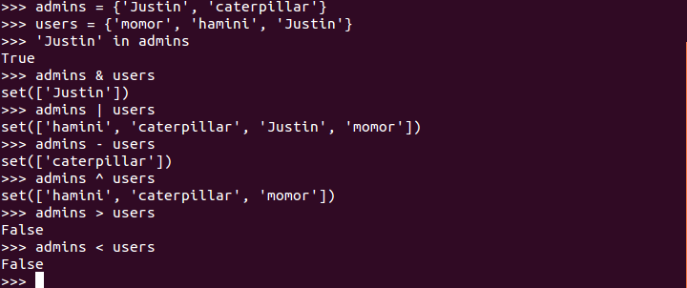
Set Type
A unordered collection. Contains no duplicate elements.
Elements should be hashable.
Exclusive or
∈

Slide 45
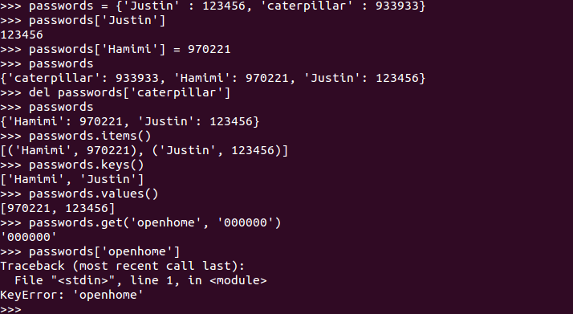
Dict Type
An object that maps keys to values.
A tuple
if 'openhome' in passwords:
return passwords['openhome']
else:
return '000000'

Slide 46
Tuple Type
A tuple is like a list, yet it’s immutable.
Shares common operations with lists.
In fact, sequences in Python (e.g. strings, lists, tuples, etc.) shares several features.
Mutable or immutable? We’ll talk about it soon…
(In Haskell - a statically-typed language - the types of elements in a tuple composes an unnamed type.)

Slide 47
Exercise 3
Open a terminal and type python. What will you see in the interactive shell if you type the following commands?
1 + 2
_
_ + 3
help()
len
keywords
quit(or simply q)
help(len)
Ctrl + D

Slide 48
After exiting the interactive shell, what will you see in the terminal if you type the following commands?
python -h
python -c 'print "Hello! Python!"'
python -c 'help(len)'
python -c 'import this'
(Try anything you see from the previous slides about built-in types.)

Slide 49
if, for, while and for comprehensions
if..else block
if..else expression, something like the ternary operator ?: in C or Java.
from sys import argv
if len(argv) > 1:
print 'Hello, ' + argv[1]
else:
print 'Hello, Guest'
Below is a block
Indentation is important.
from sys import argv
print 'Hello, ' + (argv[1] if len(argv) > 1 else 'Guest')

Slide 50
for and while
Use for in to iterate a sequence.
Use while for undetermined conditions.
numbers = [10, 20, 30]
squares = []
for number in numbers:
squares.append(number ** 2)
print squares
print 'Enter two numbers...'
m = int(raw_input('Number 1: '))
n = int(raw_input('Number 2: '))
while n != 0:
r = m % n
m = n
n = r
print 'GCD: {0}'.format(m)

Slide 51
for comprehensions
With a list comprehension we can turn this:
Into this:
numbers = [10, 20, 30]
squares = []
for number in numbers:
squares.append(number ** 2)
print squares
numbers = [10, 20, 30]
print [number ** 2 for number in numbers]

Slide 52
With a list comprehension we can turn this:
Into this:
Flatten a list of lists.
numbers = [11, 2, 45, 1, 6, 3, 7, 8, 9]
odd_numbers = []
for number in numbers:
if number % 2 != 0:
odd_numbers.append(number)
print odd_numbers
numbers = [11, 2, 45, 1, 6, 3, 7, 8, 9]
print [number for number in numbers if number % 2 != 0]
lts = [[1, 2, 3], [4, 5, 6], [7, 8, 9]]
print [ele for lt in lts for ele in lt]

Slide 53
A set comprehension
A dict comprehension
(In Haskell, a set comprehension in mathematics can be written as [2 * x | x <- N, x <= 10] which looks similar to the set comprehension.)

Slide 54
Exercise 4
Turn the following code into a single statement.
(Here's a problem that combines tuple and list comprehensions: which right triangle that has integers for all sides and all sides equal to or smaller than 10 has a perimeter of 24?)
numbers = []
for number in range(20):
numbers.append(str(number))
print ", ".join(numbers)

Slide 55
Functions, Modules, Classes and Packages
In Python, everything is an object.
Does Python impose object-oriented programming as the main programming paradigm?
Points about structuring your program.
Encapsulation and separation of abstraction layers.
State of an object.
Namespace
Physical structures of your resources, such as source files, packages, etc.

Slide 56
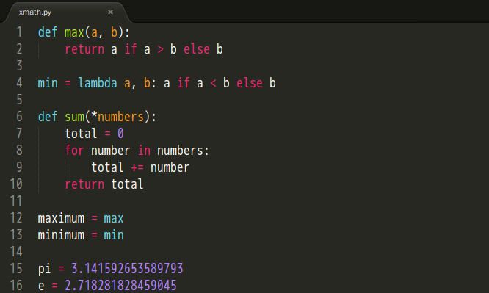
Functions
λ function
Anonymous function
Variable arguments
Functions are first-class values.

Slide 57
Modules
What’s the best way to organize functions in the previous slide?
Modules are one of the main abstraction layers available and probably the most natural one.
A file named modu.py creates a module modu.
The import modu statement will look for modu.py in the same directory. If it isn’t found, the Python interpreter will search for modu.py in the sys.path recursively; or raise an ImportError exception if it isn’t found.

Slide 58
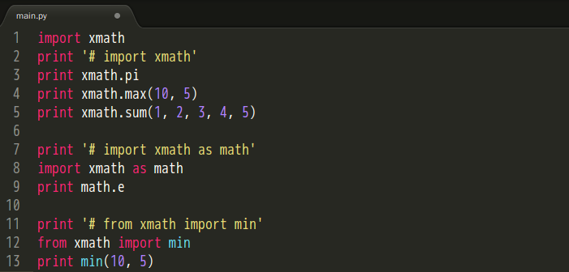
A module provides a namespace. The module’s variables, functions, and classes will be available to the caller through the module’s namespace
import, import as, from import are statements.
Create an alias
Copy it into the current module.
from modu import * is not recommended.

Slide 59
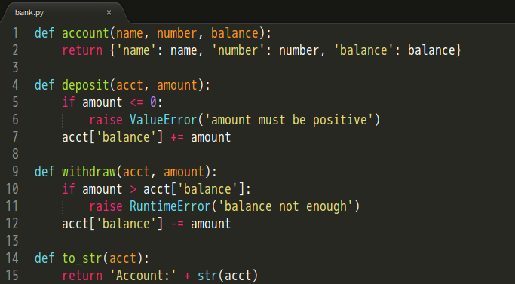
Classes
Well, where’s the playground for classes?
When we want to glue together some state and some functionality.

Slide 60
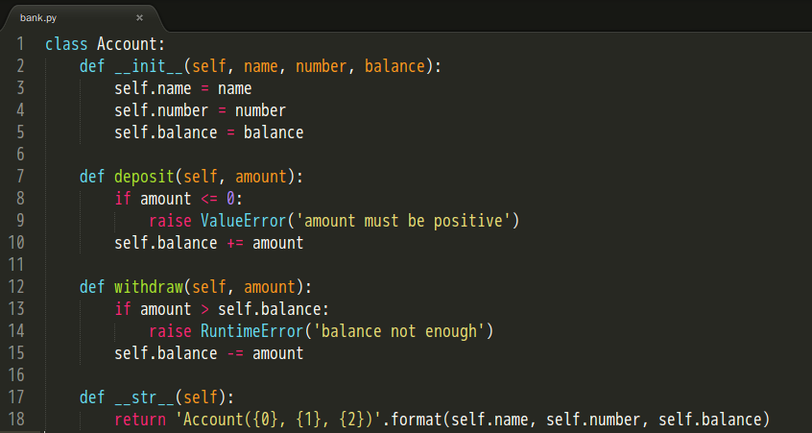
OOP is considering usability more than reusability.
Initializer
Explicit is better than implicit.
Still remember differences
between __str__ and __repr__?

Slide 61
Packages
Any directory with an __init__.py file - used to gather all package-wide definitions - is considered a package.
import pack.modu will looks for a file modu.py in the directory pack.
This statement will look for an __init__.py file in the directory pack, execute all of its top-level statements.
Then it will look for a file pack/modu.py and execute all of its top-level statements.
After these operations, any variable, function, or class defined in modu.py is available in the pack.modu namespace.

Slide 62
Exercise 5
There’s a quick and dirty main.py located in the /exercises/exercise5 of the lab file. Use modules, classes and packages learned in the previous slides to structure them as follow:
exercise5
main.py
pycon
__init__.py
xmath.py
bank.py

Slide 63
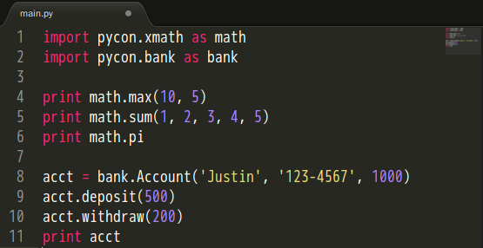
What You Should See?
Basically, you should have the following main.py and run it correctly.

Slide 64
References
String Type
http://docs.python.org/2/reference/datamodel.html#object.__repr__
http://docs.python.org/py3k/library/stdtypes.html#old-string-formatting
http://docs.python.org/py3k/library/string.html#string-formatting
List, Set, Dict, Tuple Types
http://openhome.cc/Gossip/Python/ListType.html
http://openhome.cc/Gossip/Python/SetType.html
http://openhome.cc/Gossip/Python/DictionaryType.html
http://openhome.cc/Gossip/Python/TupleType.html
Functions, Modules, Classes and Packages
http://openhome.cc/Gossip/Python/ModuleABC.html
http://openhome.cc/Gossip/Python/Class.html
http://docs.python-guide.org/en/latest/writing/structure/
Short Cuts
http://maxburstein.com/blog/python-shortcuts-for-the-python-beginner/

Slide 65
The Community
BDFL
Guido van Rossum（www.python.org/~guido）
The creator of Python, is often referred to as the Benevolent Dictator For Life.
PSF
Python Software Foundation（www.python.org/psf）
Its mission is to promote, protect, and advance the Python programming language, and to support and facilitate the growth of a diverse and international community of Python programmers.
A 501(c)(3) non-profit corporation that holds the intellectual property rights behind the Python programming language.

Slide 66
PEPs
Python Enhancement Proposals（www.python.org/dev/peps）
Describes changes to Python itself, or the standards around it.
Notable PEPs
PEP 1 -- PEP Purpose and Guidelines.
PEP 8 -- Style Guide for Python Code
PEP 20 -- The Zen of Python
PEP 257 -- Docstring Conventions
PyCon
Python Conference（www.pycon.org）
PyCon Taiwan（tw.pycon.org）
PIGgies
Python User Groups（wiki.python.org/moin/LocalUserGroups）
Taiwan Python User Group（wiki.python.org.tw）
import this

Slide 67
Documentation
What happens if you type len.__doc__ in the interactive shell?
Remember help? What’s the relationship between help(len) and len.__doc__?
Where’s len.__doc__ from?
Press ‘q’ to quit

Slide 68
DocStrings
Type the following code in the interactive shell.
Type max.__doc__ in the interactive shell.
Type help(max) in the interactive shell.
You’ll know what DocStrings are.
Remember to read PEP 257 if you want to comply with DocString Conventions.
def max(a, b):
'''max(a, b) -> value
With two arguments, return the largest argument.'''
return a if a > b else b

Slide 69
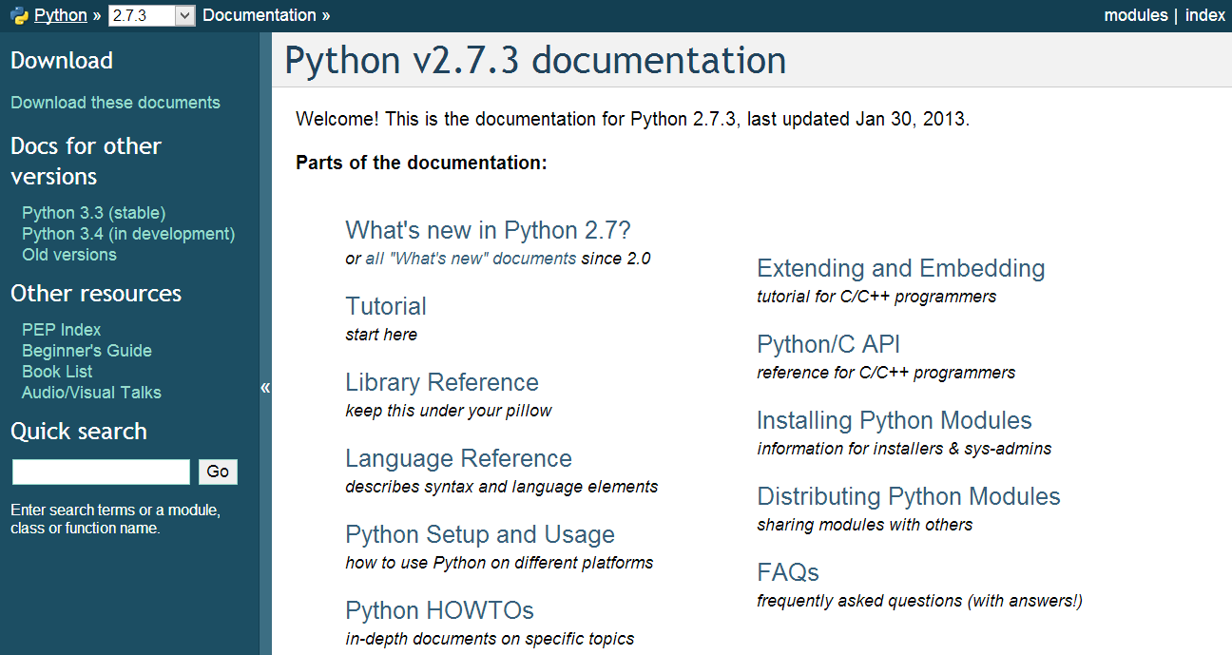
Official Documentation
docs.python.org
Python Module Index
After completing this PyConTW 2013 Tutorial, you may start here.
Remember distutils? Read this if you want to learn more.

Slide 70
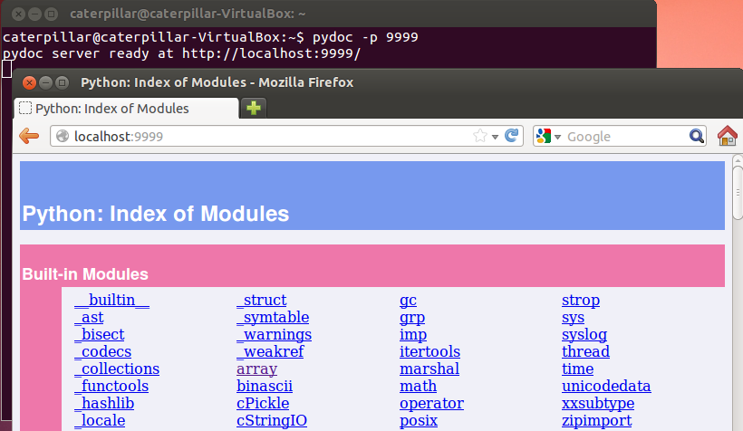
PyDoc
The pydoc module automatically generates documentation from Python modules.

Slide 71
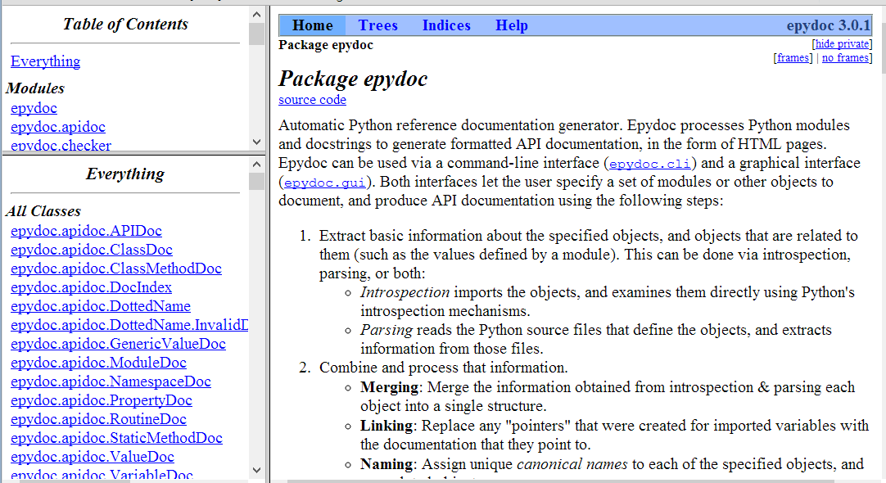
EpyDoc
Looks for something like JavaDoc?
epydoc.sourceforge.net

Slide 72
Data Management Functions
Built-in Functions（located in the __builtin__ module）
range(start, stop[, step])
zip([iterable, ...])
enumerate(sequence, start=0)
reduce(function, iterable[, initializer])

Slide 73
Exercise 6
How to iterate through a list with an index? For examples, given a list names = ['Justin', 'caterpillar', 'openhome'], print the followings.
Hints:
1. Fill in the blanks with proper codes.
2. Look up documentations about range, zip and enumerate.
0, Justin
1, caterpillar
2, openhome
names = ['Justin', 'caterpillar', 'openhome']
for ______ in ______:
print '{0}, {1}'.format(______)

Slide 74
reduce
Sometimes, it’s called foldLeft.
reduce(lambda sum, elem: sum + elem, [1, 2, 3, 4, 5], 0)
+
1
2
3
4
5
0

Slide 75
reduce
75
Sometimes, it’s called foldLeft.
reduce(lambda sum, elem: sum + elem, [1, 2, 3, 4, 5], 0)
+
2
3
4
5
1

Slide 76
reduce
76
Sometimes, it’s called foldLeft.
reduce(lambda sum, elem: sum + elem, [1, 2, 3, 4, 5], 0)
+
3
4
5
3

Slide 77
reduce
77
Sometimes, it’s called foldLeft.
reduce(lambda sum, elem: sum + elem, [1, 2, 3, 4, 5], 0)
+
4
5
6

Slide 78
reduce
78
Sometimes, it’s called foldLeft.
reduce(lambda sum, elem: sum + elem, [1, 2, 3, 4, 5], 0)
+
5
10

Slide 79
reduce
79
Sometimes, it’s called foldLeft.
reduce(lambda sum, elem: sum + elem, [1, 2, 3, 4, 5], 0)
15
5
5
5
5
5

Slide 80
reduce
reduce is a really versatile function that can be used in millions of different ways.
Once you want to calculate something from a list, consider using reduce instead of a for loop.

Slide 81
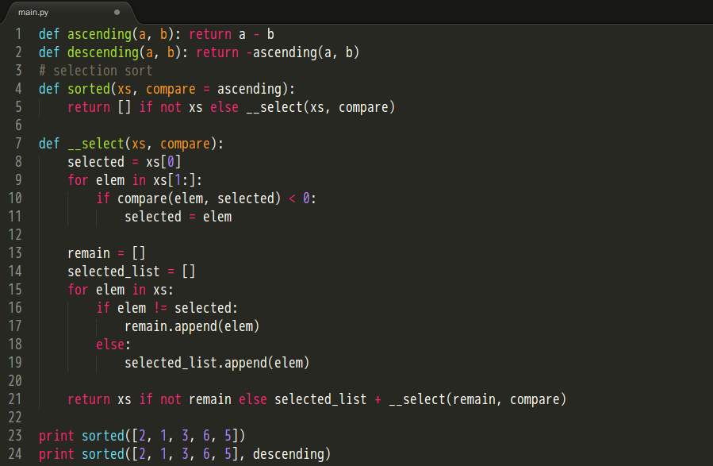
Exercise 7
Use reduce and list comprehensions to revise the following code (avaliable in lab/exercises/exercise7/main.py).

Slide 82
Persistence
Object serialization
marshal, pickle, cPickle
DBM（Database Manager）
Simple “database” interface. Dbm objects behave like mappings (dictionaries) , except that keys and values are always strings.
shelve
A “shelf” is a persistent, dictionary-like object. The values can be essentially arbitrary Python objects.
DB-API 2.0（PEP 249）
Object-Relational Mapping（3rd-party libraries）
SQLAlchemy（www.sqlalchemy.org）
SQLObject（www.sqlobject.org）

Slide 83
marshal, pickle, cPickle
A more primitive serialization module is marshal. It exists primarily to support Python’s .pyc files.
In general, pickle should always be the preferred way to serialize Python objects.
It keeps track of the objects it has already serialized, so that later references to the same object won’t be serialized again.
It can serialize user-defined classes and their instances.
Its serialization format is guaranteed to be backwards compatible across Python releases.
cPickle is written in C, so it can be up to 1000 times faster than pickle.

Slide 84
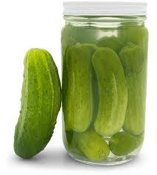
pickle
class DVD:
def __init__(self, title, year=None,
duration=None, director_id=None):
self.title = title
self.year = year
self.duration = duration
self.director_id = director_id
self.filename = self.title.replace(' ', '_') + '.pkl'
def check_filename(self, filename):
if filename is not None:
self.filename = filename

Slide 85
def save(self, filename=None):
self.check_filename(filename)
fh = None
try:
data = (self.title, self.year,
self.duration, self.director_id)
fh = open(self.filename, 'wb')
pickle.dump(data, fh)
except (EnvironmentError, pickle.PicklingError) as err:
raise SaveError(str(err))
finally:
if fh is not None:
fh.close()
def load(self, filename=None):
self.check_filename(filename)
fh = None
try:
fh = open(self.filename, 'rb')
data = pickle.load(fh)
(self.title, self.year,
self.duration, self.director_id) = data
except (EnvironmentError, pickle.PicklingError) as err:
raise LoadError(str(err))
finally:
...

Slide 86
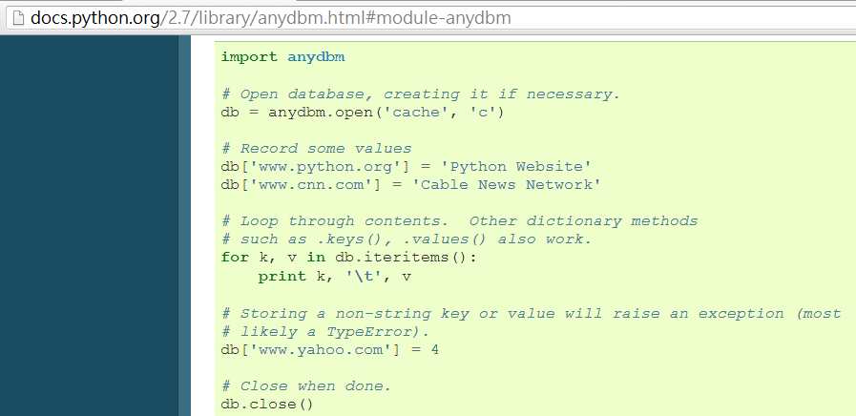
DBM
The dbm module provides an interface to the Unix “(n)dbm” library.

Slide 87
shelve
A “shelf” is a persistent, dictionary-like object. The difference with “dbm” databases is that the values (not the keys!) in a shelf can be anything that the pickle module can handle.
class DvdDao:
def __init__(self, shelve_name):
self.shelve_name = shelve_name
def save(self, dvd):
shelve_db = None
try:
shelve_db = shelve.open(self.shelve_name)
shelve_db[dvd.title] = (dvd.year,
dvd.duration, dvd.director_id)
shelve_db.sync()
finally:
if shelve_db is not None:
shelve_db.close()

Slide 88
def all(self):
shelve_db = None
try:
shelve_db = shelve.open(self.shelve_name)
return [DVD(title, *shelve_db[title])
for title in sorted(shelve_db, key=str.lower)]
finally:
if shelve_db is not None:
shelve_db.close()
return []
def load(self, title):
shelve_db = None
try:
shelve_db = shelve.open(self.shelve_name)
if title in shelve_db:
return DVD(title, *shelve_db[title])
finally:
if shelve_db is not None:
shelve_db.close()
return None

Slide 89
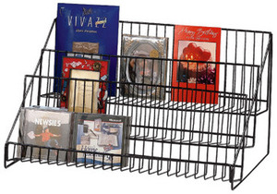
def remove(self, title):
shelve_db = None
try:
shelve_db = shelve.open(self.shelve_name)
del shelve_db[title]
shelve_db.sync()
finally:
if shelve_db is not None:
shelve_db.close()

Slide 90
DB-API 2.0（PEP 249）
The sqlite3 module provides a SQL interface compliant with the DB-API 2.0.
dvds
directors
id
title
year
duration
director_id
id
name

Slide 91
def connect(name):
create = not os.path.exists(name)
conn = sqlite3.connect(name)
if create:
cursor = conn.cursor()
cursor.execute("CREATE TABLE directors ("
"id INTEGER PRIMARY KEY AUTOINCREMENT UNIQUE NOT NULL, "
"name TEXT UNIQUE NOT NULL)")
cursor.execute("CREATE TABLE dvds ("
"id INTEGER PRIMARY KEY AUTOINCREMENT UNIQUE NOT NULL, "
"title TEXT NOT NULL, "
"year INTEGER NOT NULL, "
"duration INTEGER NOT NULL, "
"director_id INTEGER NOT NULL, "
"FOREIGN KEY (director_id) REFERENCES directors)")
conn.commit()
return conn

Slide 92
def add_dvd(conn, title, year, duration, director):
director_id = get_and_set_director(conn, director)
cursor = conn.cursor()
cursor.execute("INSERT INTO dvds "
"(title, year, duration, director_id) "
"VALUES (?, ?, ?, ?)",
(title, year, duration, director_id))
conn.commit()
def get_and_set_director(conn, director):
director_id = get_director_id(conn, director)
if director_id is not None:
return director_id
cursor = conn.cursor()
cursor.execute("INSERT INTO directors (name) VALUES (?)",
(director,))
conn.commit()
return get_director_id(conn, director)
def get_director_id(conn, director):
cursor = conn.cursor()
cursor.execute("SELECT id FROM directors WHERE name=?",
(director,))
fields = cursor.fetchone()
return fields[0] if fields is not None else None

Slide 93
def all_dvds(conn):
cursor = conn.cursor()
sql = ("SELECT dvds.title, dvds.year, dvds.duration, "
"directors.name FROM dvds, directors "
"WHERE dvds.director_id = directors.id"
" ORDER BY dvds.title")
cursor.execute(sql)
return [(str(fields[0]), fields[1], fields[2], str(fields[3]))
for fields in cursor]
def all_directors(conn):
cursor = conn.cursor()
cursor.execute("SELECT name FROM directors ORDER BY name")
return [str(fields[0]) for fields in cursor]

Slide 94
Exercise 8
There’re three incomplete source files located in lab/exercises/exercise8. Choose what you are interested in and complete it.
All code you need were listed in the previous slides.

Slide 95
References
The Community
http://www.python.org/~guido/
http://www.python.org/psf/
http://www.python.org/dev/peps/
http://www.pycon.org/
http://wiki.python.org/moin/LocalUserGroups/
Documentation
http://docs.python.org/2.7/
http://docs.python.org/2/library/pydoc.html
Data Management Functions
http://docs.python.org/2.7/library/functions.html
Persistence
http://docs.python.org/2/library/pickle.html
http://docs.python.org/2.7/library/dbm.html
http://docs.python.org/2/library/shelve.html
http://docs.python.org/2.7/library/sqlite3.html

Slide 96
Libraries vs Frameworks
What is the difference between a framework and a library?
Using libraries, your code is in control: you decides when to ask questions, when to read responses, and when to process those results.
name = raw_input('What is your name?')
process_name(name)
quest = raw_input('What is your quest?')
process_quest(quest)

Slide 97
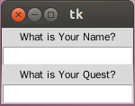
A framework decides when to call your functions. The control is inverted - it calls you rather you calling the framework.
import Tkinter
top = Tkinter.Tk()
Tkinter.Label(top, text='What is Your Name?').pack()
name_var = Tkinter.StringVar()
name_entry = Tkinter.Entry(top, textvariable=name_var)
name_entry.pack()
name_entry.bind('<FocusOut>', lambda event: process_name(name_var))
Tkinter.Label(top, text='What is Your Quest?').pack()
quest_var = Tkinter.StringVar()
quest_entry = Tkinter.Entry(top, textvariable=quest_var)
quest_entry.pack()
quest_entry.bind('<FocusOut>', lambda event: process_name(quest_var))
Tkinter.mainloop()

Slide 98
Inversion of Control
Using libraries
Using frameworks
lib1
lib2
lib3
You control the flow.
lib5
lib4
comp1
comp2
The framework controls the flow.
comp4
comp3

Slide 99
Do We Need a Framework?
Libraries bring developers freedom.
Frameworks bring developers constraints.
Do we need a framework?
Do we want to follow the flow?
Do we make decisions according to technical reasons, or business reasons?
A right framework brings you a heaven; the wrong one brings you a hell.

Slide 100
Getting Started with Django
Django (www.djangoproject.com) is a high-level Python Web framework that encourages rapid development and clean, pragmatic design.
Object-relational mapper
Automatic admin interface
Elegant URL design
Template system
Cache system
Internationalization

Slide 101
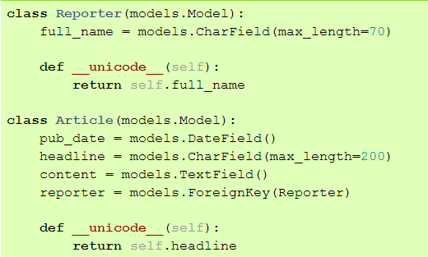
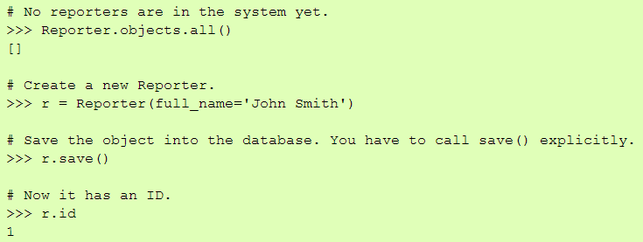
Design Your Models
Inheritance

Slide 102
Design Your URLs

Slide 103
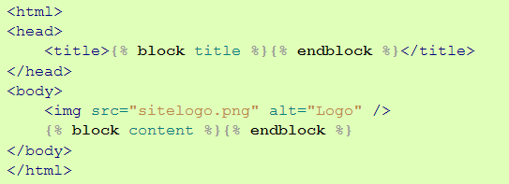
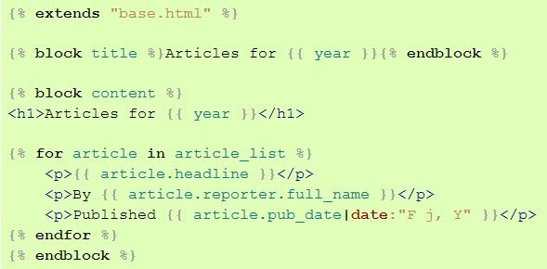
Write Your Views and Templates
A request parameter.

Slide 104
Creating a Project（Exercise 9）
We’d like to install an offical realse of Django 1.5.1 with pip under a virtual Python environment provided by virtualenv. And Then, create our first django project.
~/scripts$ virtualenv --distribute venv
~/scripts$ cd venv
~/scripts/venv$ source bin/activate
~/scripts/venv$ pip install Django==1.5.1
~/scripts/venv$ python -c 'import django; print django.get_version()'
~/scripts/venv$ django-admin.py startproject mysite
~/scripts/venv$ ls -al mysite
~/scripts/venv$ cd mysite
~/scripts/venv$ python manage.py runserver

Slide 105
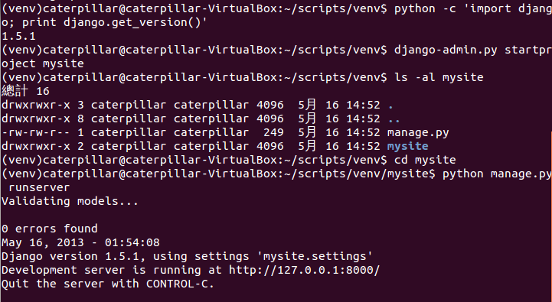
What You Should See

Slide 106
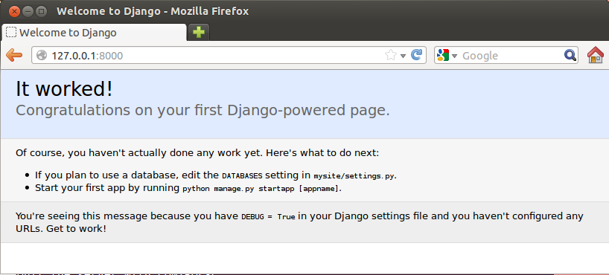
What You Should See

Slide 107
What startproject Created
You can rename it to anything you like.
A command-line utility that lets you interact with this project
mysite
manage.py
The actual Python package for your project.
mysite
__init__.py
Settings/configuration for this project.
settings.py
urls.py
The URL declarations for this project
Django’s primary deployment platform is WSGL.
wsgi.py
An entry-point for WSGI-compatible webservers to serve your project.

Slide 108
Creating a Database and an App（Exercise 10）
Edit mysite/settings.py. Change the following keys in the DATABASES 'default' item to match your database connection settings.
python manage.py syncdb

Slide 109
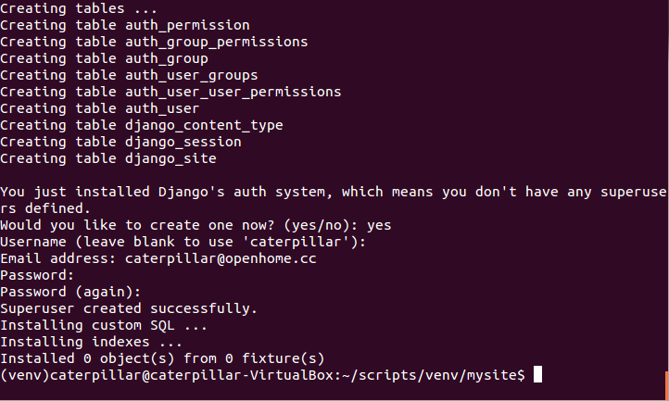
What You Should See

Slide 110
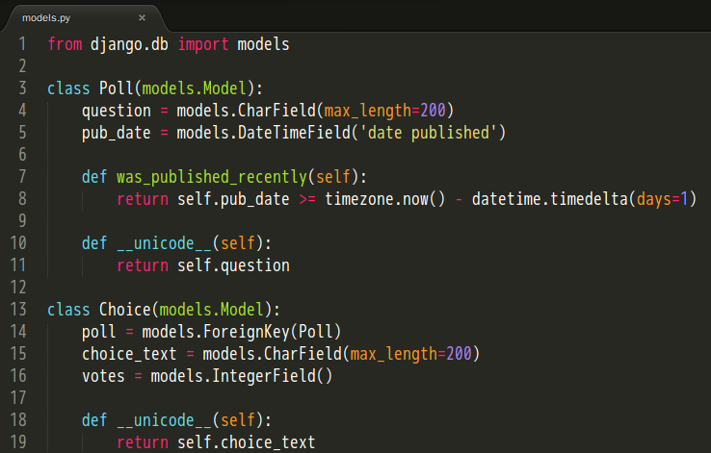
Type the following command to create a simple poll app.
python manage.py startapp polls
Edit the polls/models.py so it looks like this:
polls
__init__.py
models.py
tests.py
views.py

Slide 111
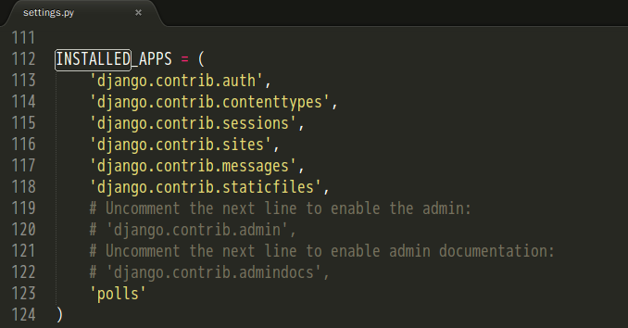
Edit the settings.py again, and change the INSTALLED_APPS setting to include the string 'polls'.
Type the following command to create tables for the polls app.
python manage.py sql polls
python manage.py syncdb

Slide 112
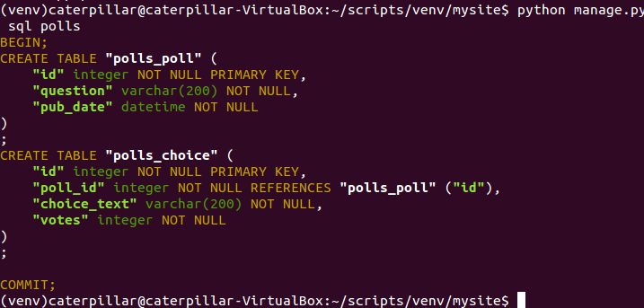
What You Should See

Slide 113
Playing API with the Python shell
Type the following command to set the DJANGO_SETTINGS_MODULE environment variable, which gives Django the Python import path to your settings.py file.
python manage.py shell

Slide 114
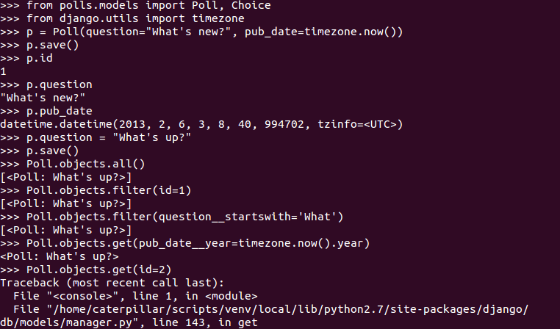
Basic ORM

Slide 115
One-to-One Relationship

Slide 116
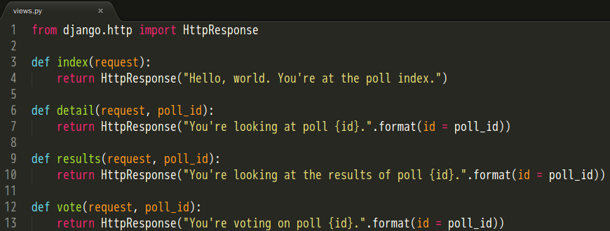
Writing Your First View（Exercise 11）
Let’s write your first view. Open the file polls/views.py and put the following Python code in it:

Slide 117
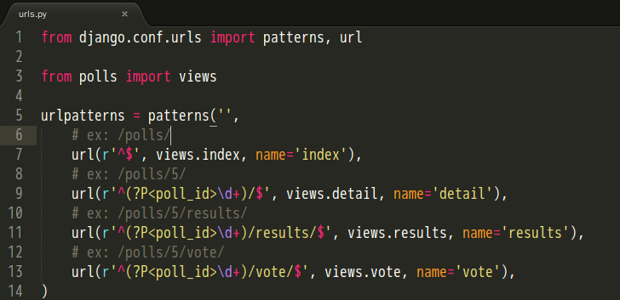
Create a file called urls.py in the polls directory. Include the following code:
Open urls.py in the mysite directory. Include the following code:

Slide 118
Type the following command to start the Django development server.
python manage.py runserver
Visit the following urls with your browser.
http://localhost:8000/polls/
http://localhost:8000/polls/5/
http://localhost:8000/polls/5/results/
http://localhost:8000/polls/5/vote/

Slide 119
What You Should See

Slide 120
Controllers or Views?
We are using Django MVC framework. Are functions index, details, results and vote belong to controllers or views?
Well, the standard names are debatable.
In Django’s case, a “view” is the Python callback function for a particular URL.
Where does the “controller” fit in, then? In Django’s case, it’s probably the framework itself.
As you’ll see soon, you might say that Django is a MTV framework – that is, “Model”, “Template”, and “View”.

Slide 121
(Is there before_filter in Django as in Rails?
No. before_, around_ and after_ filter concepts aren't present in Django.
It’s not hard to hard-code what you need. Or, you can use a generic decorator, such as those provided by the Django authentication system.)

Slide 122
URLconf
Determining which view is called is done by Python modules informally titled ‘URLconfs’.
These modules are pure Python code and are a simple mapping between URL patterns to Python callback functions (your views).
The url() function needs two required arguments and one suggested argument.
regex: URL patterns are simple regular expressions.
view: When Django finds a regular expression match, Django calls the specified view function, with an HttpRequest object as the first argument and any “captured” values from the regular expression as other arguments.
name: Naming your URL lets you refer to it unambiguously from elsewhere in Django especially templates.

Slide 123
Simple URL Patterns
For urlpatterns in mysite/urls.py.
Any request starting with “polls/“
url(r'^polls/', include('polls.urls'))
Drop “polls/” and use the remaining to match patterns defined in the polls.urls module.

Slide 124
For urlpatterns in polls/urls.py.
An empty string
Call the views.index function
url(r'^$', views.index)
The remaining represents an number, capture it as poll_id
url(r'^(?P<poll_id>\d+)/$', views.detail)
Call the views.details function. The second argument is the captured poll_id.
url(r'^(?P<poll_id>\d+)/results/$', views.results)
Starting with an number and ends with “/results/”

Slide 125
References
Libraries vs Frameworks
http://martinfowler.com/bliki/InversionOfControl.html
Getting Started with Django
https://docs.djangoproject.com/en/1.5/intro/overview/
https://docs.djangoproject.com/en/1.5/
https://docs.djangoproject.com/en/1.5/intro/install/
http://stackoverflow.com/questions/12339608/installing-django-1-5development-version-in-virtualenv
https://docs.djangoproject.com/en/1.5/intro/tutorial01/
Writing Your First View
https://docs.djangoproject.com/en/1.5/intro/tutorial03/
https://docs.djangoproject.com/en/dev/faq/general/#django-appears-to-be-a-mvc-framework-but-you-call-the-controller-the-view-and-the-view-the-template-how-come-you-don-t-use-the-standard-names
https://docs.djangoproject.com/en/1.5/topics/auth/default/

Slide 126
Using the Template System
Edit the Python code to change the way the page looks? We don’t want to back to the spaghetti world.
Use Django’s template system to separate the design from Python.
使用標籤來控制呈現邏輯
使用 dot 查找文脈變數

Slide 127
Writing Templates（Exercise 12）
Create a directory called templates in your polls directory. Django will look for templates in there.
Create another directory called polls, and within that Create a file called index.html.
In other words, your template should be at polls/templates/polls/index.html.
Put the following code in that template:

Slide 128
Create a file called detail.html and put the following code in that template:

Slide 129
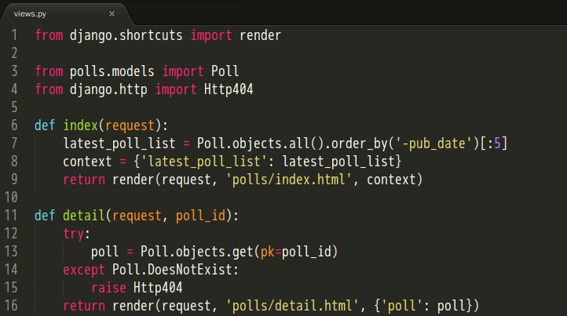
Open polls/views.py and revise the functions index and detail as follows:
Context variables
A template name
Raise a 404 error

Slide 130
Use the interactive Python shell.
python manage.py shell
Create a new poll.
from polls.models import Poll, Choice
from django.utils import timezone
p = Poll(question="What's up?", pub_date=timezone.now())
p.save()
Create two choices.
p.choice_set.create(choice_text='Not much', votes=0)
p.choice_set.create(choice_text='The sky', votes=0)

Slide 131
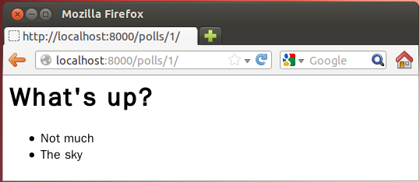
What You Should See

Slide 132
A shortcut: render()
from django.http import HttpResponse
from django.template import Context, loader
from polls.models import Poll
def index(request):
latest_poll_list = Poll.objects.order_by('-pub_date')[:5]
template = loader.get_template('polls/index.html')
context = Context({
'latest_poll_list': latest_poll_list,
})
return HttpResponse(template.render(context))
All Django wants is the HttpResponse.
from django.shortcuts import render
from polls.models import Poll
def index(request):
latest_poll_list = Poll.objects.all().order_by('-pub_date')[:5]
context = {'latest_poll_list': latest_poll_list}
return render(request, 'polls/index.html', context)

Slide 133
A shortcut: get_object_or_404()
from django.http import Http404
# ...
def detail(request, poll_id):
try:
poll = Poll.objects.get(pk=poll_id)
except Poll.DoesNotExist:
raise Http404
return render(request, 'polls/detail.html', {'poll': poll})
from django.shortcuts import render, get_object_or_404
# ...
def detail(request, poll_id):
poll = get_object_or_404(Poll, pk=poll_id)
return render(request, 'polls/detail.html', {'poll': poll})

Slide 134
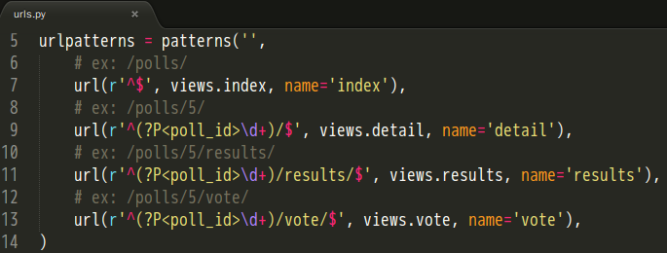
Removing Hardcoded URLs in Templates
Since you defined the name argument in the url() functions in the polls.urls module…

Slide 135
You can remove a reliance on specific URL paths…
By using the {% url %} template tag:

Slide 136
Namespacing URL Names（Exercise 13）
In the mysite/urls.py file, change url to include namespacing:
Change the url of your polls/index.html template:

Slide 137
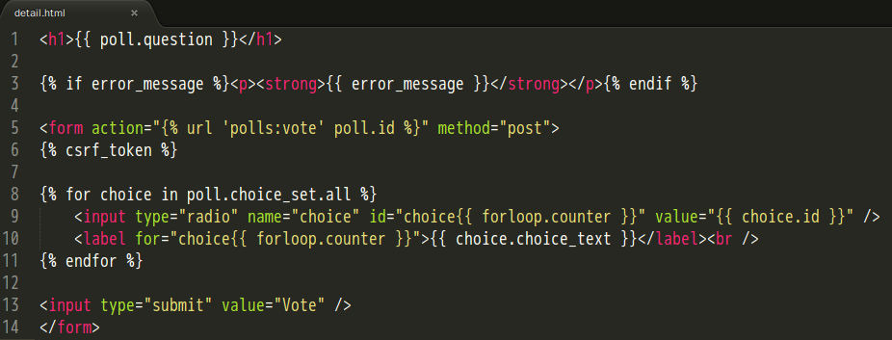
Update polls/detail.html to contains an HTML <form> element:
Avoid Cross Site Request Forgeries
Indicate how many times the for tag has gone through its loop.

Slide 138
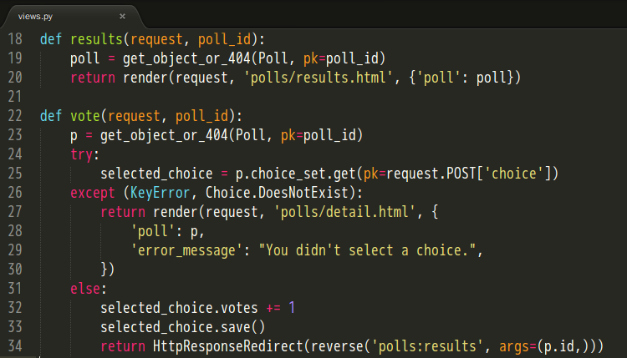
Add the following to polls/views.py:
Return a string like '/polls/3/results/'

Slide 139
Writing a Simple Form（Exercise 13 Continued）
Create a polls/results.html template:

Slide 140
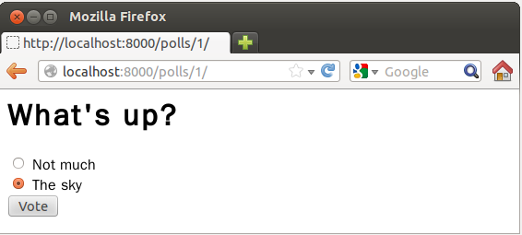
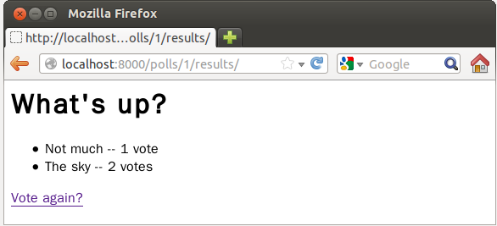
What You Should See

Slide 141
A Bit About CSRF
Include malicious code or a link in a page that accesses a web application that the user has authenticated and the session has not timed out.
A Cross-Site Request Forgery Example.
Bob’s session at www.webapp.com is still alive.
In a message board, Bob views a post from a hacker where there is a crafted HTML image element.
<img src="http://www.webapp.com/project/1/destroy">

Slide 142
The actual crafted image or link isn’t necessarily situated in the web application’s domain, it can be anywhere – in a forum, blog post or email.
POST requests also can be sent (automatically).
<a href="http://www.harmless.com/" onclick="
var f = document.createElement('form');
f.style.display = 'none';
this.parentNode.appendChild(f);
f.method = 'POST';
f.action = 'http://www.example.com/account/destroy';
f.submit();
return false;">To the harmless survey</a>
<img src="http://www.harmless.com/img" width="400" height="400" onmouseover="..." />

Slide 143
CSRF Countermeasures
Use GET and POST appropriately.
Use GET if the request is idempotent.
Use POST if the request changes the state of the server.
Use a security token in non-GET requests.
(If your web application is RESTful, you might be used to additional HTTP verbs, such as PUT or DELETE.)
Avoid Cross Site Request Forgeries

Slide 144
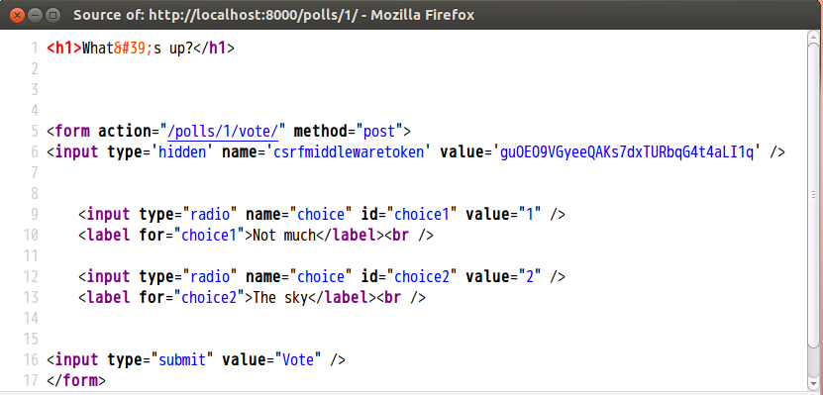

Slide 145
Testing
The assert statement
A convenient way to insert debugging assertions into a program.
The doctest module
Search for pieces of text that look like interactive sessions, and then executes them to verify that they work exactly as shown.
The unittest module
Sometimes referred to as “PyUnit”, a Python language version of JUnit.
Third-party testing tools
nose（nose.readthedocs.org/en/latest/）
pytest（pytest.org）

Slide 146
Before we go on…
Within a module, the module’s name (as a string) is available as the value of the global variable __name__.
When you run a Python module with:
The code in the module will be executed, just as if you imported it, but with the __name__ set to '__main__'.
This means that you can include a self-test at the end of the module:
python fibo.py <arguments>
if __name__ == "__main__":
self_test_code_here

Slide 147
assert
A convenient way to insert assertions into a program:
The assert expression is equivalent to:
The assert expression1, expression2 is equivalent to:
assert_stmt ::= assert expression ["," expression]
if __debug__:
if not expression: raise AssertionError
if __debug__:
if not expression1: raise AssertionError(expression2)

Slide 148
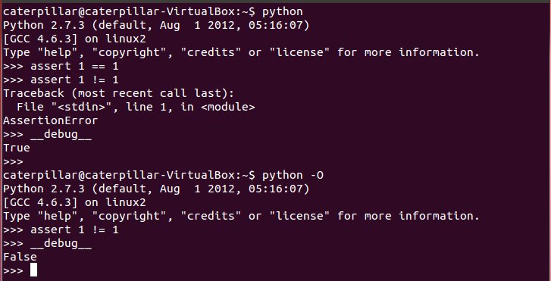
The built-in variable __debug__ is True under normal circumstances, False when optimization is requested (command line option -O).

Slide 149
When to Use Assertions?
Preconditions（in private functions only）
The requirements which a function requires its caller to fulfill.
Postconditions
Verifying the promises made by a function to its caller.
Class invariants
Validating object state.
Internal Invariants
Using assertions instead of comments.
Unreachable code（Control-Flow Invariants）
Parts of your program which you expect to be unreachable.

Slide 150
Preconditions
An Example:
Defensive Programming
def __set_refresh_Interval(interval):
if interval > 0 and interval <= 1000 / MAX_REFRESH_RATE:
raise ValueError('Illegal interval: ' + interval)
# set the refresh interval or others ...
def __set_refresh_Interval(rate):
(assert interval > 0 and interval <= 1000 / MAX_REFRESH_RATE,
'Illegal interval: ' + interval)
# set the refresh interval or others ...

Slide 151
Internal Invariants
if balance >= 10000:
...
elif 10000 > balance >= 100:
...
else: # the balance should be less than 100
...
An assumption concerning a program's behavior
if balance >= 10000:
...
else if 10000 > balance >= 100:
...
else:
assert balance < 100, balance
...

Slide 152
Internal Invariants
A programmer believes that one of the conditions will always be fulfilled.
if suit == Suit.CLUBS:
...
elif suit == Suit.DIAMONDS:
...
elif suit == Suit.HEARTS:
...
elif suit == Suit.SPADES:
...
if suit == Suit.CLUBS:
...
elif suit == Suit.DIAMONDS:
...
elif suit == Suit.HEARTS:
...
elif suit == Suit.SPADES:
...
else:
assert False, suit

Slide 153
Unreachable code
An example:
def foo(list):
for ele in list:
if ...:
return
# execution should never reach this point!!!
def foo(list):
for ele in list:
if ...:
return
assert False

Slide 154
doctest
Checks that a module’s docstrings are up-to-date.
Performs regression testing by verifying that interactive examples from a test.
Writes tutorial for a package, liberally illustrated with input-output examples. This has the flavor of “literate testing” or “executable documentation”.

Slide 155
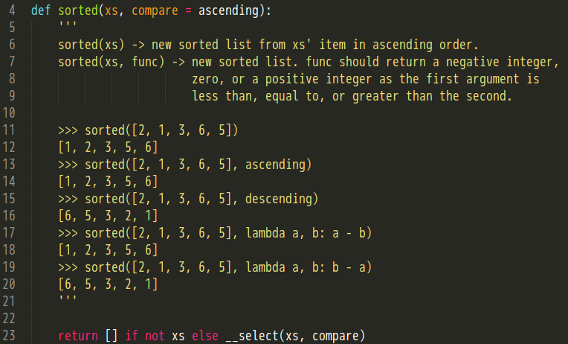
Checking Examples in Docstrings

Slide 156
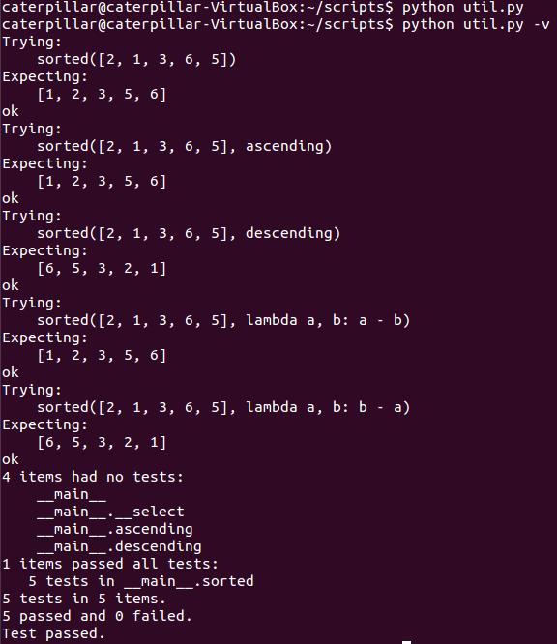
Print a detailed log.

Slide 157
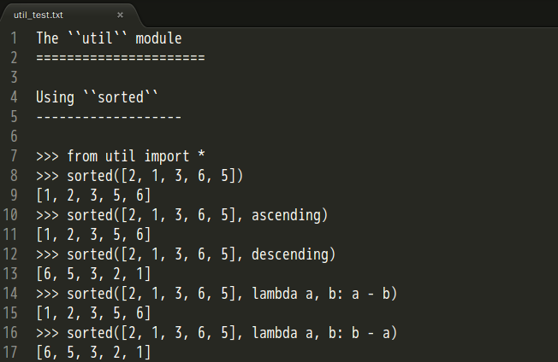
Checking Examples in a Text File
import doctest
doctest.testfile(“util_test.txt")

Slide 158
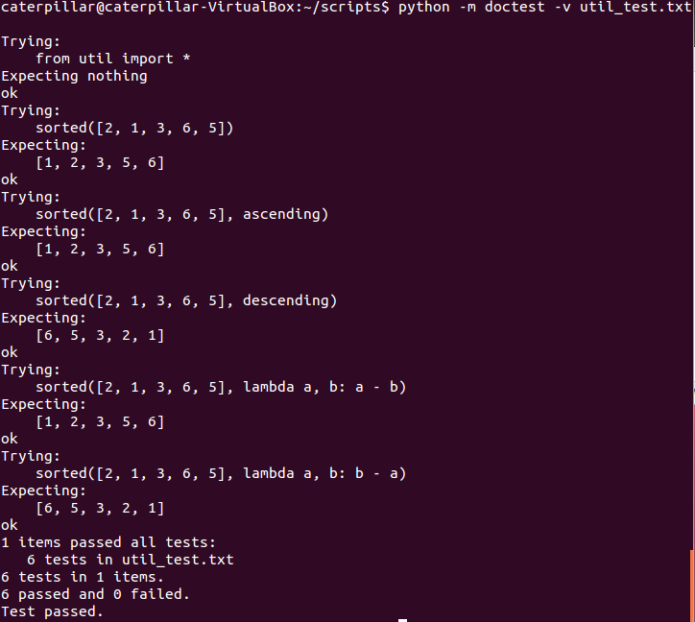
We can simply type this command to load a test file.

Slide 159
Exercise 14
Pick up util.py located in the exercises/exercise14 of the lab file. Replace those two print statement with the following:
Write docstrings as you seen in the slide of “Checking Examples in Docstrings”.
Run the following commands and see what happens.
python util.py
python util.py -v
if __name__ == '__main__':
import doctest
doctest.testmod()

Slide 160
What You Should See

Slide 161
Edit a text file ‘util_text.txt’ as you see in the slide of “Checking Examples in a Text File”.
Run the following commands and see what happens.
python -m doctest util_test.txt
python -m doctest –v util_test.txt

Slide 162
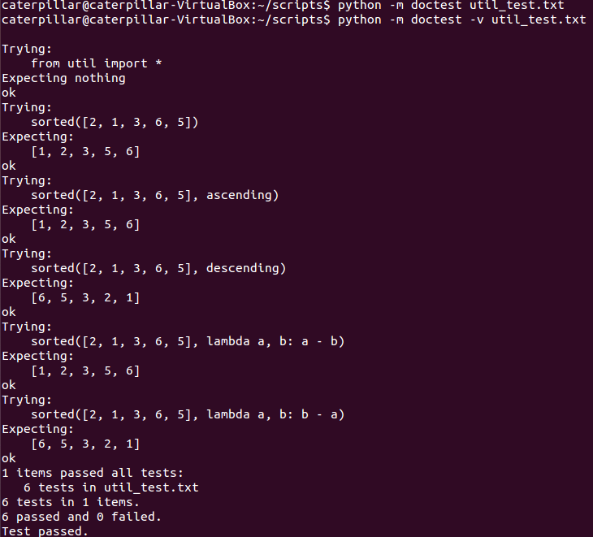
What You Should See

Slide 163
References
Using the Template System
https://docs.djangoproject.com/en/1.5/intro/tutorial04/
https://docs.djangoproject.com/en/1.5/topics/templates/
A Bit About Cross-Site Request Forgery
http://guides.rubyonrails.org/security.html#cross-site-request-forgery-csrf
http://www.ithome.com.tw/itadm/article.php?c=80062
Testing
http://docs.python.org/2/tutorial/modules.html
http://docs.python.org/2/reference/simple_stmts.html#the-assert-statement
http://docs.python.org/2/library/constants.html#__debug__
http://docs.oracle.com/javase/1.4.2/docs/guide/lang/assert.html
http://docs.python.org/2/library/doctest.html

Slide 164
unittest（Testing Continued）
Test case
The smallest unit of testing.
Test fixture
Represents the preparation needed to perform one or more tests, and any associate cleanup actions.
Test suite
A collection of test cases, test suites, or both.
Test runner
A component which orchestrates the execution of tests and provides the outcome to the user.

Slide 165
Test Case
unittest provides a base class, TestCase, which may be used to create new test cases.
import unittest
import calculator
class CalculatorTestCase(unittest.TestCase):
def setUp(self):
self.args = (3, 2)
def tearDown(self):
self.args = None
def test_plus(self):
expected = 5;
result = calculator.plus(*self.args);
self.assertEquals(expected, result);
def test_minus(self):
expected = 1;
result = calculator.minus(*self.args);
self.assertEquals(expected, result);
The individual test is defined with a method whose name starts with test.

Slide 166
Test Fixture
Often, many small test cases will use the same fixture.
The test runner will run setUp prior to each test and invoke tearDown after each test.
One real case is creating a new table and inserting data in setUp, running a test, and then dropping the table in tearDown.

Slide 167
Test Suite
Add specified tests
Create a test suite and populate it with all tests of a test case automatically.
suite = unittest.TestSuite()
suite.addTest(CalculatorTestCase('test_plus'))
suite.addTest(CalculatorTestCase('test_minus'))
tests = ['test_plus', 'test_minus']
suite = unittest.TestSuite(map(CalculatorTestCase, tests))
unittest.TestLoader().loadTestsFromTestCase(CalculatorTestCase)

Slide 168
Add one test suite to a test suite.
Compose all suites.
So, you can compose tests freely.
suite2 = unittest.TestSuite()
suite2.addTest(suite)
suite2.addTest(OtherTestCase('test_orz'))
suite1 = module1.TheTestSuite()
suite2 = module2.TheTestSuite()
alltests = unittest.TestSuite([suite1, suite2])

Slide 169
Test Runner
Use TextTestRunner directly.
Or…
suite = (unittest.TestLoader()
.loadTestsFromTestCase(CalculatorTestCase))
unittest.TextTestRunner(verbosity=2).run(suite)
unittest.main(verbosity=2)

Slide 170
Command-Line Interface
Run tests from modules, classes or even individual test methods:
Run tests with higher verbosity by passing in the -v flag:
For a list of all the command-line options:
python -m unittest test_module1 test_module2
python -m unittest test_module.TestClass
python -m unittest test_module.TestClass.test_method
python -m unittest -v test_module
python -m unittest -h

Slide 171
Exercise 15
http://jjhou.boolan.com/jjtbooks-refactoring.htm

Slide 172
The file ‘dvdlib.py’ located in lab/exercises/exercise15 is a replication of the sample program in the chapter 1 of the book ‘Refactoring’.
We’re refactoring the statement method of the Customer class according the process of the “Decomposing and Redistributing the Statement Method” session in “Refactoring”.
We’re using unittest to ensure that our each refactoring doesn’t break anything.

Slide 173
What Should You See
Movie
title
price_code
Rental
movie
days_rented
Customer
name
rentals
add_rental
statement
1
*
*
1
Movie
title
price_code
Rental
movie
days_rented
get_charge
get_freq_renter_points
Customer
name
rentals
add_rental
statement
get_total_charge
get_total_freq_renter_points
1
*
*
1

Slide 174
Profiling
timeit
Measures execution time of small code snippets.
cProfile
Describes the run time performance of a program.
Provides a variety of statistics.
Recommended for most users; it’s a C extension.
profile
A pure Python module whose interface is imitated by cProfile, so they are mostly interchangeable; cProfile has a much lower overhead but is newer and might not be available on all systems.

Slide 175
timeit
How to generate the following string?
Yes or no?
String concatenation is slow.
The function join is fast.
all = ''
for s in strs:
all = all + s + ','
all = all + '99'
Provides strings '0' '1' '2' … '98'
','.join(strs)
Provides strings '0' '1' '2' … '99'

Slide 176
timeit
s = '''
all = ''
for s in strs:
all = all + s + ','
all = all + '99'
'''
Answers: Yes, Yes
You guessed right answers? …
Total elapsed time, in seconds.
A generator

Slide 177
timeit
Python interface
Command-Line Interface
Default: 1000000
~$ python -m timeit '",".join(str(n) for n in xrange(100))'
10000 loops, best of 3: 23.6 usec per loop

Slide 178
A More Realistic Example

Slide 179
cProfile（profile）
Profile an application with a main entry point

Slide 180
The Column Headings
ncalls
“number of calls”, lists the number of calls to the specified function.
tottime
“total time”, spent in the given function (and excluding time made in calls to sub-functions).
percall
tottime / ncalls
cumtime
“cumulative time”, spent in this and all subfunctions (from invocation till exit).
percall
the quotient of cumtime divided by primitive calls.
filename:lineno(function)
provides the respective data of each function

Slide 181
pstats
To save the results of a profile into a file:
To load the statistics data:
cProfile.run('sorting.selectionSort(l)', 'select_stats')
import pstats
p = pstats.Stats('select_stats')
p.strip_dirs().sort_stats('name').print_stats()
p.sort_stats('cumulative').print_stats(10)
p.sort_stats('time').print_stats(10)

Slide 182
The file cProfile.py can also be invoked as a script to profile another script.
python -m cProfile myscript.py
cProfile.py [-o output_file] [-s sort_order]

Slide 183
A Small GUI Utility
http://www.vrplumber.com/programming/runsnakerun/

Slide 184
PyCon Taiwan
PyCon Taiwan 2012
http://tw.pycon.org/2012/program/
PyCon Taiwan 2013
http://tw.pycon.org/2013/en/program/

Slide 185
PyCon Taiwan 2012
Personal choices
Even Faster Django
Pyjamas - A Python-based Web Application Development Framework
Developing Python Apps on Windows Azure
PyKinect: Body Iteration Application Development Using Python
STAF 在自動化測試上的延伸應用 – TMSTAF
Qt Quick GUI Programming with PySide
所見非所得 - Metaclass 能幹嗎?

Slide 186
PyCon Taiwan 2013
Personal choices
Use Pyramid Like a Pro
MoSQL: More than SQL, and less than ORM
如何用 Django 在 24 小時內作出 prototype 微創業，以 petneed.me 為例
Python memory management & Impact to memory-hungry application (DT)
Dive into Python Class
Python Coding Style Guide - 哥寫的 Python 是 Google Style
Extend your legacy application with Python
CPython 程式碼解析

Slide 187
Personal choices
Extend your legacy application with Python
CPython 程式碼解析
駭客看 Django
做遊戲學 Python
Big Data Analysis in Python
周蟒 WEB 積木版與 Blockly
The Life of an Ubuntu Developer
用 VPython 學 Python
當 Python 遇上魔術方塊

Slide 188
References
Testing
http://docs.python.org/2/library/unittest.html
https://python-guide.readthedocs.org/en/latest/writing/tests/
Profiling
http://docs.python.org/2/library/timeit.html
http://docs.python.org/2/library/profile.html
http://www.vrplumber.com/programming/runsnakerun/
PyCon Taiwan
http://tw.pycon.org/2012/program/
http://tw.pycon.org/2013/en/program/

