Slide 1
勒索軟體事件分析與SSL流量可視性

Slide 2
The SSL/TLS Protocol

Slide 3




Server authentication
TLS/SSL is based on public certificates and private keys
Certificates are issued and signed by Certificate Authority (CA)
HTTPS clients first request the server public certificate and validate it using list of trusted CAs
When the server certificate is validated (name, date, etc.), the client sends its HTTP request
Public certificate
+ Private Key (signed by CA)
1. Request server public certificate
List of trusted CA
2. Server public certificate
3. Server certificate validation
Notes:
Servers also can ask for client certificates to authenticate clients.
This requires Client certificate deployment on the user’s end device and is rarely used.

Slide 4
SSL Negotiation
SYN (TCP Port 443)
SYN/ACK
ACK
CLIENT_HELLO (Highest SSL Version, Ciphers Supported, Data Compression Methods, SessionID, Random Data)
SERVER_HELLO (Selected SSL Version, Selected Cipher, Selected Data Compr. Method, Assigned SessionID, Random Data)
CERTIFICATE (Public Key, Authentication Signature)
SERVER_DONE
CERTIFICATE_VERIFY (Client informs the server that it has verified the server's certificate)
CHANGE_CIPHER_SPEC (contents of subsequent SSL record data sent by the client during the SSL session will be encrypted)
FINISHED (digest of all the SSL handshake commands so far for validation)
CHANGE_CIPHER_SPEC (subsequent data sent by the server during the SSL session will be encrypted)
FINISHED (digest of all the SSL handshake commands so far for validation)
Client sends server symmetric secret key encrypted with server’s public key.
From now user data is encrypted.

Slide 5

HTTPS communication with clients
Client SSL templates
  To enable HTTPS communication with the Clients
  Client SSL template
    Public certificate that will be presented to Clients
    Private key (and its passphrase)
    SSL cipher supported ("encrypted algorithm")
    (optional) Client certificate request
Public certificate
+ Private Key
(signed by CA)
1. Request server public certificate
AX Series
List of
trusted CA
2. Server public certificate
3. Server cert
validation
4. (optional) Request client public certificate
6. Client cert validation
5. Client public certificate
CA to use for Client cert validation
Notes:
Supported Cipher Suites:
Key Exchange: 512/1024/2048-bit RSA
Encryption: AES, RC4, DES, 3DES
Hash: HA, MD5

Slide 6
HTTPS communication with servers
Server SSL templates
  To enable HTTPS communication with the Servers
  Server SSL template
    SSL cipher supported ("encrypted algorithm")
    (optional) CA that will be used to validate the Server’s certificate
AX Series
1. Request server public certificate
CA to use for
Server cert
validation
2. Server public certificate
Public certificate
+ Private Key
(signed by CA)
3. (optional) Server cert validation
Notes:
Supported Cipher Suites:
Key Exchange: 512/1024/2048-bit RSA
Encryption: AES, RC4, DES, 3DES
Hash: HA, MD5

Slide 7
SSL流量逐年增加
100%?
67%
25-35%
In 2016
In 2013
Sources:
NSS Labs, Sandvine
7

Slide 8
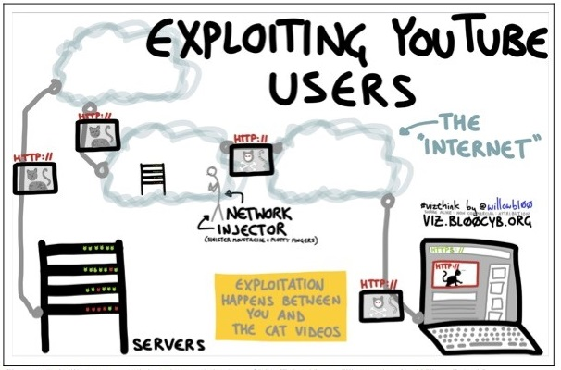
為什麼大家都要加密流量？
史諾登事件(2013)
各國政府都在監控網路上的流量
YouTube and Microsoft Live
都曾經被插入惡意軟件
  現在兩個都已使用加密技術
如用網站使用https,會使你的網站排名變高
Source: Washington Post
Notes:
As a result “s said they are accelerating pGoogle and Microsoft executiverevious plans to encrypt” traffic
Source for picture: https://www.washingtonpost.com/world/national-security/spyware-tools-allow-buyers-to-slip-malicious-code-into-youtube-videos-microsoft-pages/2014/08/15/31c5696c-249c-11e4-8593-da634b334390_story.html
Application owners are adding SSL support to improve Google search engine ranking.

Slide 9






以前的網路環境
Network Forensics
Alert
DLP
Alert
Block
Block
IPS
Firewall
ATP
z
Sales & Marketing
Accounting
Engineering
Sales & Marketing
Accounting
Engineering

Slide 10
現在的網路環境
Anomalous Activity
Data
Exfiltration
Network Forensics
DLP
Successful
Attack
Undetected Malware
IPS
Firewall
ATP
z
Sales & Marketing
Accounting
Engineering
Sales & Marketing
Accounting
Engineering

Slide 11







新世代的資安設備

Slide 12
Next Gen Firewalls的SSL效能
Performance Impact with 2048-bit SSL Ciphers
81%: The average of performance loss across 7 NG Firewalls
Source: “SSL Performance Problems,” NSS Labs, 2013

Slide 13
加密流量暗藏攻擊者！
67%
50%
80%
加密的流量
by 2016
攻擊者透過加密
流量規避資安設備
資安設備像是Firewall IPS UTM無法檢測加密流量
Sources:
Sandvine Internet Phenomena Report “Security Leaders Must Address Threats From Rising SSL Traffic,” 2013
Notes:
Reports from A10 service providers indicate 35 to 40% of traffic is encrypted today, compared to 25-35% reported by NSS Labs in 2013. Encryption started to take off after the Snowden revelations about government snooping. Soon, Google, Facebook, Twitter, LinkedIn and many more started encrypting traffic. Now, virtually every search engine, online mail service, social media site, online file storage site encrypts data.
This has led Gartner to predict that 50% of all attacks will use encryption to bypass controls by 2017 (and this prediction is conservative.) Yet despite this, 80% of organizations with firewalls, IPS, or Unified Threat Management appliance do not decrypt SSL traffic.
This could be because NSS Labs found that the average performance of seven leading NG Firewalls fell an average of 81% when decrypting SSL traffic with 2048-bit keys.

Slide 14

攻擊者
可以隱藏在
SSL
流量中

Slide 15




滲透攻擊
惡意廣告使用了SSL加密的技術
惡意軟體通過社交平台發佈
惡意軟件透過電子郵件附件和即時通訊應用程式發送
DDoS與Web攻擊
Yahoo 被插入惡意廣告
Facebook, Twitter, LinkedIn社交軟體都使用SSL,導致惡意連結或軟體無法被資安設備察覺
Skype, Whatsapp或Email都被用來傳送惡意軟體
攻擊者使用SSL 進行攻擊

Slide 16


資料外洩就隱藏在SSL流量中
內部使用者的濫用
  內部員工使用外部信箱傳輸機密資料Gmail, Yahoo Mail, MS Live encrypt
  內部員工使用外部免費空間上傳機密資料 Dropbox, iCloud, OneDrive encrypt data
C&C Server的流量
  被殭屍網路病毒感染的設備,也透過SSL與C&C Server 連線
  大多數的加密勒索病毒，一般會向遠端遙控C&C主機取得加密金鑰，再暗中加密受害電腦中的檔案

Slide 17














惡意軟體如何利用加密流量？
Malicious attachment
sent over SMTPS
Malicious file in
instant messaging
Drive-by download
from an HTTPS site
Botnet Herder
Clients
Encryption obscures:
  殭屍網路
  C&C 連線
  資料外洩
HTTPS
Data exfiltration over
SSL channels
Command and Control Servers
Notes:
C&C commands can be sent via cloud storage or even as comments on legitimate websites

Slide 18
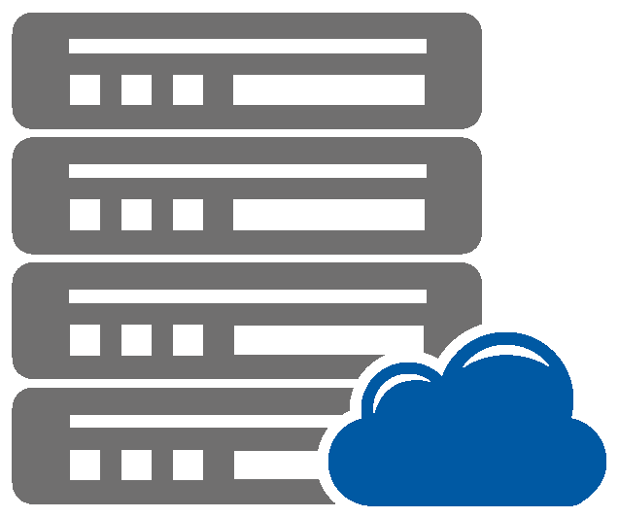


SSL
HTTP
HTTP
SSL
Security Device
Client
Security Device
Remote Server
Inside Device
Decrypt
Outside Device
Re-encrypt

Slide 19
SSLi Deployments
SSL
HTTP
SSL
Client
Internal
External
Dual-ADP Inline Deployment
Port count needs to be considered
Performance is halved
Explicit Proxy & Implicit Proxy
vWire, L2, & L3 security devices supported
Notes:
Dual-ADP Inline deployment
Port count Needs to be considered
Performance is halved
Explicit Proxy as well as Implicit Proxy mode is supported
vWire, L2, & L3 security devices supported

Slide 20




SSLi Ladder Diagram: New Site
Client
Inside Thunder ADC
Security Device
Outside Thunder ADC
Server
Encrypted Zone
Clear-text Zone
Encrypted Zone
Https://example.com/
SYN|SYN-ACK|ACK
443
Client Hello
Cache
SYN|SYN-ACK|ACK
443
Client Hello
Server Cert + Public Key, Signed by well-known CA
Server Hello
SSL Handshake Messages
Forged Server Cert + Local Public Key,
Signed by Local CA
SSL Handshake Finished
Proxied Server Cert + Local Public Key,
Signed by Local CA
Server Hello
SSL Handshake Messages
RST
SSL Handshake Finished
Encrypted Application Data
SYN|SYN-ACK|ACK
8080
Clear-Text Application Data
SYN|SYN-ACK|ACK
443
Client Hello
SSL Handshake Messages
SSL Handshake Finished
Encrypted Application Data
Encrypted Application Response
Clear-Text Application Response
Encrypted Application Response
Notes:
Establish SSL connection with the remote server and get the certificate from the remote server
Extract header information from server certificate.
Change the Issuer and the Public Key as defined in Client-SSL-Template.
Re-sign the new certificate using the CA-Certificate as specified in Client-SSL-Template.
Send the reconstructed Server-Hello to client.
Data decrypted and sent in clear-text through the security device.
New SSL session initiated with remote server.
Data encrypted and sent to remote server.
Response is decrypted and sent through the security device.
Response is encrypted again and sent to the client.

Slide 21
SSLi Ladder Diagram: Previously visited site
Client
Inside Thunder ADC
Security Device
Outside Thunder ADC
Server
Encrypted Zone
Clear-text Zone
Encrypted Zone
Https://example.com/
Cache
SYN|SYN-ACK|ACK
443
Client Hello
Proxied Server Cert + Local Public Key,
Signed by Local CA
Server Hello
SSL Handshake Messages
SSL Handshake Finished
Encrypted Application Data
SYN|SYN-ACK|ACK
8080
Clear-Text Application Data
SYN|SYN-ACK|ACK
443
Client Hello
SSL Handshake Messages
SSL Handshake Finished
Encrypted Application Data
Encrypted Application Response
Clear-Text Application Response
Encrypted Application Response
Notes:
Since the certificate exists in cache, send the reconstructed Server-Hello to client.
Data decrypted and sent in cleat-text through the security device.
New SSL session initiated with remote server.
Data encrypted and sent to remote server.
Response is decrypted and sent through the security device.
Response is encrypted again and sent to the client.

Slide 22
SSLi + Explicit Proxy
SSL
(EP)
HTTP
HTTP
SSL
Client
Explicit Proxy + SSLi Inside
SSLi Outside
Source Class-Lists
Destination Class-Lists
BrightCloud URL Categories
DNS Lookup
Source NAT
Fall-back Service- Group
Proxy-Chaining
First Partition
Accepts Explicit Proxy Traffic
Connect Header is removed
Dest IP is changed
Converts SSL traffic to HTTP
Second Partition
Converts HTTP Back to SSL
Notes:
With 4.1.0, we now have Integrated Explicit Proxy support is now built-into SSLi.
Basically Explicit Proxy and SSLi Inside partitions are merged
- Support for Proxy Chaining, ICAP and AAM

Slide 23

ICAP support
DLP / AV
SSL
ReqMod /
RespMod
HTTP
SSL
Client
Internal
External
  Provides SSL visibility to ICAP enabled DLP & AV systems
  ICAP ReqMod and RespMod Support
  Secure ICAP Support
  Advanced ICAP logging
  Conforms to ICAP client recommendations in RFC 3507
Notes:
4.1.0 also brings ICAP support with SSLi
Which Provides SSL visibility to an ICAP enabled DLP/AV appliance
Our ICAP solution is based on RFC 3507

Slide 24
SSLi Gateway - 重新定義 DMZ/Security Zone
SSLi解決方案

Slide 25

SSLi解決你的資安設備困境
$$
$$
Performance Hit
$$
Performance Hit
$$
$$
Performance Hit
Performance Hit
Performance Hit
AV / DLP
Packet Broker
SSLi
Secure Web
Gateway
APT
IPS
NGFW
SSLi
FW
Enterprise Traffic : User to Internet

Slide 26
Savings: Open Once Inspect Many Times
$$
Performance Hit
✔
✔
✔
✔
✔
AV / DLP
Packet Broker
SSLi
Secure Web
Gateway
APT
IPS
NGFW
SSLi
Enterprise Traffic : User to Internet

Slide 27
SSLi Challenges
  Privacy (HIPAA)
    BrightCloud URL Category Bypass
  Certificate Pinning (Ex. Twitter App)
    SNI Bypass
  CAC Authentication
    Client-Cert Bypass
  Private Key Security
    HSM (onboard & Network) support
  Elliptic Curve Cryptography
    ECDHE and DHE support
  Non-HTTP protocol support
    SMTP and startTLS support
    POP3 & IMAPS
  Server Certificate Validation
    CRL, OCSP, Alt Signing Key
  Others:
    Intercept List
    SSLi Failsafe
Notes:
Some notable past challenges before we move on to 4.1.0 specific features
First off, Privacy. Ok so we take ssl traffic and we intercept it. But we need to bypass sensitive traffic such as user financial and health related data
- The solution was BrightCloud URL Categorization

Slide 28




解決SSL盲點又不影響性能
SSL Insight 優勢:
  幫助客戶檢測未知的SSL流量
  提升其他Security設備的效能
Internet Server
SSL Insight 功能:
  支援ECDHE ciphers
  10x more performance
  可Load balancing 到資安設備
  支援Transparent proxy 或 explicit proxy 部署
  支援 ICAP support 可將解密的檔案傳輸到DLP or AV scanners
  動態端口攔截(0 Port)
  惡意網站過濾(webroot)
Encrypted
Decrypted
Security Device
Encrypted
Client
Client

Slide 29




解決方案
IP Reputation/
Malware List
Internet Server
多數客戶所面臨的問題：
惡意軟體嘗試透過SSL進行攻擊,有80%的資安設備無法檢查SSL流量
Web category DB
in the cloud
Encrypted
Decrypted
建議作法：
使用SSLi與資安設備廠商搭配,來檢查並防禦SSL攻擊流量
我們設備與多家資安設備廠商皆為合作夥伴,
支援多種架構部署且可以幫助客戶檢測SSL流量
SSLi Device
Security devices
Encrypted

Slide 30
SSLi LAB Demo
SSL
HTTP
SSL
Client
Internal
External

Slide 31
Thank you!

