Slide 1
pfSense
Ming-Chang Cheng
鄭明彰
everfree@ntct.edu.tw
May 22 / May 29 , 2014

Slide 2
pfSense
Base on FreeBSD
Start in 2004 as a fork of the m0n0wall project
BSD License
Firewall / Router
Latest release 2.1.3 / May 2, 2014
IPv6（Captive Portal missing）
Free, powerful, open source firewall and security solution
http://www.pfsense.org

Slide 3
pfSense 2.1 Changes Overview
IPv6 support
PBI package
FreeBSD 8.3 base
Multi-instance captive portal
High Availability changes

Slide 4
pfSense 2.2 Plans
FreeBSD 10 base
PF performacne
Wireless
IPv6

Slide 5
Hareware
Requirements Specific to Individual Platforms:
Live CD or USB
Hard drive installation
Embedded: CF card, win32 disk imager
https://www.pfsense.org/hardware/index.html
Notices: NICs
Disable BIOS ACPI and PNP OS

Slide 6
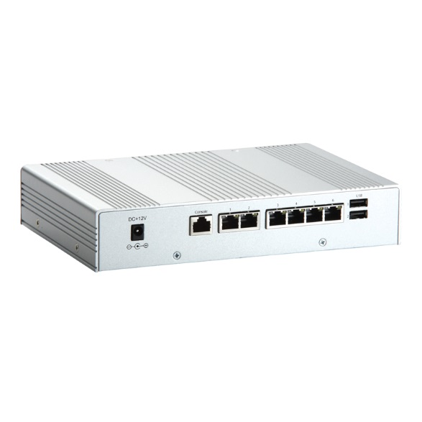
Embedded System
Low power and high performance
Supports 6 10/100/1000Mbps Ethernet ports
Supports one 2.5" SATA HDD
Memory up to 4 GB
Console connect
More other model?

Slide 7
Simulated Environment
Vmware Workstation: Two virtual machines setting
pfSense
NIC1: Bridged
NIC2: VMnet2
NIC3: VMnet3
Win7
NIC1：VMnet2 or VMnet3

Slide 8
Simulated Environment
pfSense and Win7 setting
pfSense
WAN
LAN（Bridge mode）
NAT（DHCP）
Win7
LAN （Static）or NAT（DHCP）

Slide 9
Installing pfSense
32bit or 64bit
Burn the ISO image to a CD
Boot your computer from the CD
Select I, Install to hard drive
Boot Troubleshooting
Quick Install, Standard Kernel, Reboot
Initial pfSense configuration
Access web interface

Slide 10
Initial pfSense configuration
Do you want to set up VLANs now [y|n]?
Enter the WAN interface or 'a' for auto-detection?
Enter the LAN interface or 'a' for auto-detection?
NOTE: this enables full Firewalling/NAT mode.
(or nothing if finished)
Enter the Optional 1 interface name or 'a' for auto-detection?
(or nothing if finished)
WAN: Default DHCP
LAN: DHCP Server 192.168.1.1
Account and Password: admin, pfsense

Slide 11
Initial Configuration
Wizards
WAN
Static IP
Disable block private networks options
Allow admin access

Slide 12
Bridged mode
LAN: Disable DHCP Server, Set up new IP
LAN: None IP, Firewall rules, source type=any
System: Advanced: System Tunables: net.link.bridge.pfil_bridge=1
Interfaces: Bridge: WAN and LAN
Firewall: NAT: Outbound: Manual Outbound NAT rule generation
Delete all automatically created NAT mappings
Client Gateway?

Slide 13
SSH
System: Advanced: Admin Access: Enable Secure Shell
Firewall Rules: improve security
Account and Password
0) Logout (SSH only) 8) Shell
1) Assign Interfaces 9) pfTop
2) Set interface(s) IP address 10) Filter Logs
3) Reset webConfigurator password 11) Restart webConfigurator
4) Reset to factory defaults 12) pfSense Developer Shell
5) Reboot system 13) Upgrade from console
6) Halt system 14) Disable Secure Shell (sshd)
7) Ping host 15) Restore recent configuration

Slide 14
NAT
Interfaces: assign network ports
Interfaces: OPT1
NAT: Static IPv4: 192.168.1.1/24
Services: DHCP server: NAT: Enable DHCP server on NAT interface
DHCP Ranges
DNS servers: not set up
Firewall: NAT: Outbound
Interface: WAN, Source: 192.168.1.0/24, Translation: Interface address
NAT online？

Slide 15
DHCP Server
IPv4 Configuration Type: not none
DHCP Static Mappings for this interface
Deny Unknown Clients
Static ARP
Status: DHCP leases

Slide 16
Firewall Rules
Top-Down, First Match
WAN: IN Rules
LAN:OUT Rules
Aliases: Host, Network, Port
Aliases Include Aliases
Schedules

Slide 17
1:1 NAT
Firewall: Virtual IP Address: Edit
WAN: Unused IP
IP Alias: netmask=32
Firewall: NAT: 1:1
Interface: WAN
External subnet IP: Your IP Alias
Internal IP: LAN private IP
Firewall: Rules:
Destination: LAN private IP
Destination port range: your ports

Slide 18
Port Forward
Firewall: NAT: Port Forward
Interface: WAN
Destination:Your IP Alias
Destination port range: your ports
Redirect target IP: LAN private IP
Redirect target port: your ports

Slide 19
Other NAT Otpions
System: Advanced: Firewall and NAT
NAT Reflection mode for port forwards
Enable NAT Reflection for 1:1 NAT
Enable automatic outbound NAT for Reflection

Slide 20
Traffic Shaper
Limit bandwidth per IP
Firewall: Traffic Shaper: Limiter
Bandwidth
download
upload
Firewall: Rules: Edit
In/Out: upload/download
QoS

Slide 21
Captive portal
Enable DNS forwarder
DNS: pfSense IP
Services: Captive portal
Idle timeout, Hard timeout
After authentication Redirection URL
Concurrent user logins
Per-user bandwidth restriction
Authentication
Portal page contents, Authentication error page contents

Slide 22
Captive portal
Pass-through MAC
Allowed IP address
File Manager
Vouchers
Roll#
Minutes per Ticket
Count
Comment

Slide 23
Package: Squid
Squid: web proxy cache
Transparent proxy, Cache, Traffic
https://doc.pfsense.org/index.php/Squid_Package_Tuning
Lightsquid: web proxy report
Enable log in squid package with "/var/squid/logs" path
SquidGuard: proxy URL filter
http://www.squidguard.org/blacklists.html
http://hubpages.com/hub/How-to-setup-a-transparent-proxy-using-pfSense
Filter https: DNS forwarder: Host Overrides

Slide 24
Package: pfBlocker
TopSpammers
iBlockList
https://www.iblocklist.com/lists.php
spyware, hijacked, dshield, webexploit, ads, ZeuS, SpyEye, Palevo, Malicious, malc0de
Emerging Threats
http://rules.emergingthreats.net/fwrules/emerging-Block-IPs.txt
http://rules.emergingthreats.net/blockrules/compromised-ips.txt
http://doc.emergingthreats.net/pub/Main/RussianBusinessNetwork/RussianBusinessNetworkIPs.txt
Bruteforce login attacks
http://www.us.openbl.org/lists/base_30days.txt
Firewall Maximum Table Entries
Firewall Maximum States

Slide 25
Other Package
Bandwidthd
ntop
pflowd
Snort
Suricata

